Slide 1
Seismometer Position Optimization Studies for Newtonian Noise Mitigation
Patrick Schillings and Johannes Erdmann
III. Physikalisches Institut A, RWTH Aachen University
With help from Francesca Badaracco and Jan Harms
14.06.2024

Slide 2
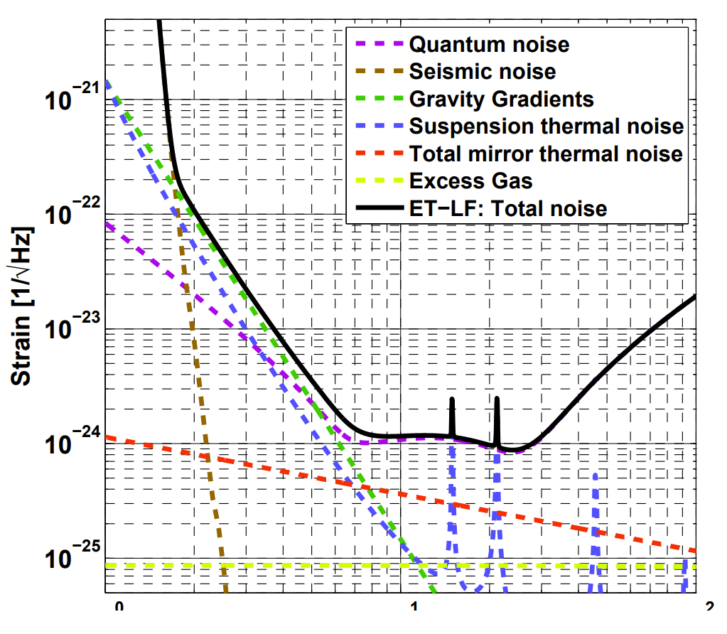
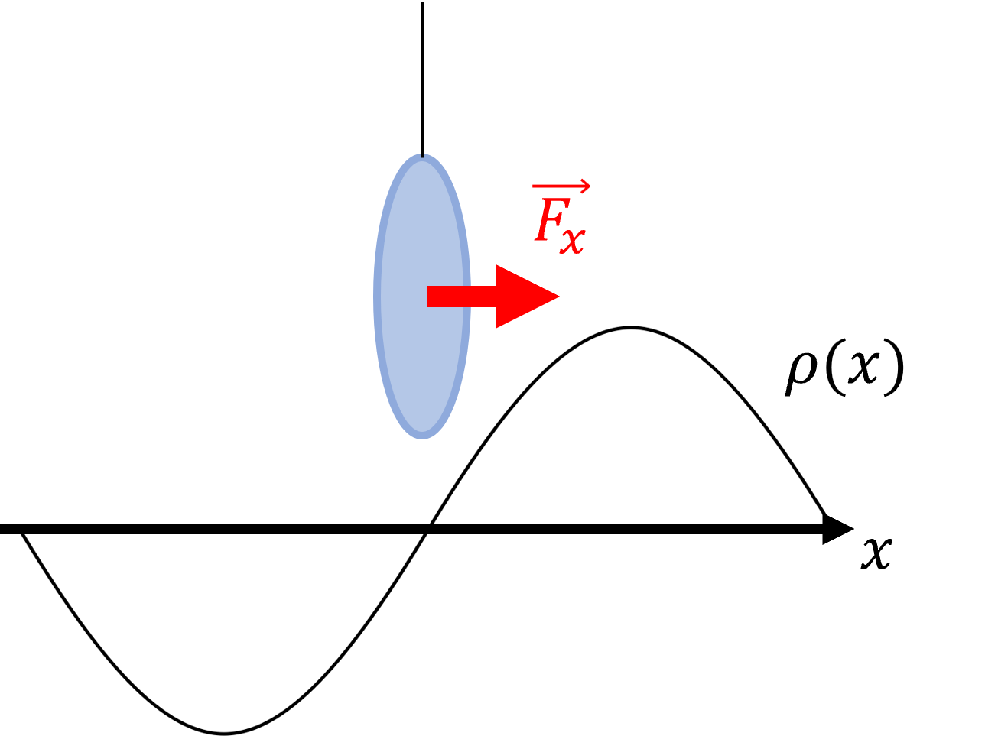
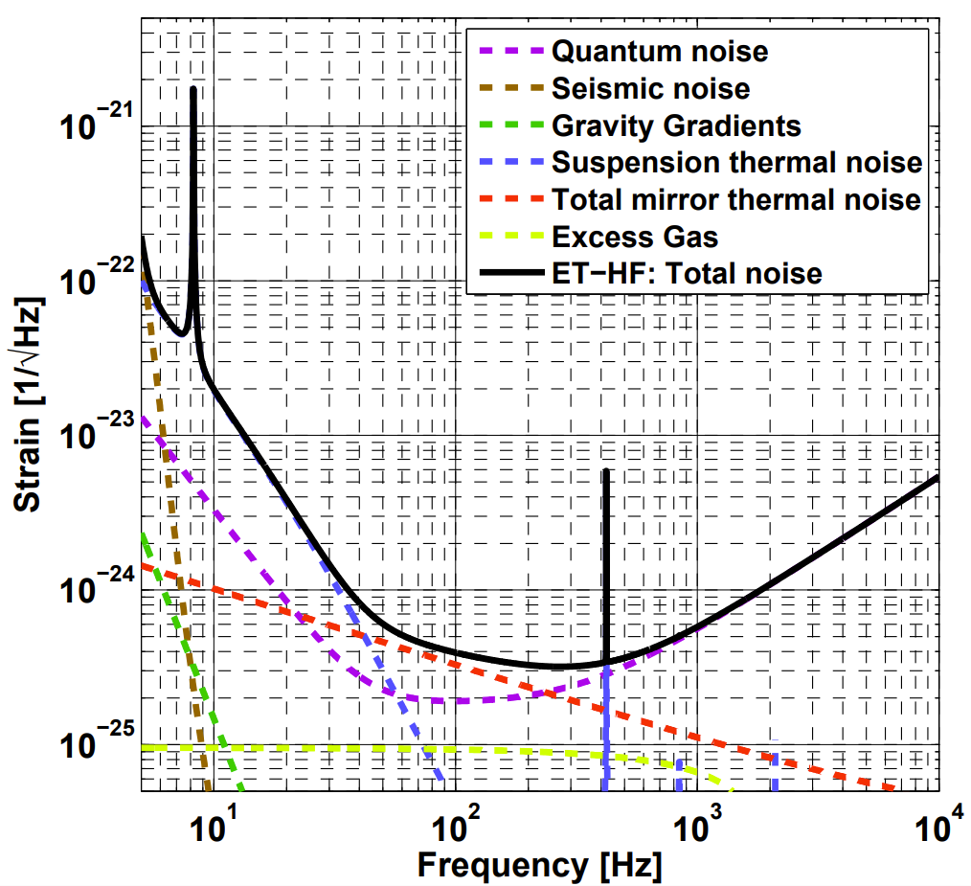
The Setup
Hild et al., arXiv:1012.0908

Slide 3
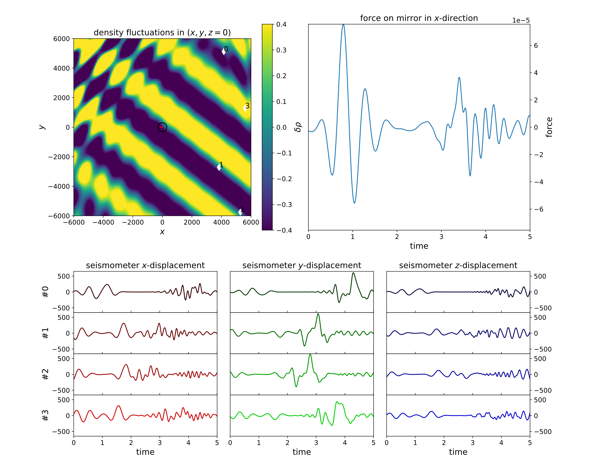
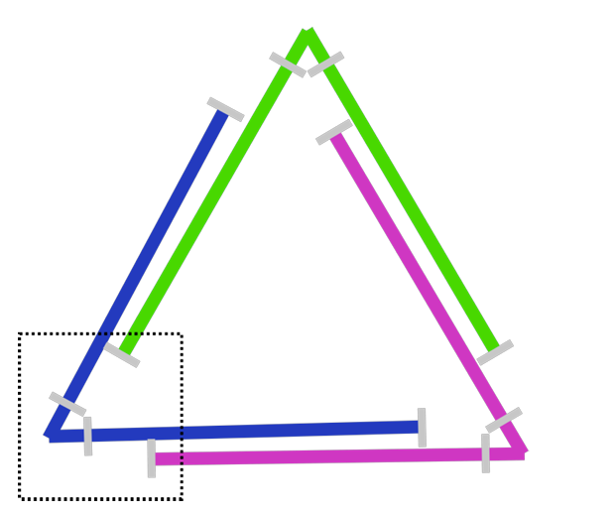
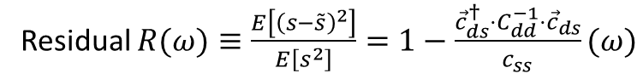
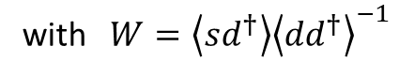
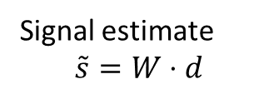
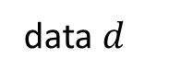
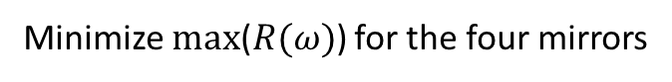
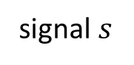
One Mirror: F. Badaracco & J. Harms, arXiv:1903.07936
Wiener Filter
Joint Corner: F. Badaracco et al., arXiv:2310.05709
signal $s$
Signal estimate
$$\tilde{s}=W⋅d$$
with $W=\left\langle sd^{†}\right\rangle {\left\langle dd^{†}\right\rangle }^{−1}$
Residual $R(ω)≡\frac{E\left[{\left(s−\tilde{s}\right)}^{2}\right]}{E\left[s^{2}\right]}=1−\frac{{\vec{c}}_{ds}^{†}⋅C_{dd}^{−1}⋅{\vec{c}}_{ds}}{c_{ss}}(ω)$
Fabry-Perot-Cavity
Joint Corner
Assumptions: homogeniety, isotropy, plain waves
data $d$
Minimize max($R(ω)$) for the four mirrors

Slide 4
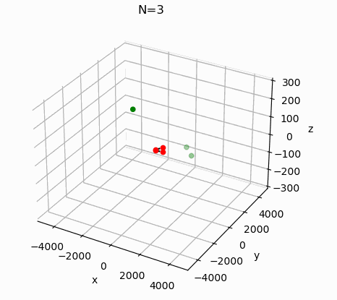
Optimization Algorithm
Original Code: arXiv:2310.05709
→Particle Swarm Optimization
(general, fast and reliable for small N)
Parameter (benchmark value/range):
Number of Seismometers N (15/1-100)
Signal-to-Noise-Ratio of operating seismometers SNR (15/1-30)
Optimization frequency f (1 Hz/1-20 Hz)
Ratio of P- and S-waves p (0.2/0-1)
seismometer
mirror

Slide 5
Parameter Studies
What influence do the different parameters have?

Slide 6
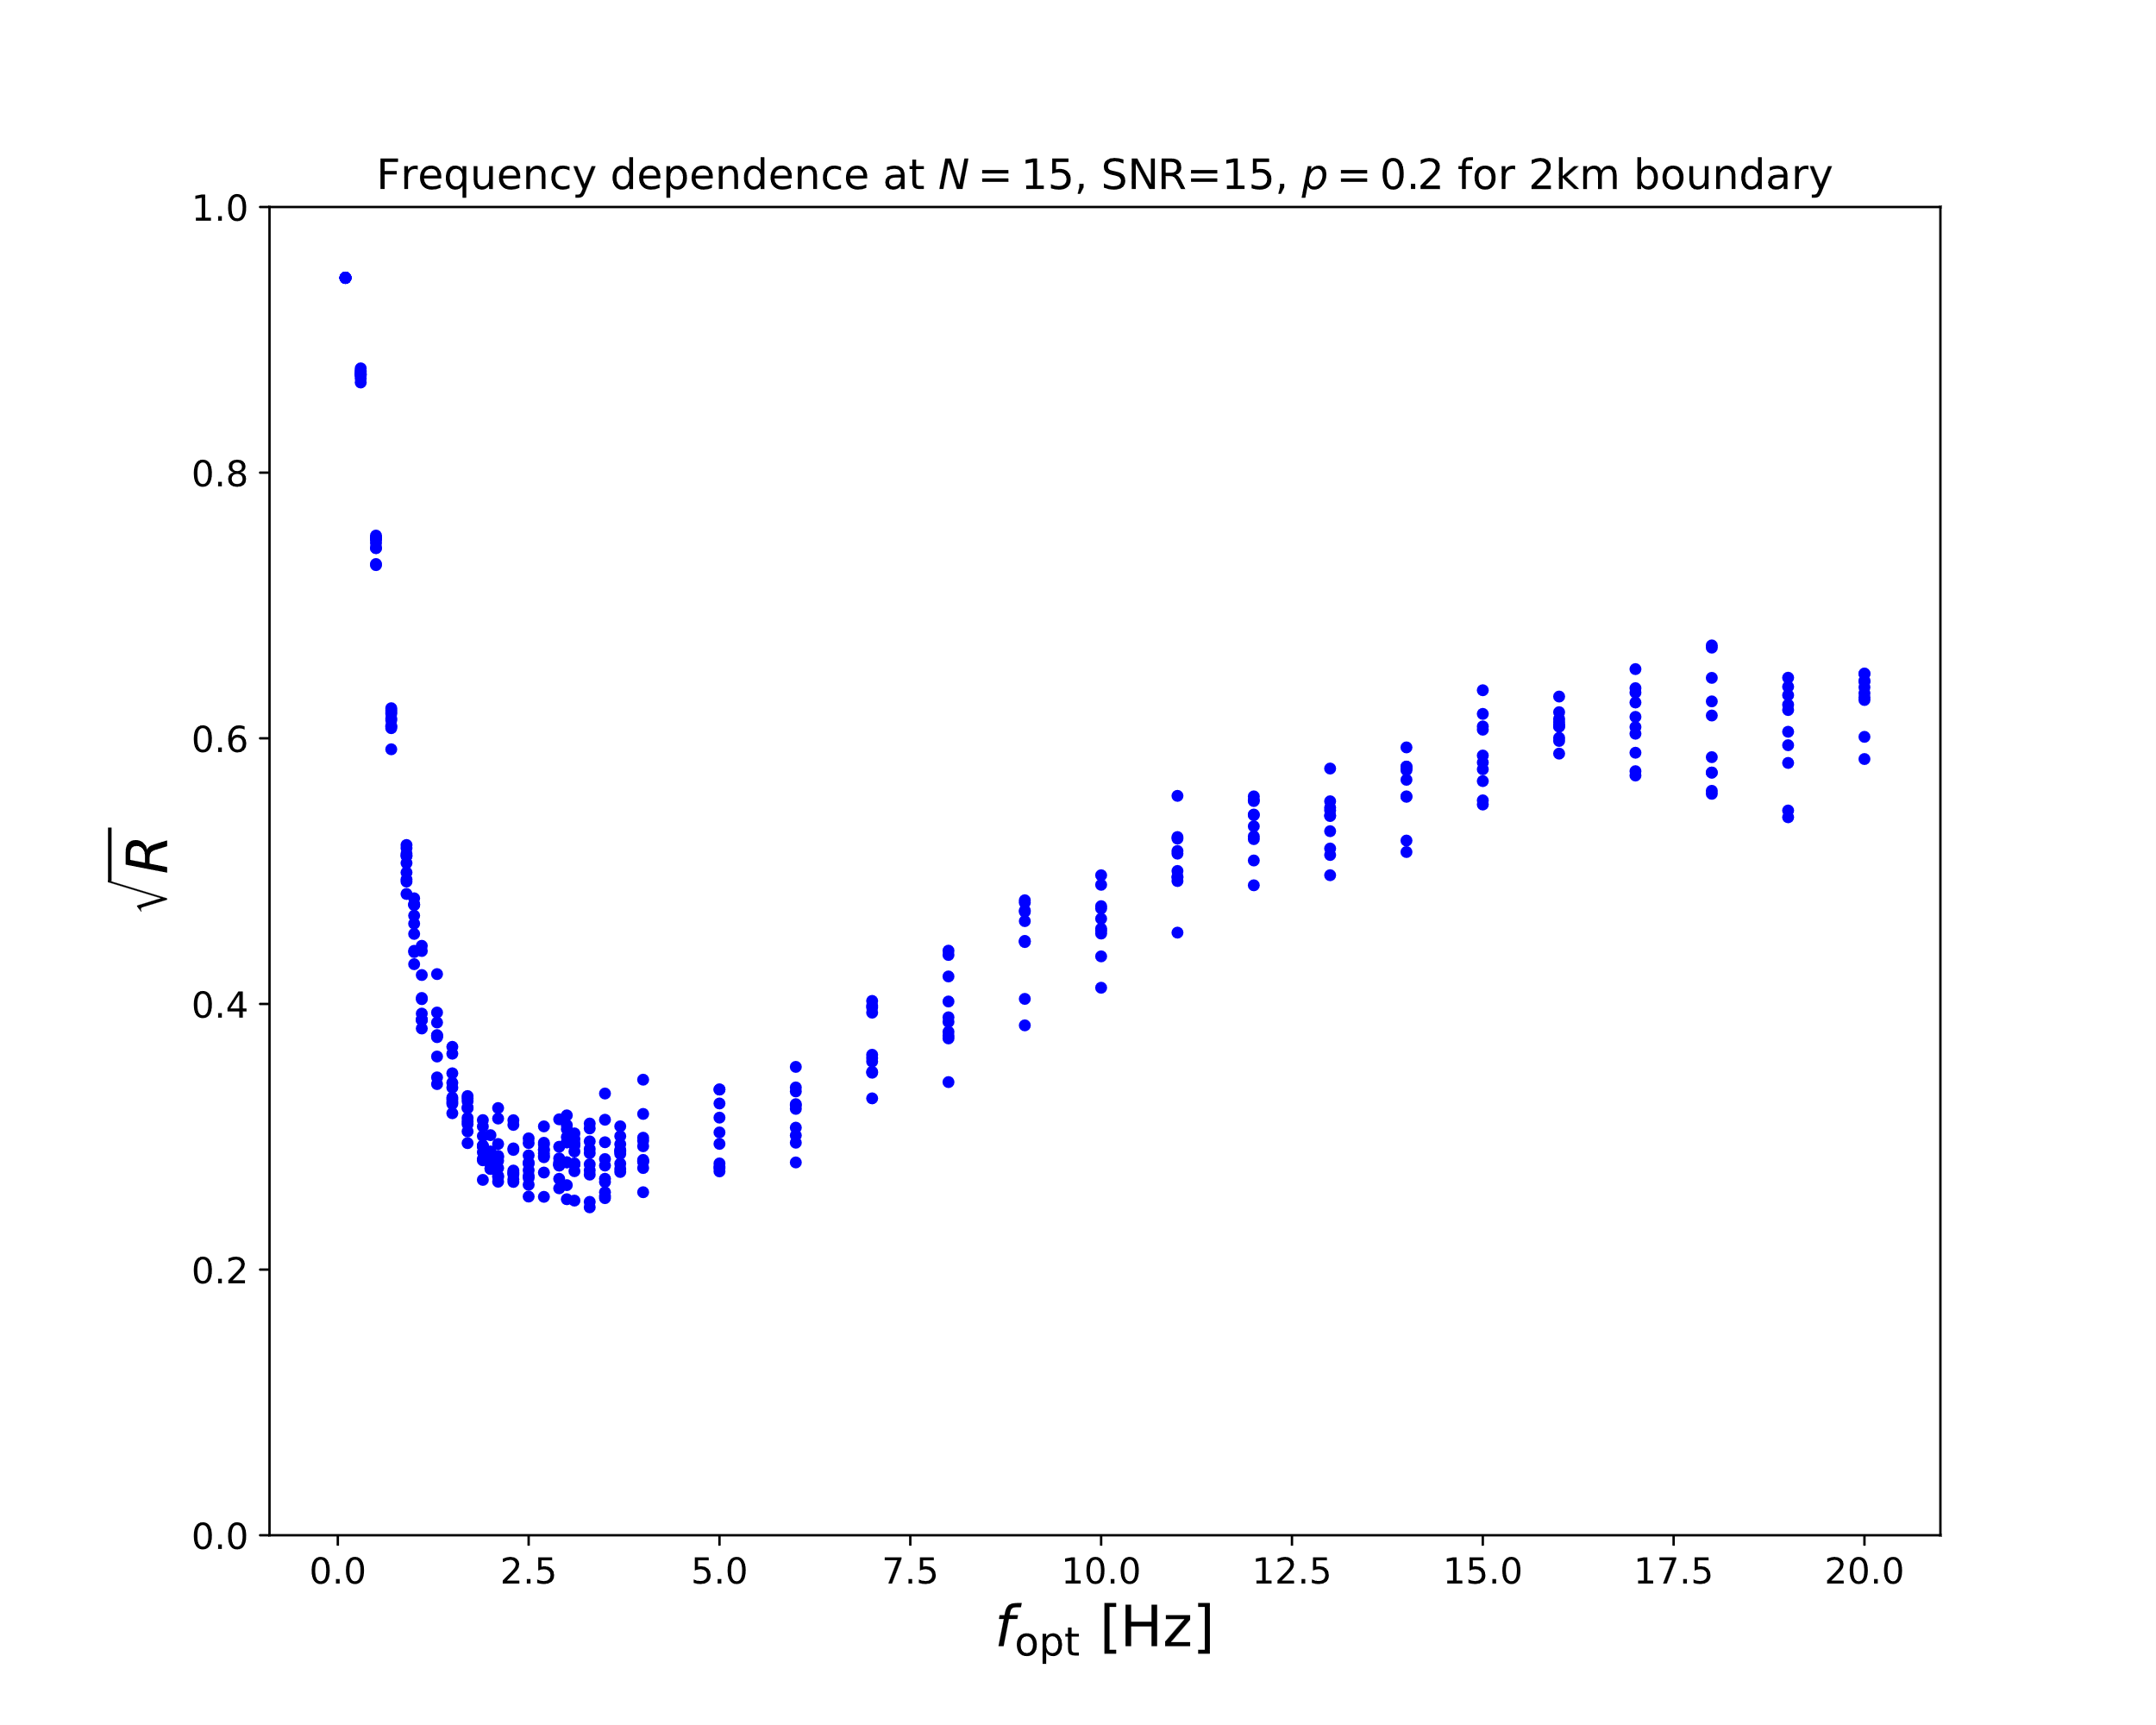
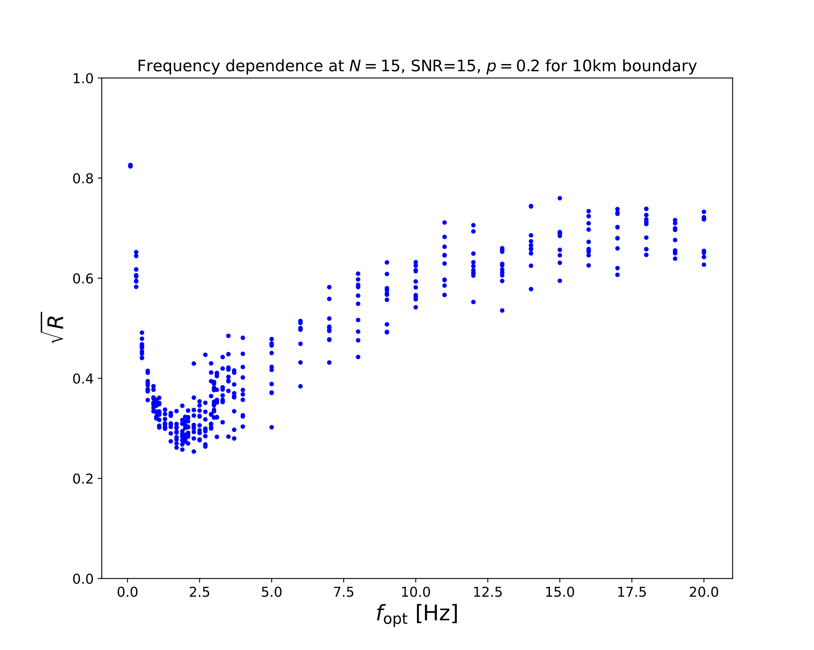
Boundary Dependency
Seismometers need space to predict low frequency Newtonian Noise

Slide 7
Boundary Dependency
Larger spread and higher residuals due to worse convergence of PSO in larger volume…
Seismometers need space to predict low frequency Newtonian Noise

Slide 8
Boundary Dependency
Larger spread and higher residuals due to worse convergence of PSO in larger volume…
… but better results for low frequencies = higher wavelengths (residual worsens if boundary<wavelength/4)
Seismometers need space to predict low frequency Newtonian Noise

Slide 9
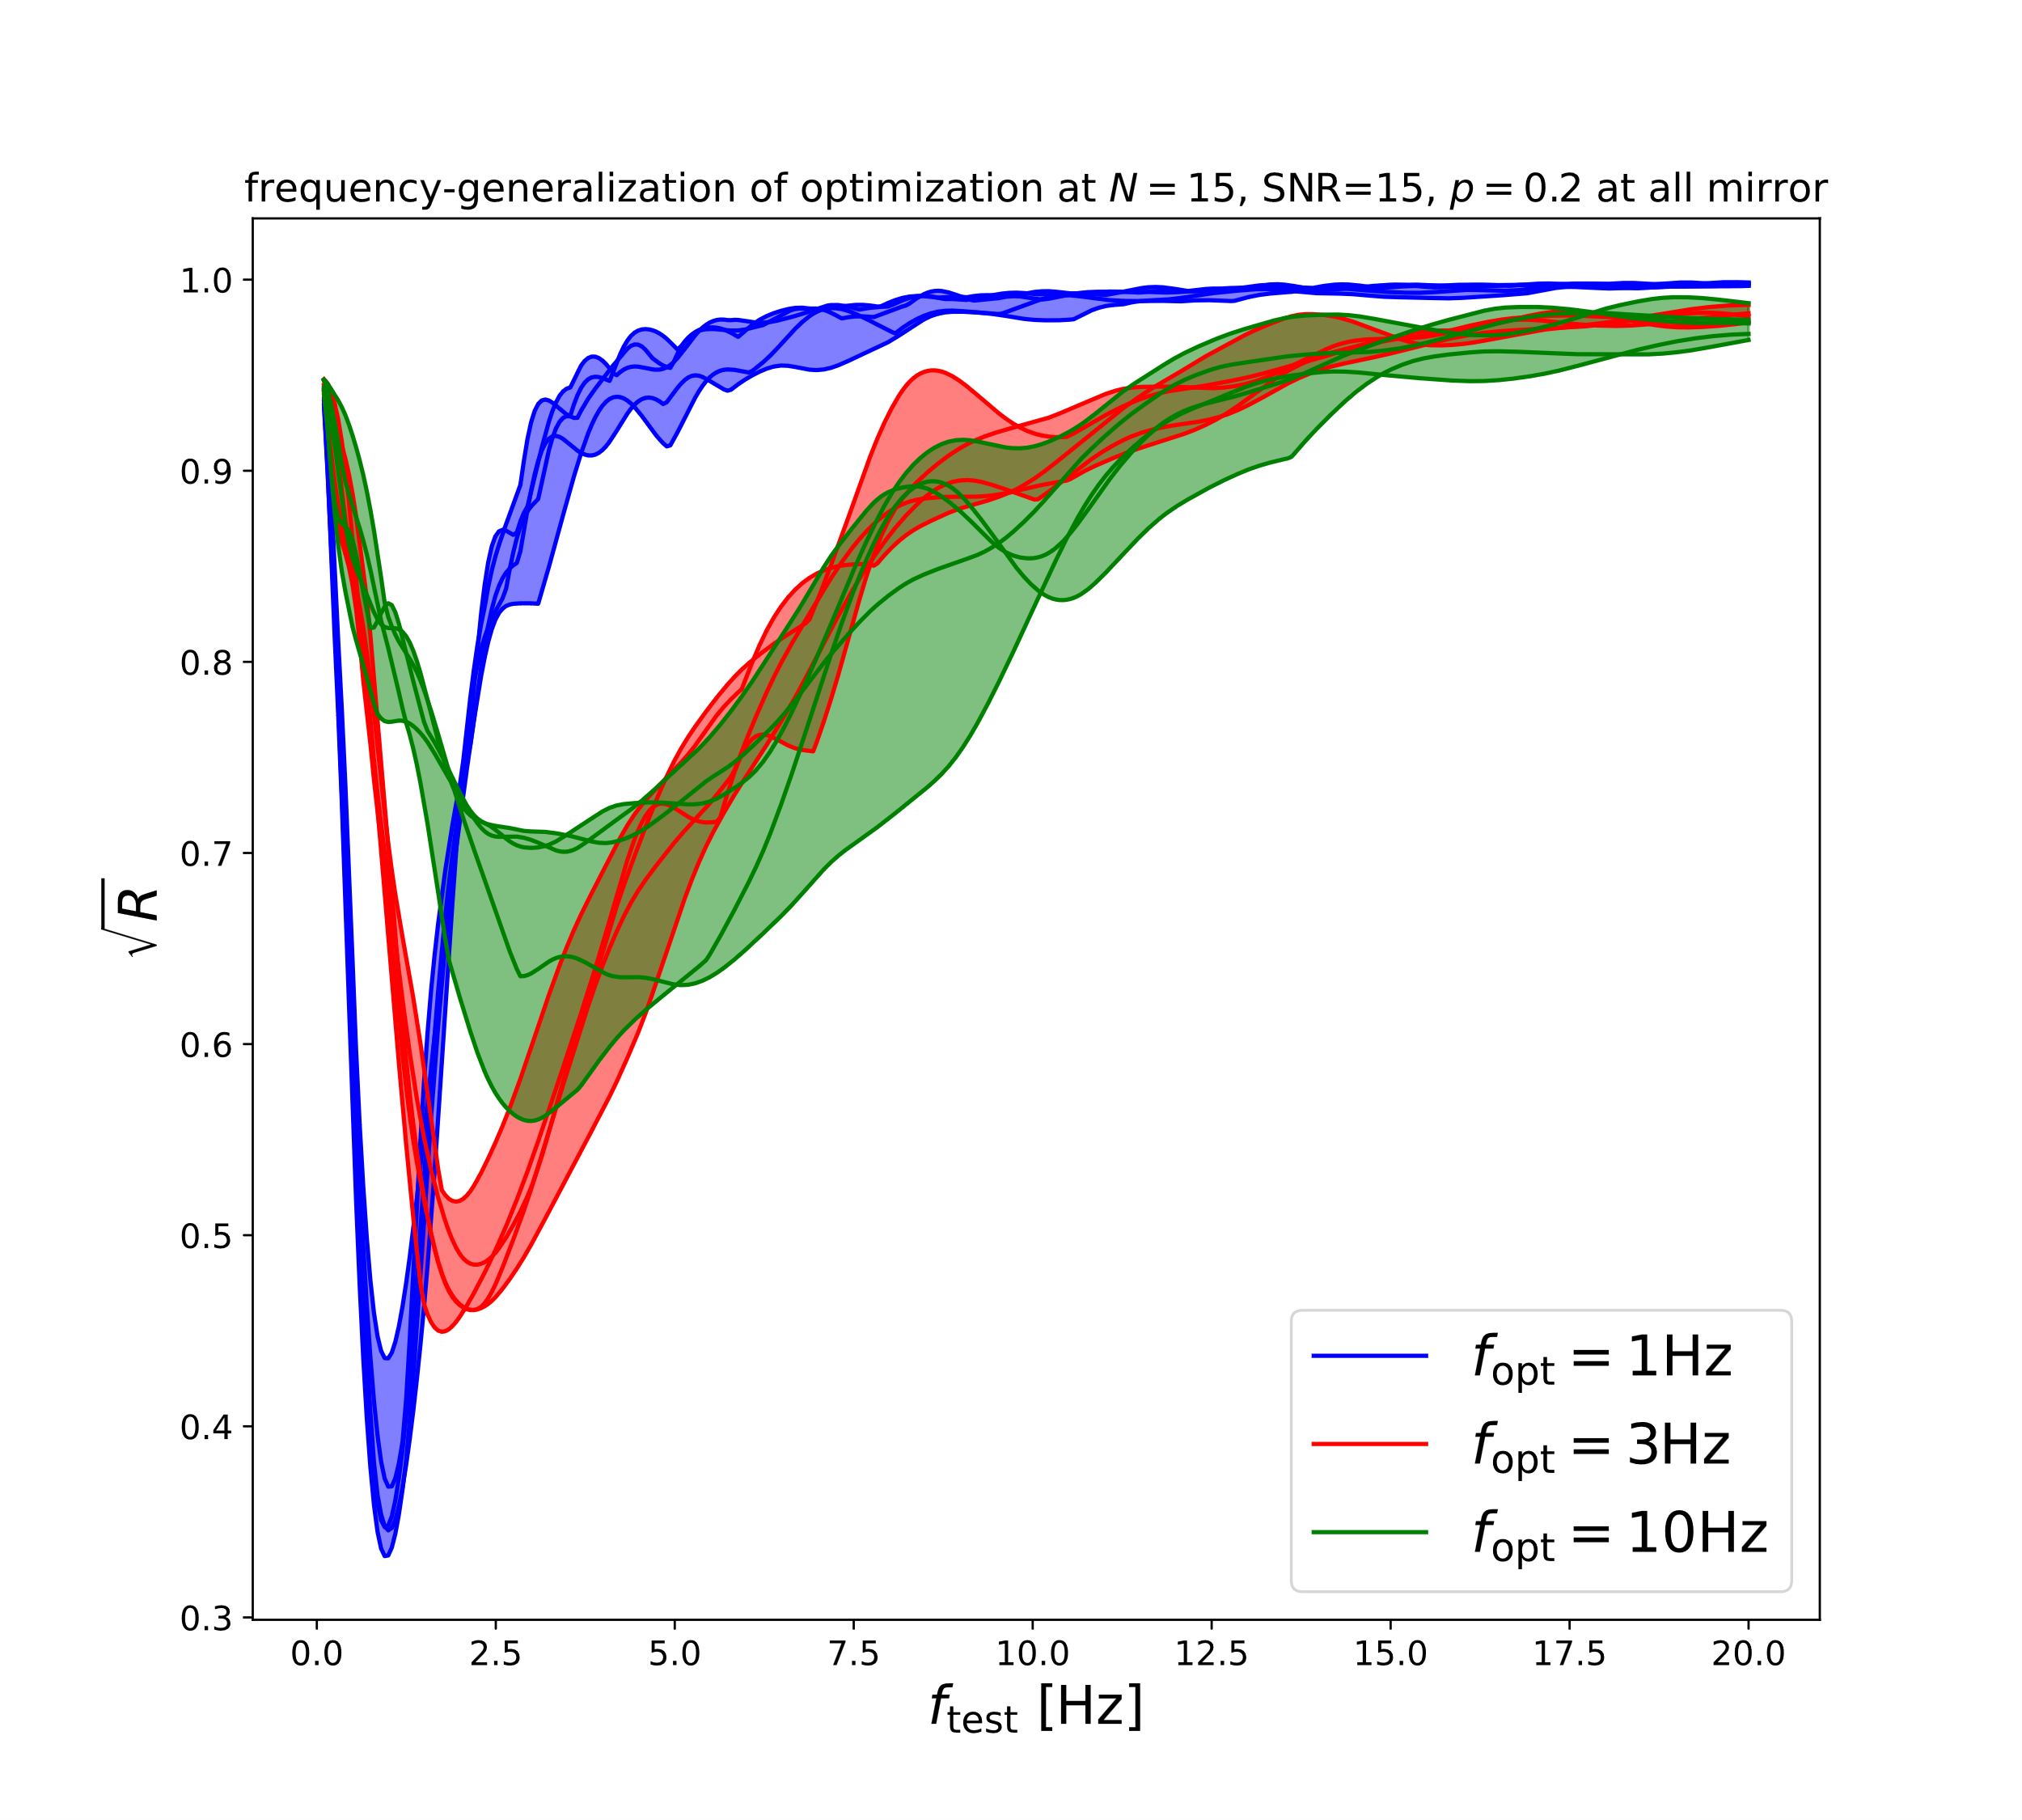
Frequency Dependency
Hild et al., arXiv:1012.0908
Depends strongly on actual seismometer positions

Slide 10
Frequency Dependency
Hild et al., arXiv:1012.0908
Depends strongly on actual seismometer positions
Works differently well for different optimization frequencies

Slide 11
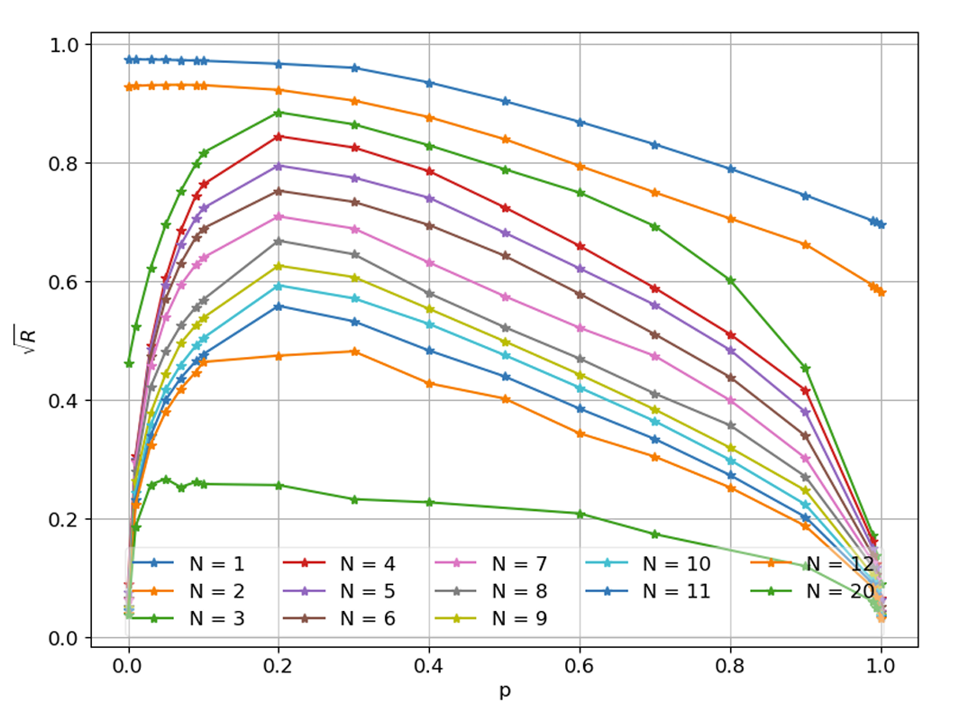
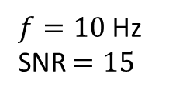
p Dependency
F. Badaracco et al., arXiv:2310.05709
$f=10$ Hz
SNR $=15$
S-waves only
P-waves only

Slide 12
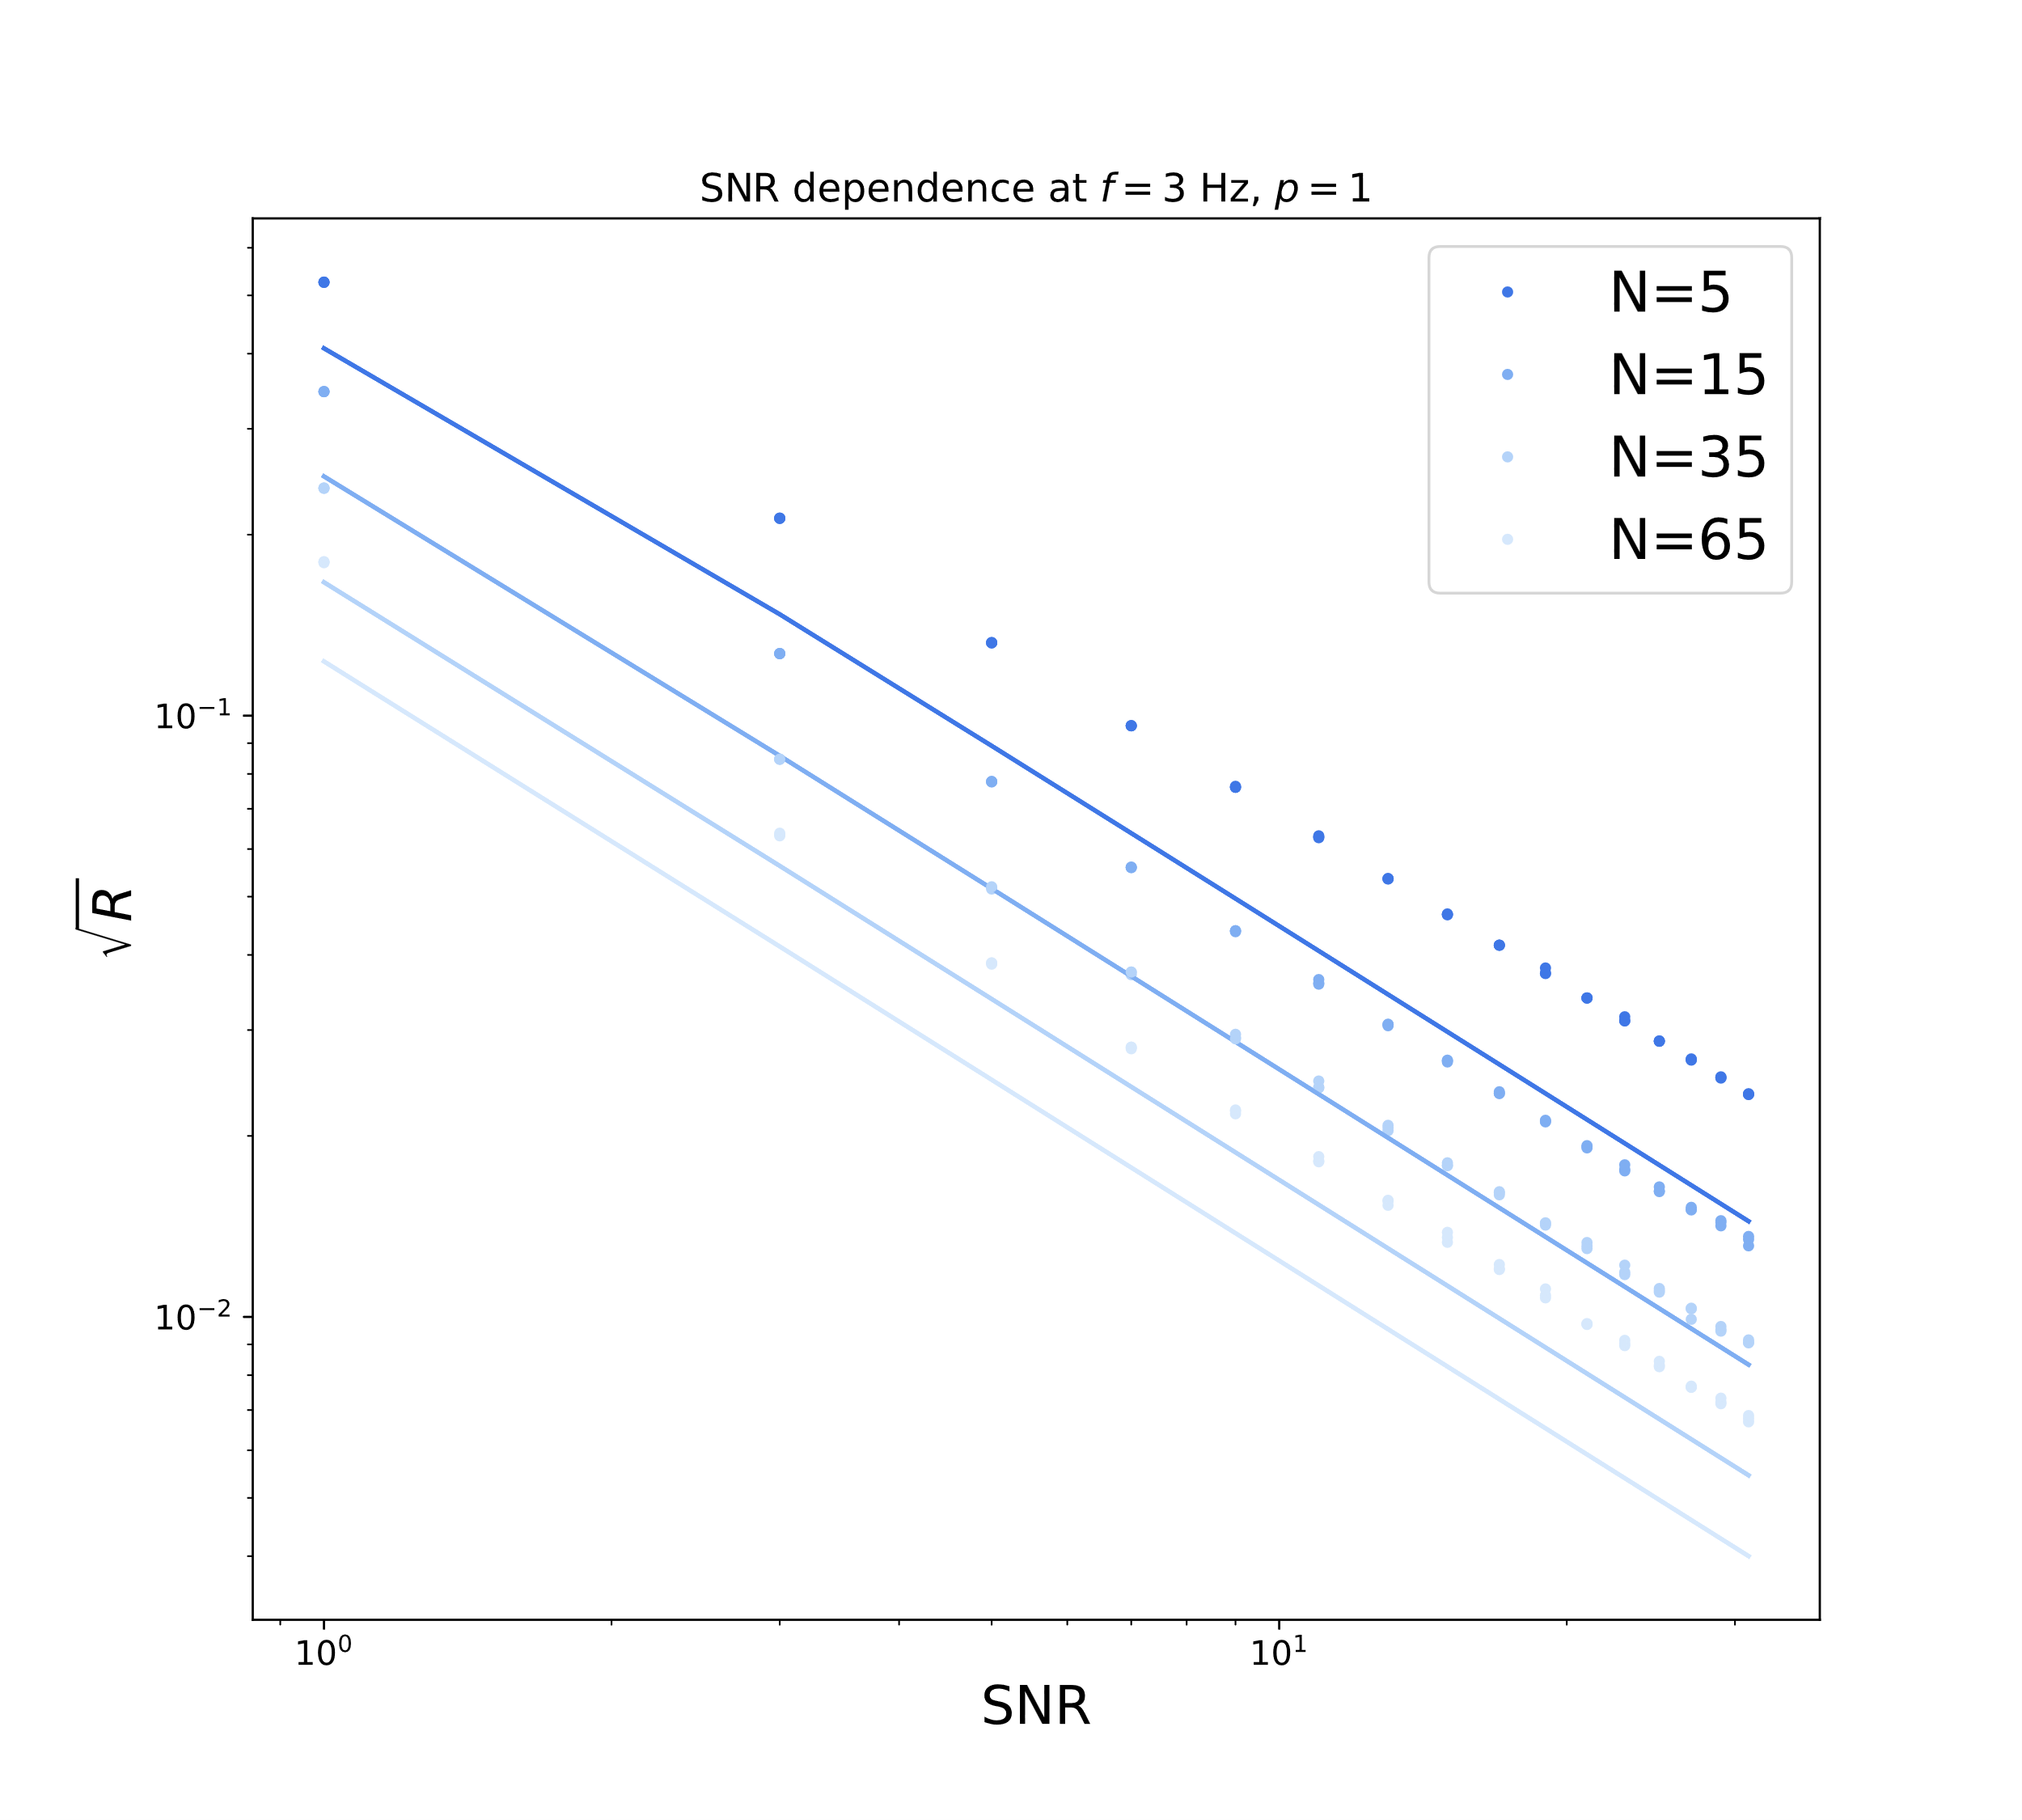
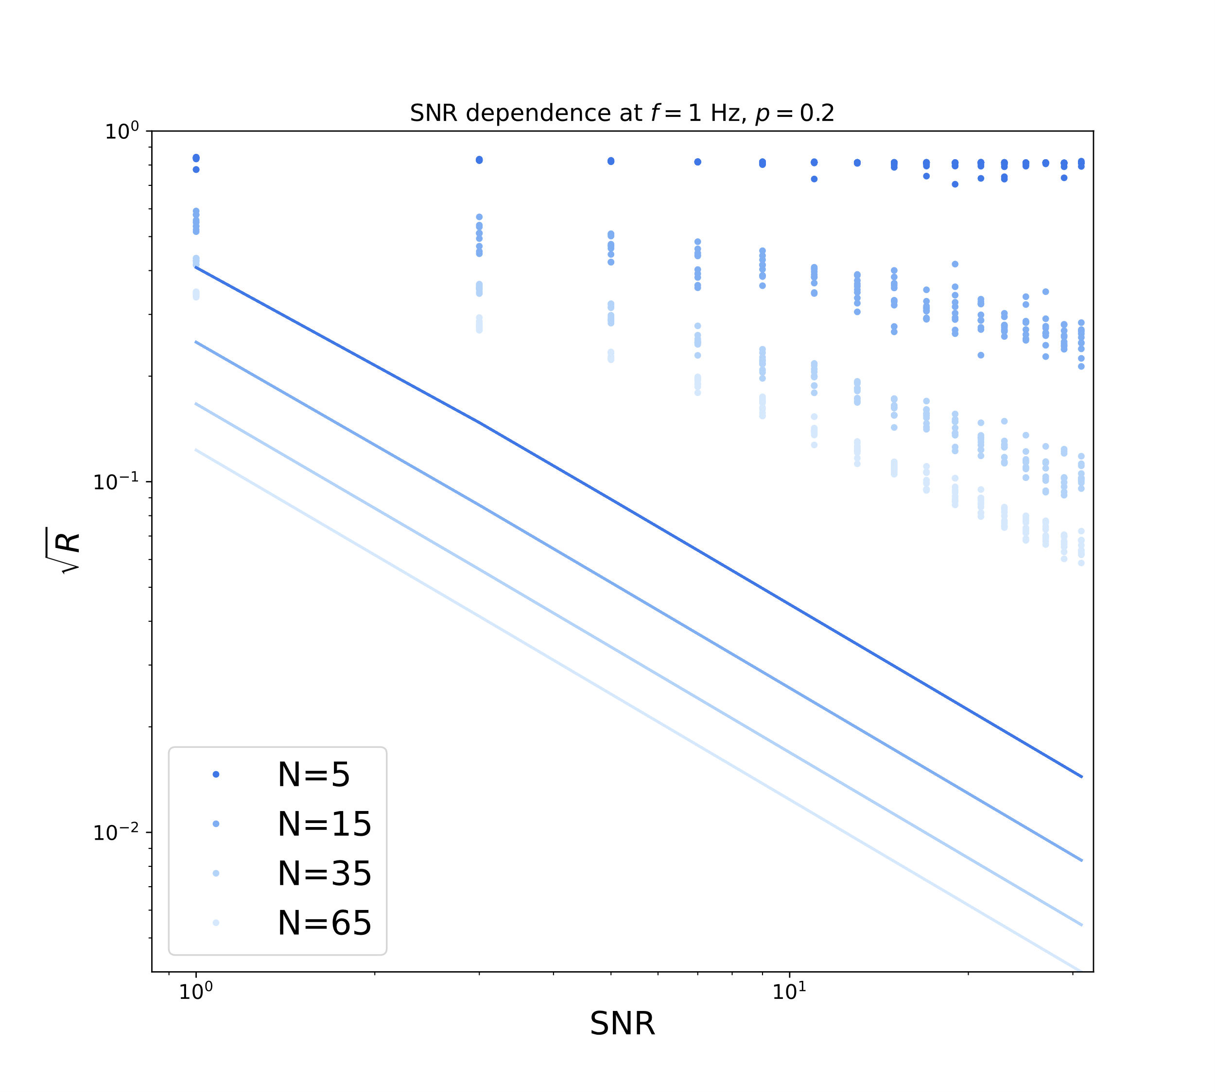
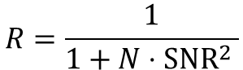
SNR Dependency
R decreases with N and SNR as expected
Well above SNR-limit (mitigation only limited by noise, not translation) when p!=1 or 0
$$R=\frac{1}{1+N⋅{SNR}^{2} }$$

Slide 13
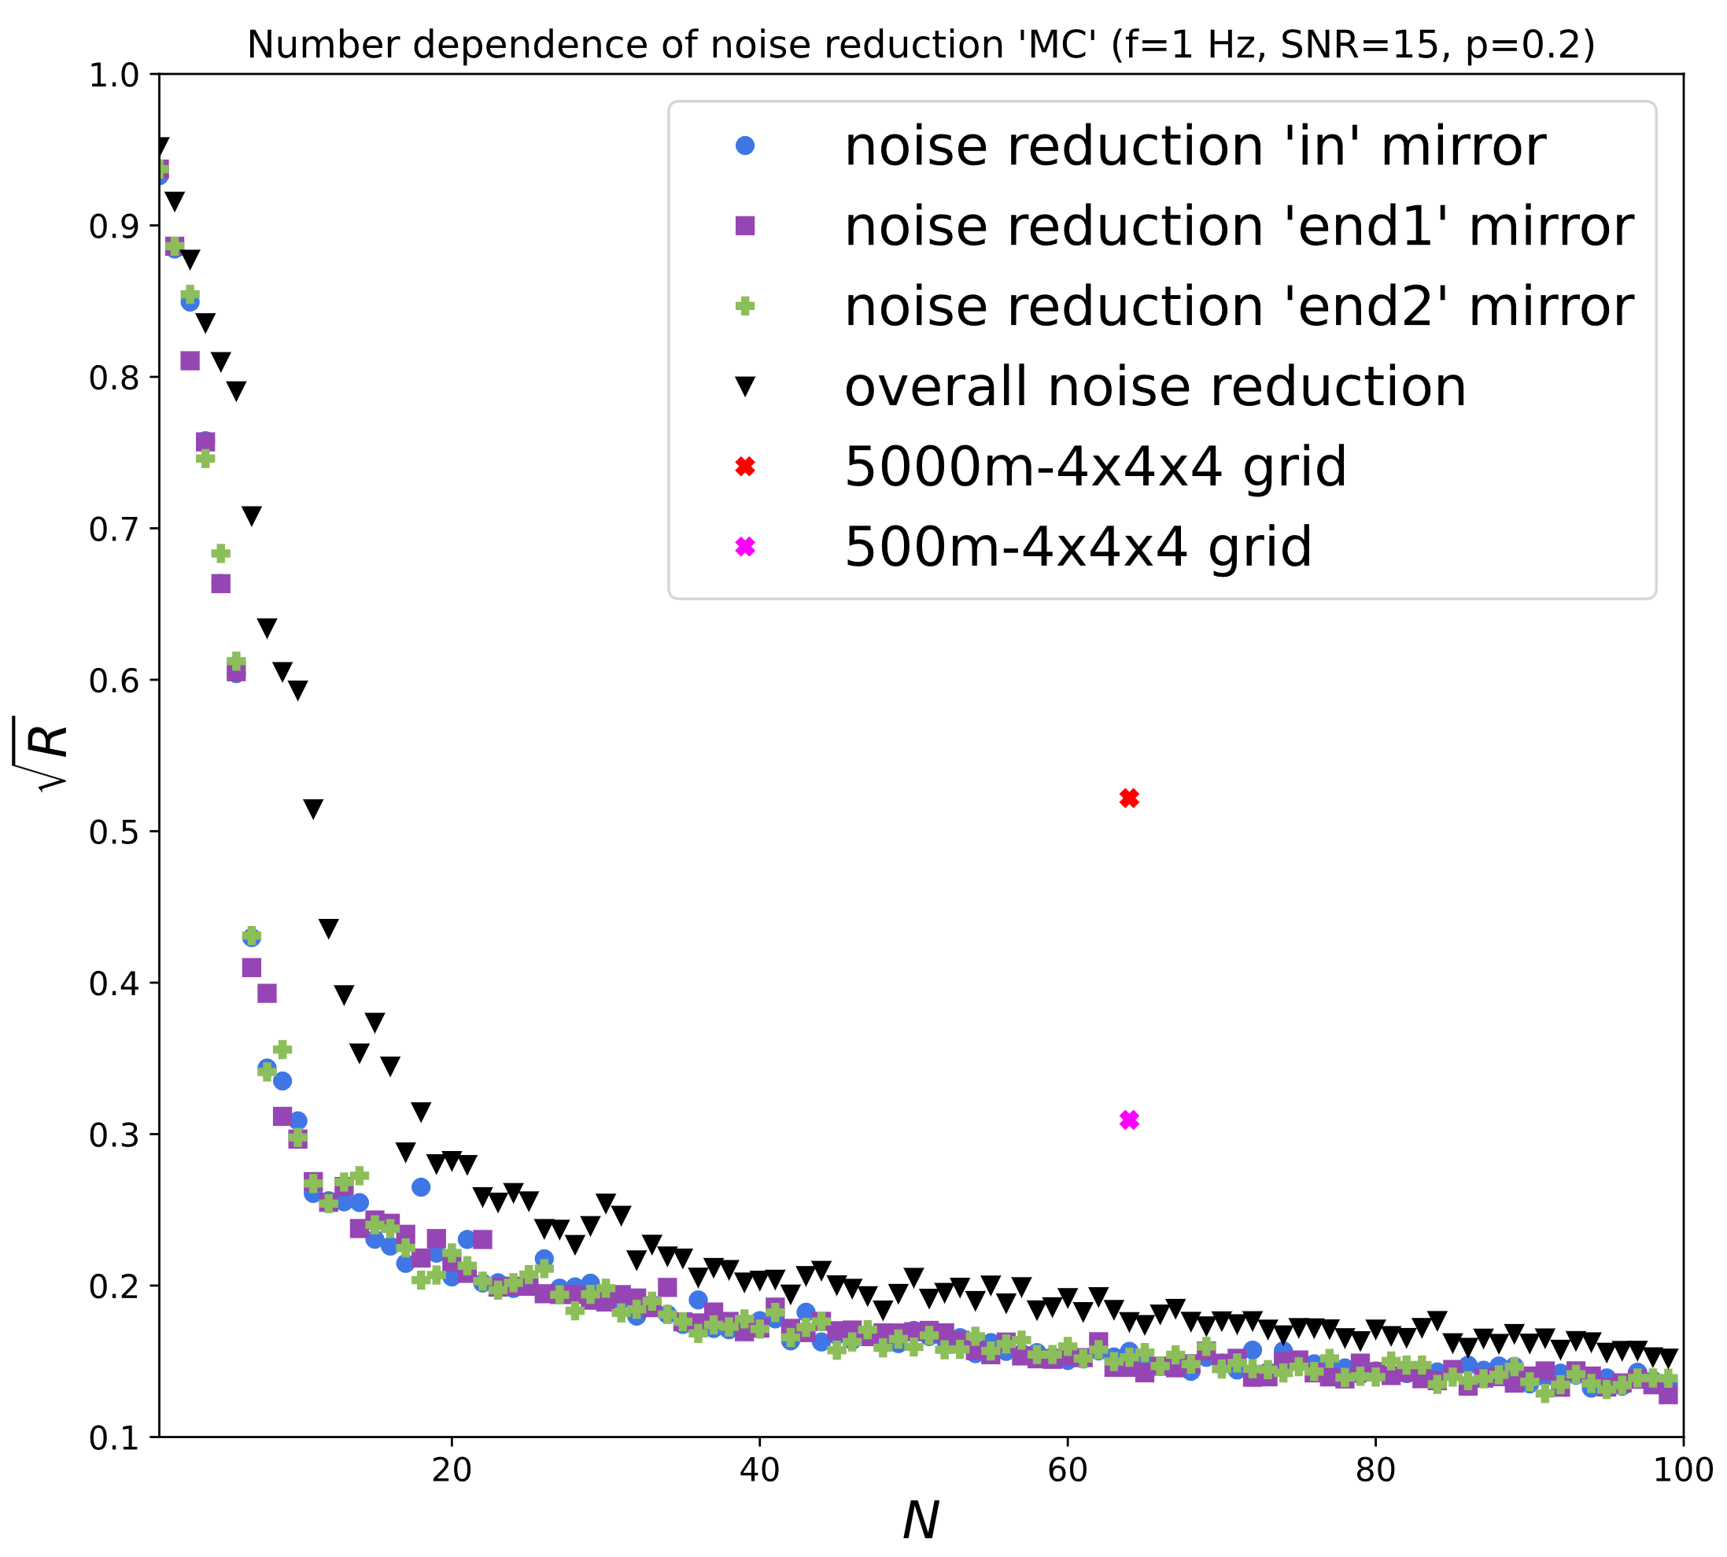
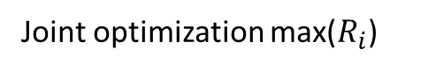
Dependence on Number of Seismometers
Single mirror optimization
Joint optimization max($R_{i}$)
Non-optimized guess (regular grid)
end2 +
84%
in ●
end1 ■
Strong improvement may be possible

Slide 14
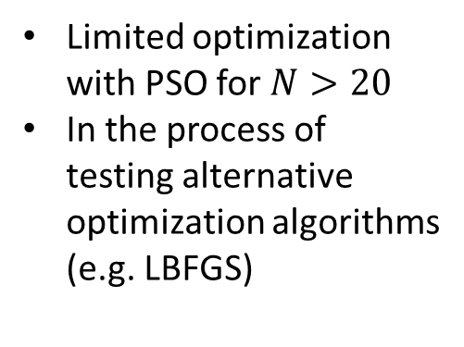
Dependence on Number of Seismometers
Single mirror optimization
Joint optimization
Non-optimized guess (regular grid)
end2 +
1000m-4x4x4 grid
84%
in ●
end1 ■
Strong improvement may be possible even without full optimization
Limited optimization with PSO for $N>20$
In the process of testing alternative optimization algorithms (e.g. LBFGS)

Slide 15
In-Tunnel Optimization
How much improvement can we still archieve if we limit the optimization procedure to the tunnel surface?

Slide 16
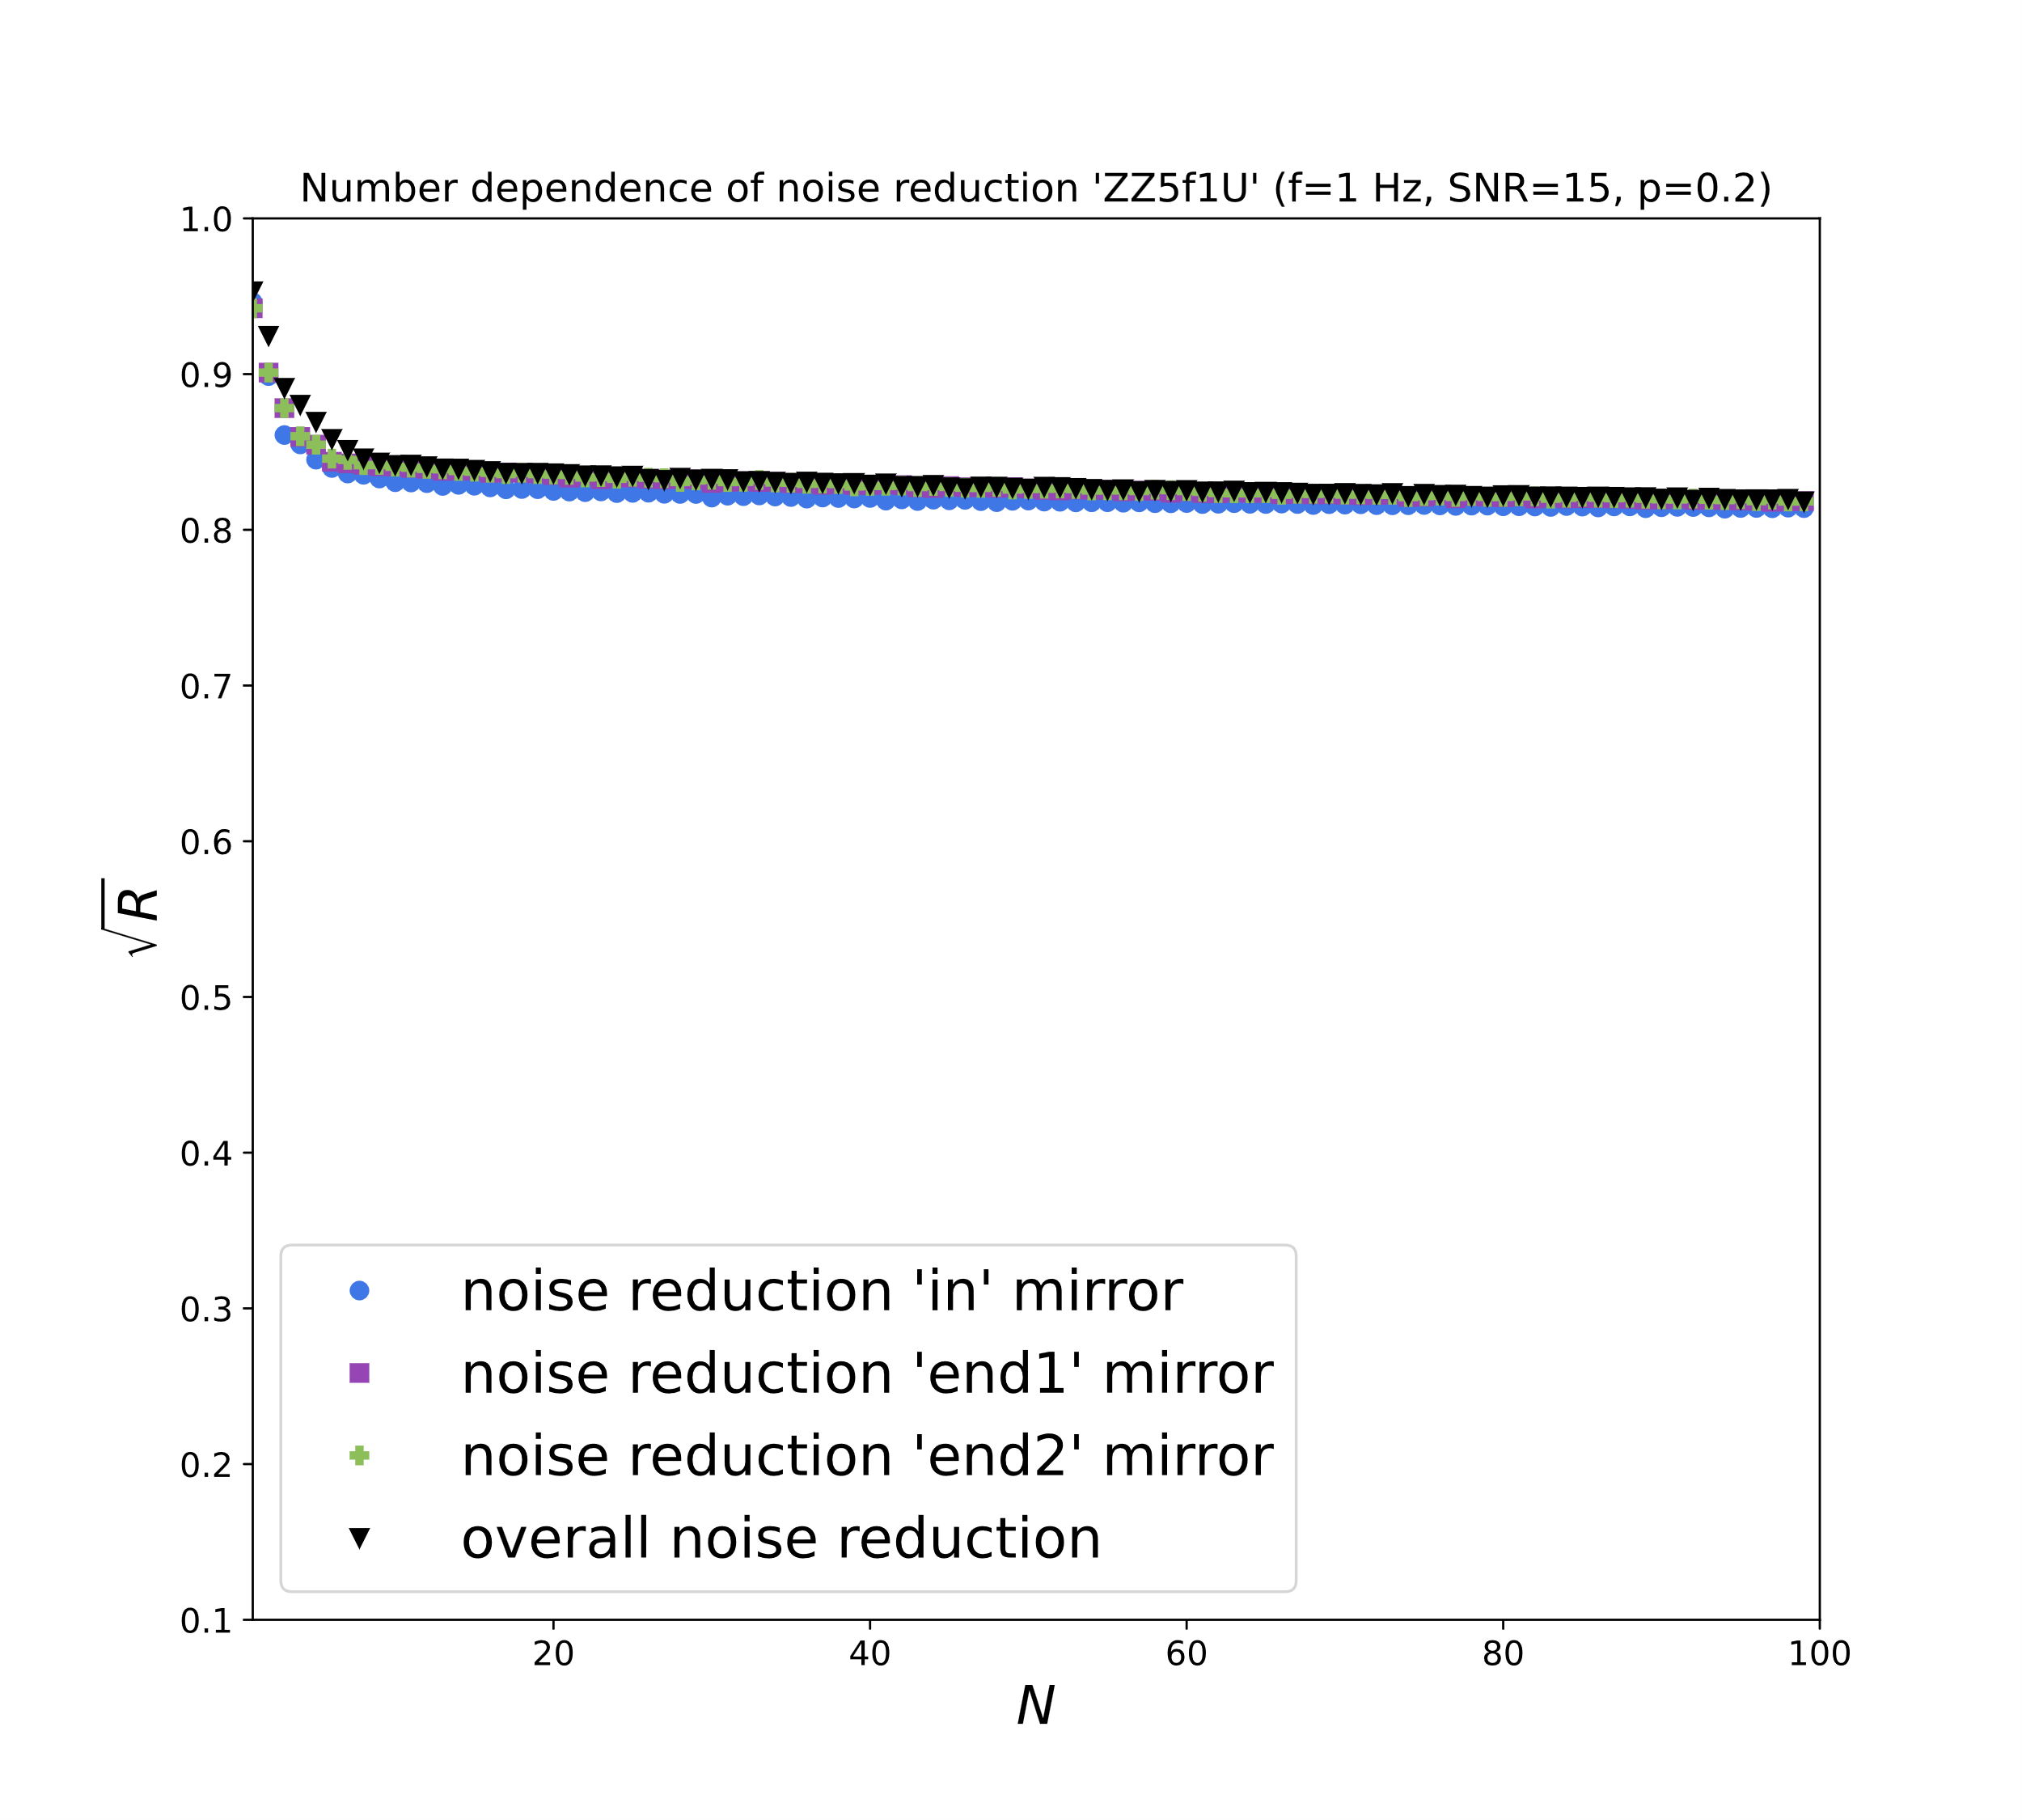
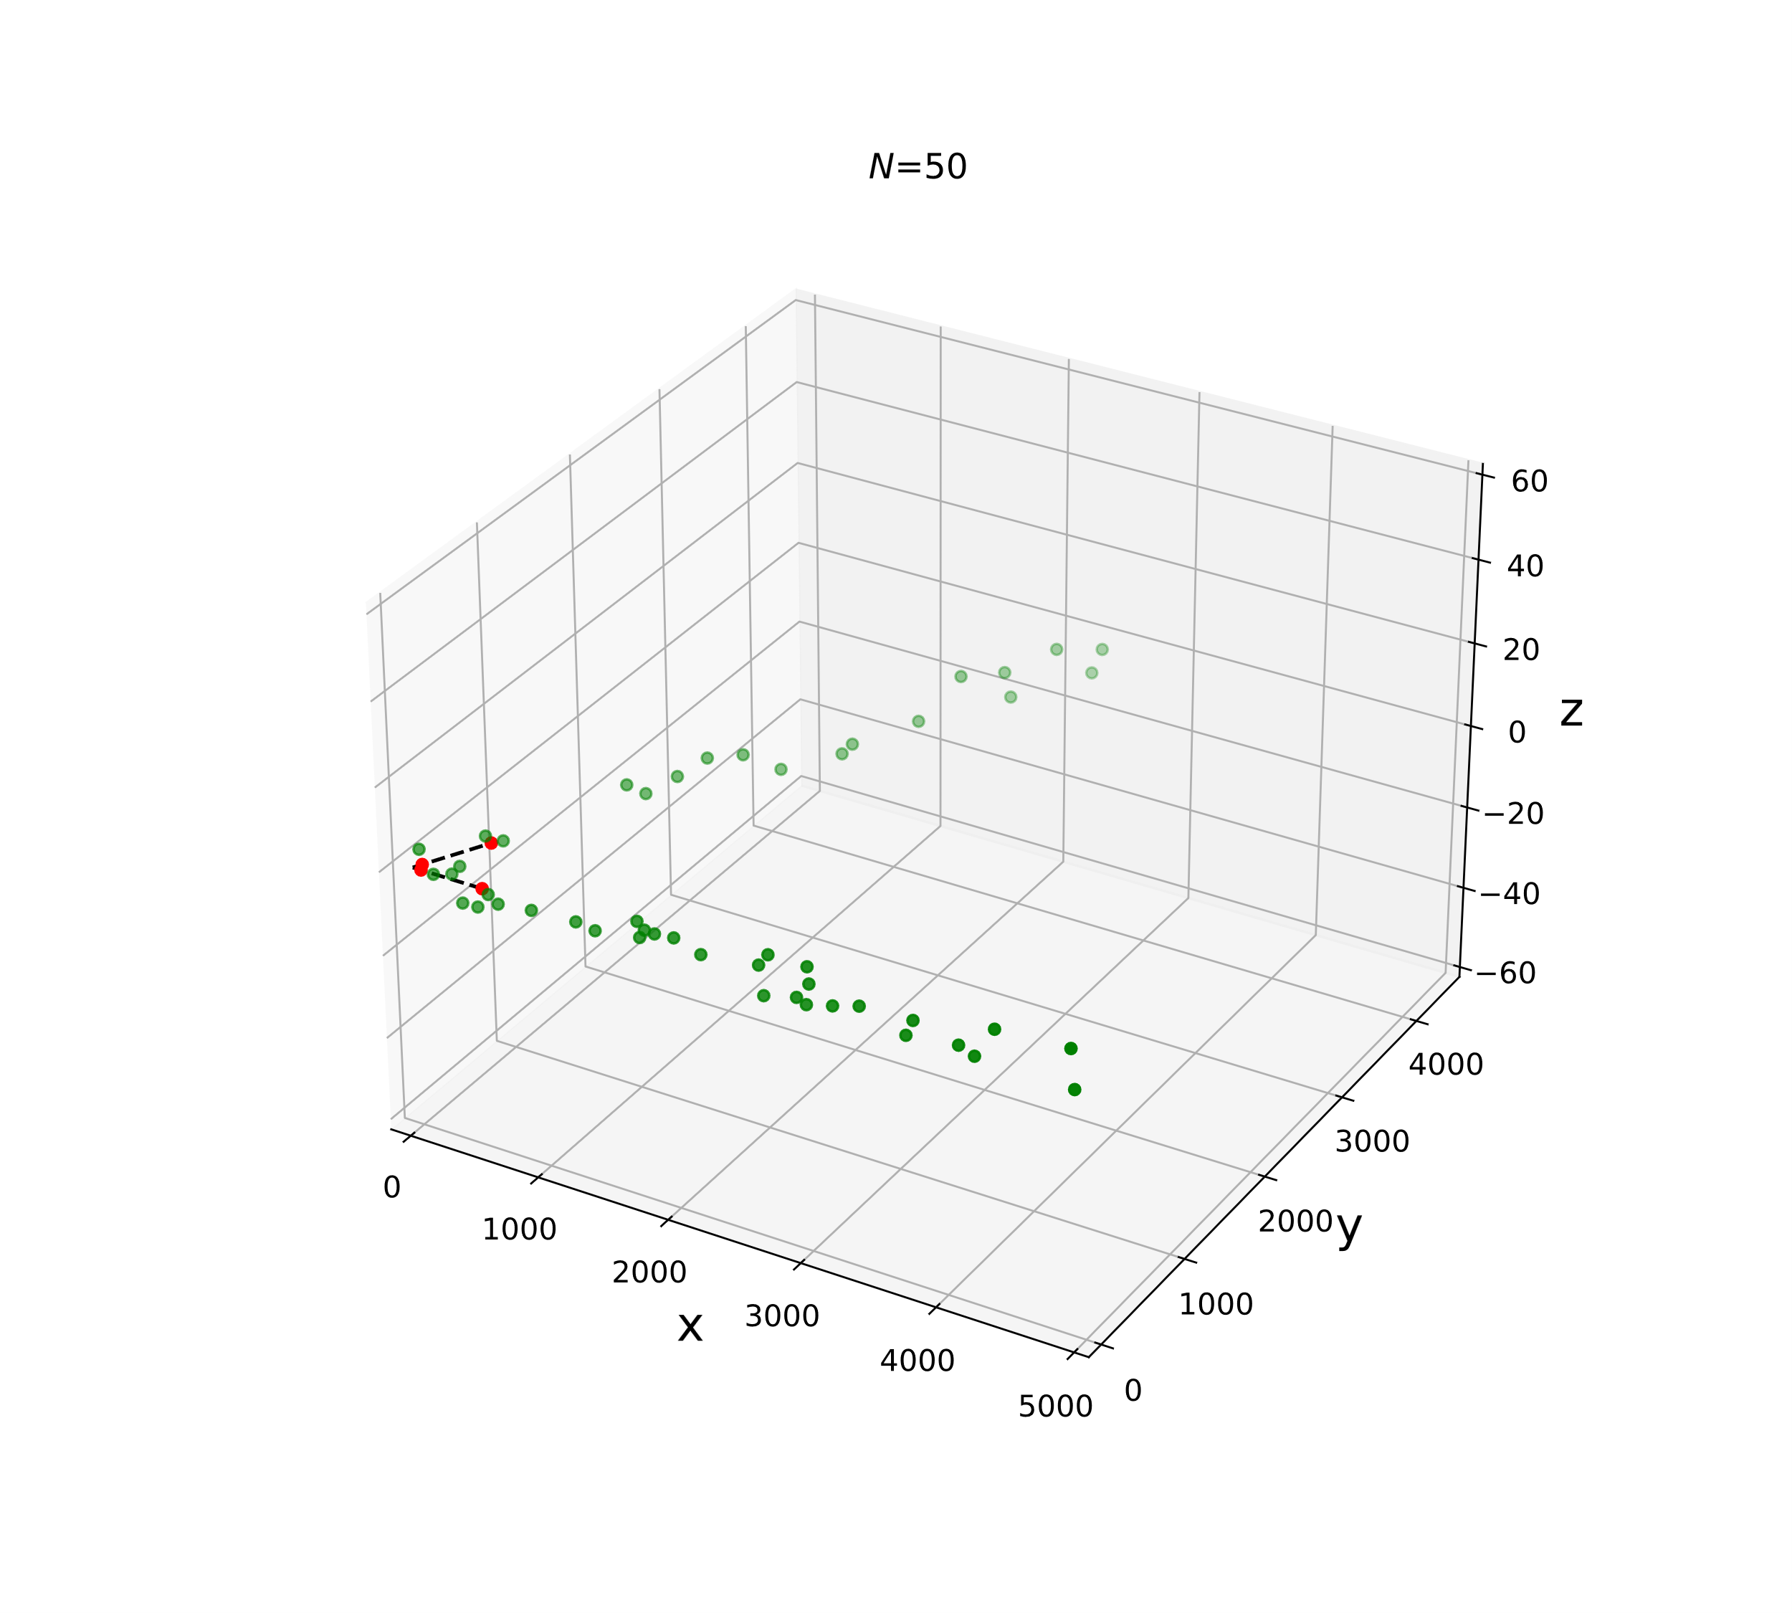
Two-Cylinder-Model
end2 +
in ●
end1 ■
16%
Far from sufficient on its own, but can be used to support the borehole-seismometers
Tunnel radius = 5m

Slide 17
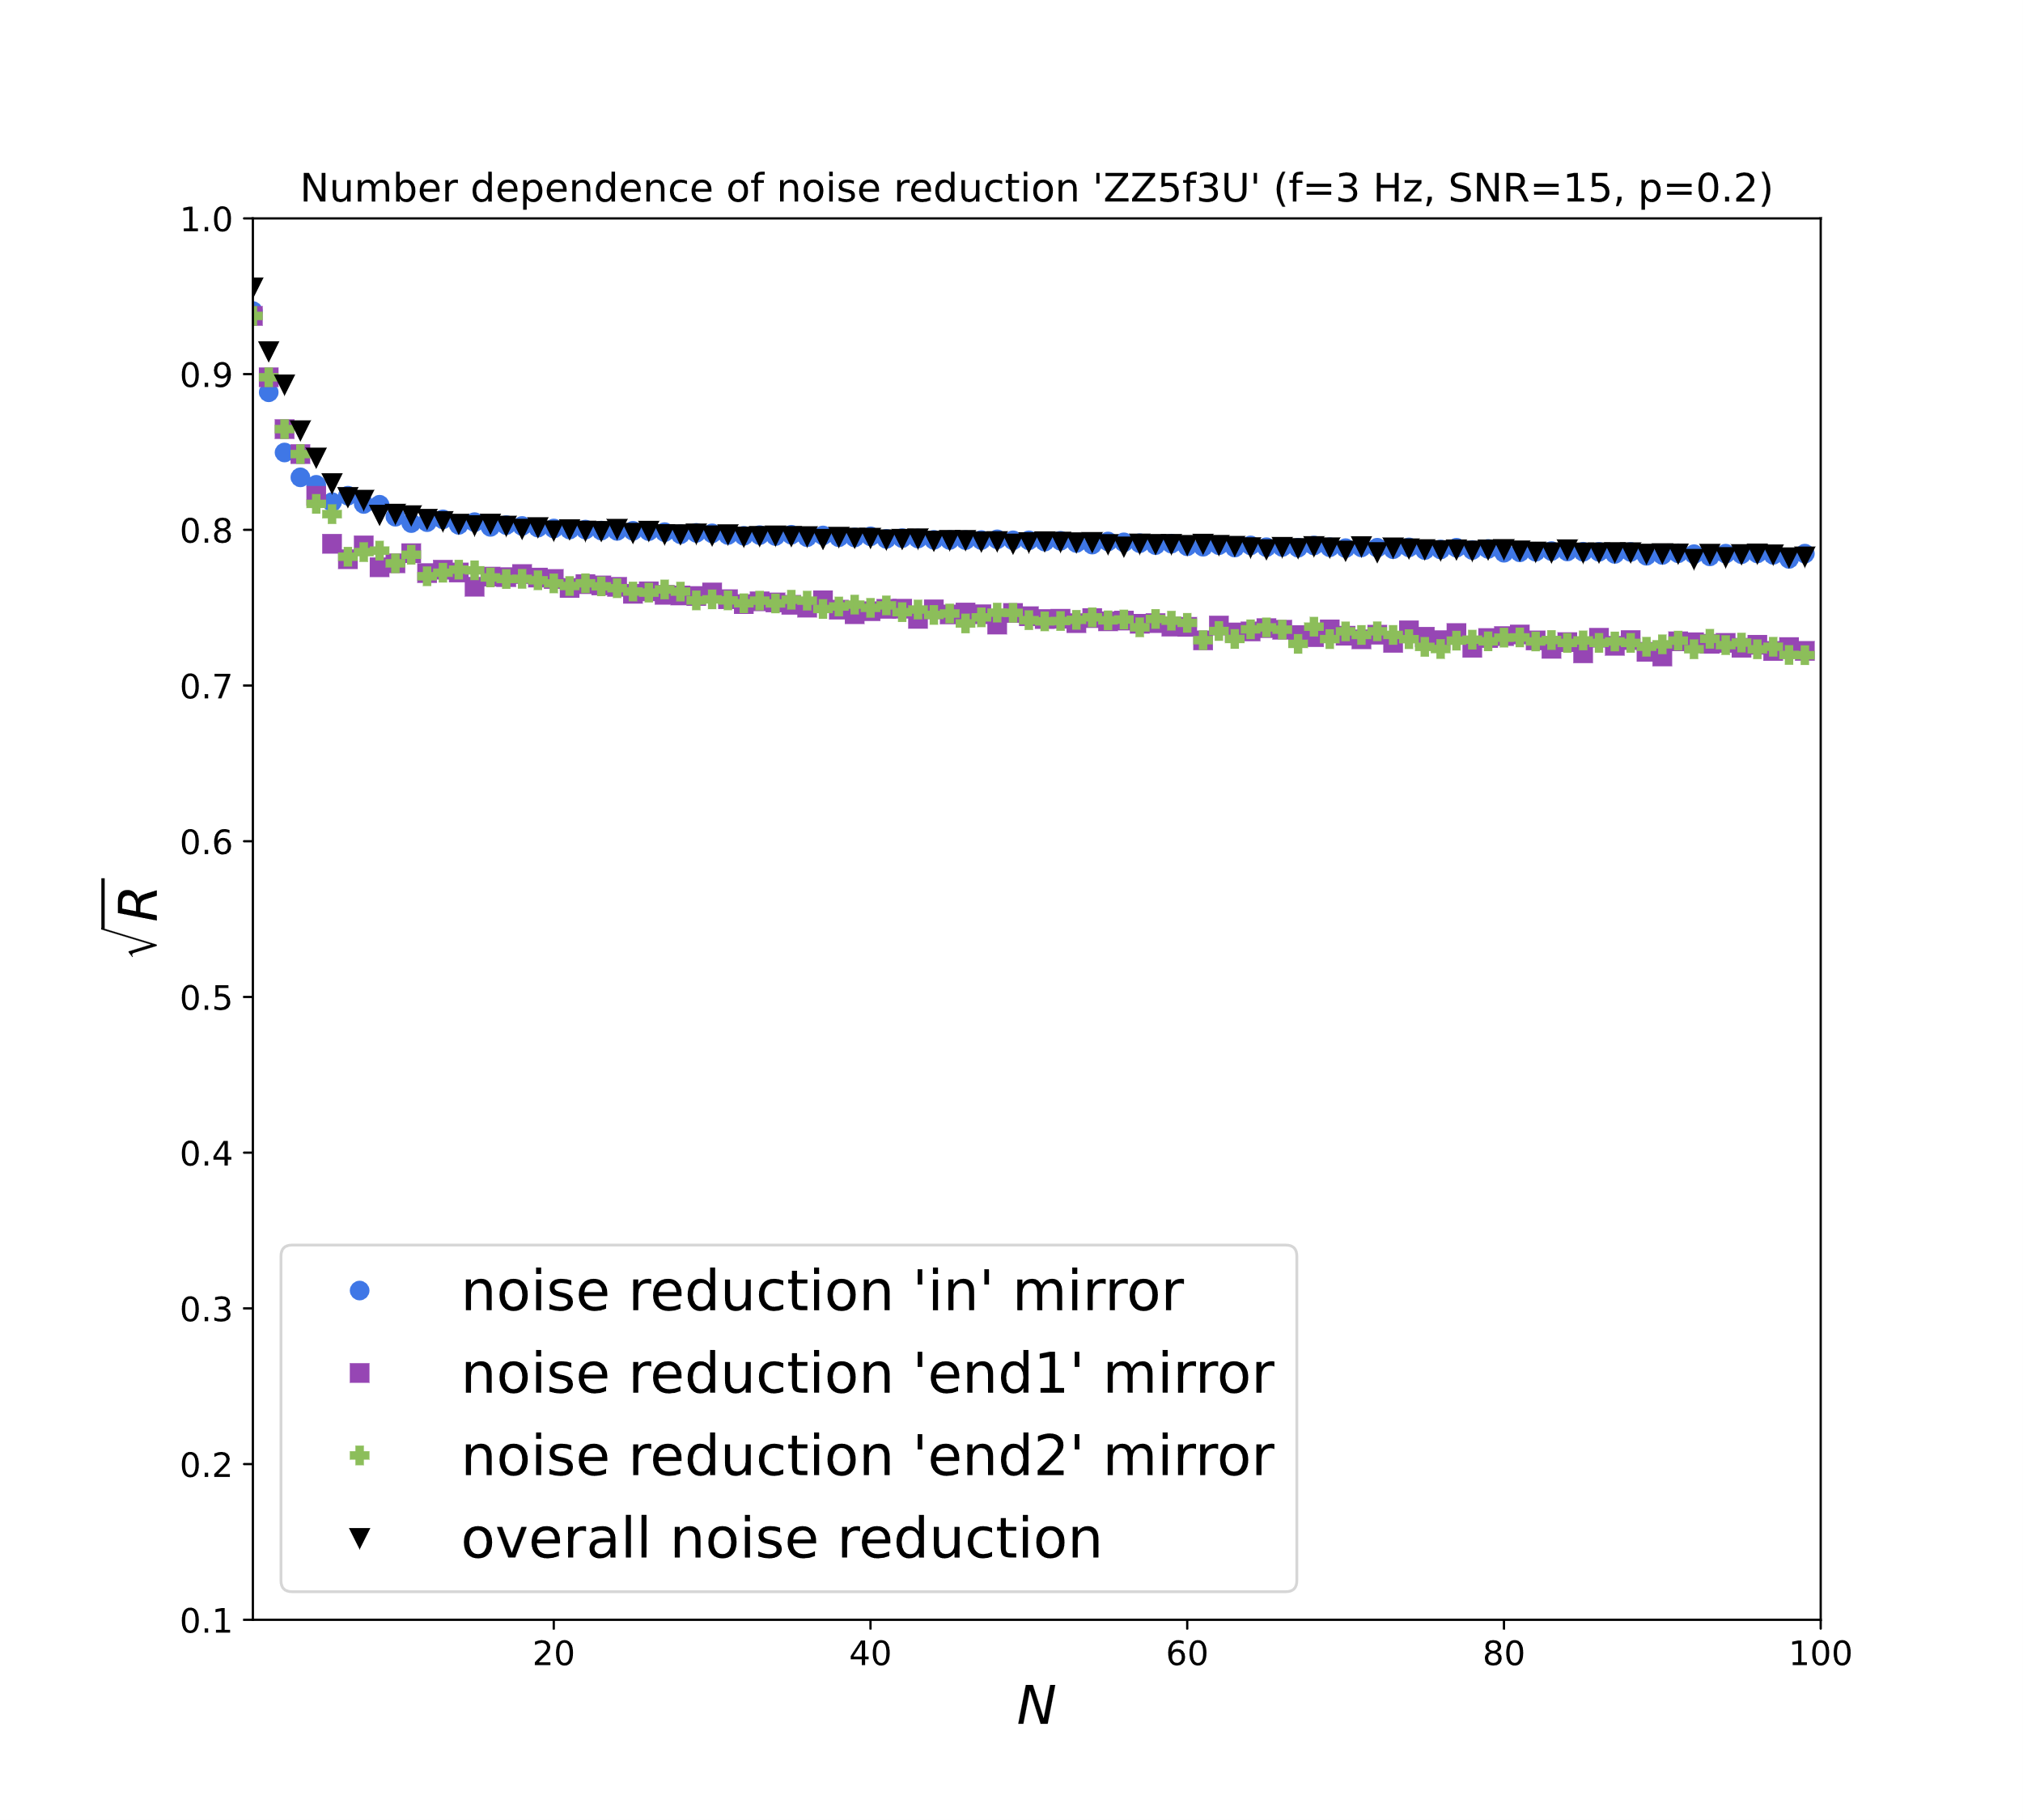
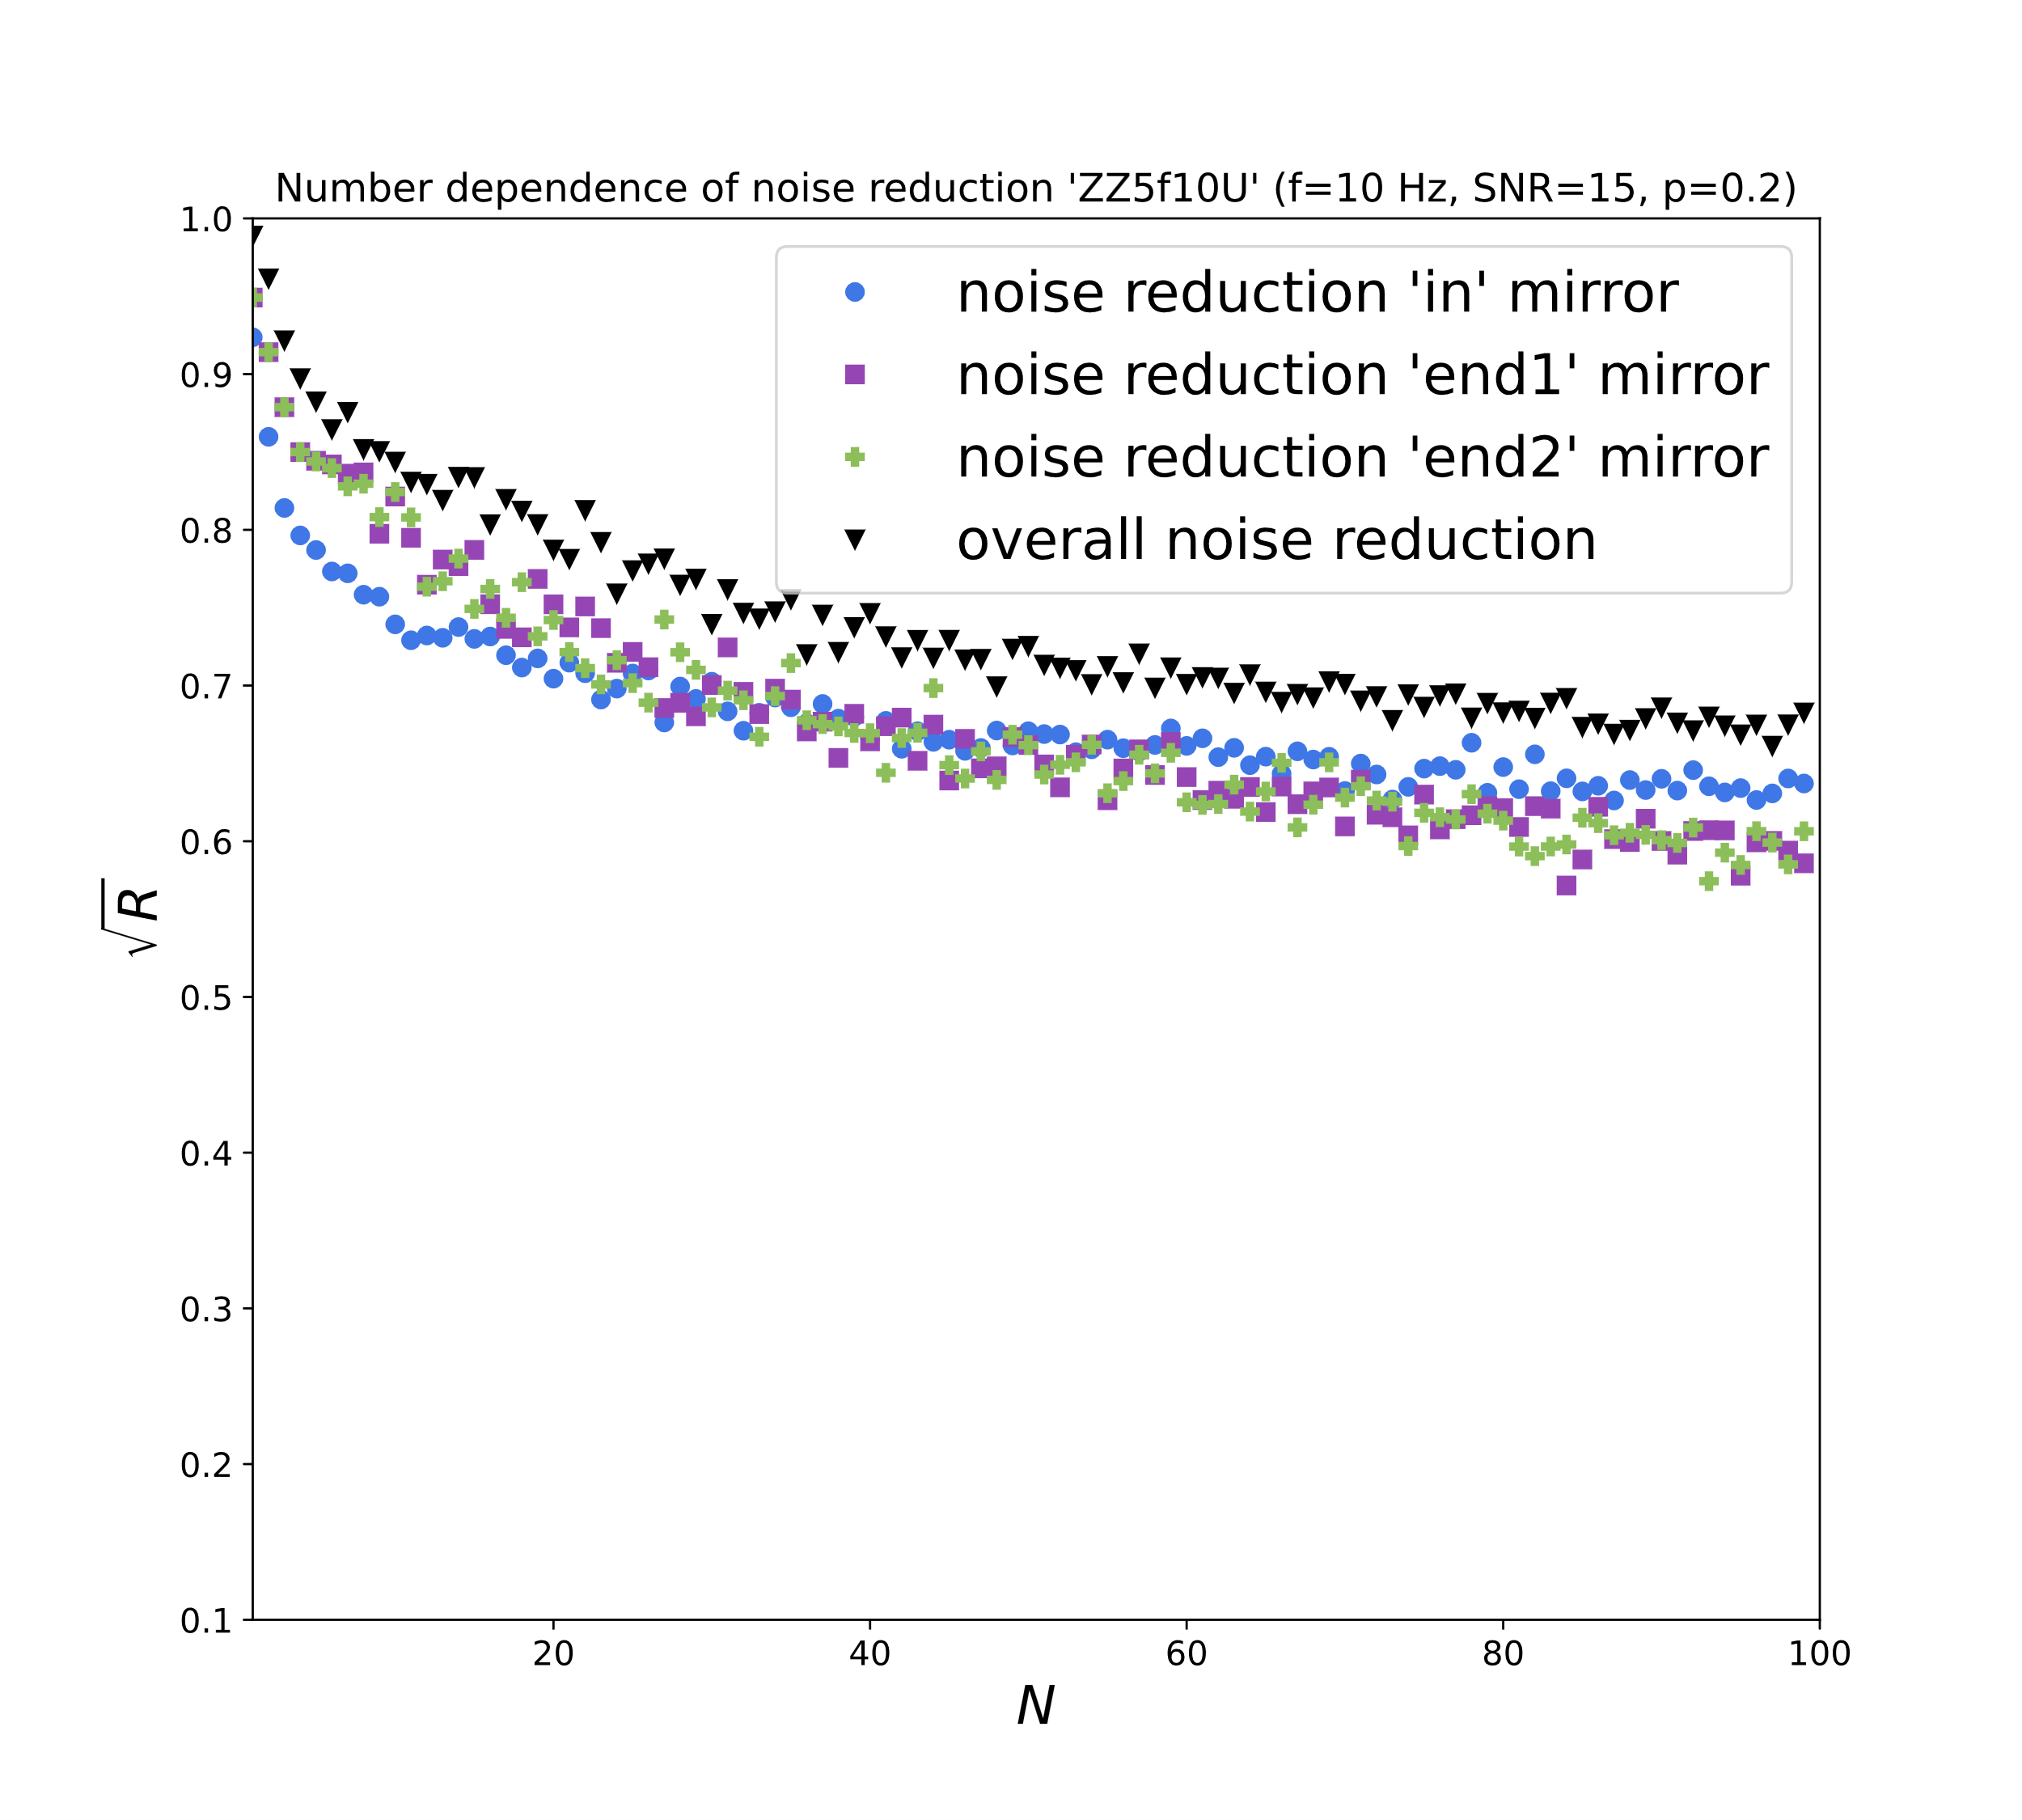
…for Different Frequencies
end2 +
in ●
end1 ■
19%
30%
Baselines between pairs of seismometers are of wavelength order in more directions and closer to the mirrors if wavelength is shorter
→Better NN estimation for higher f
1 km
5 km

Slide 18
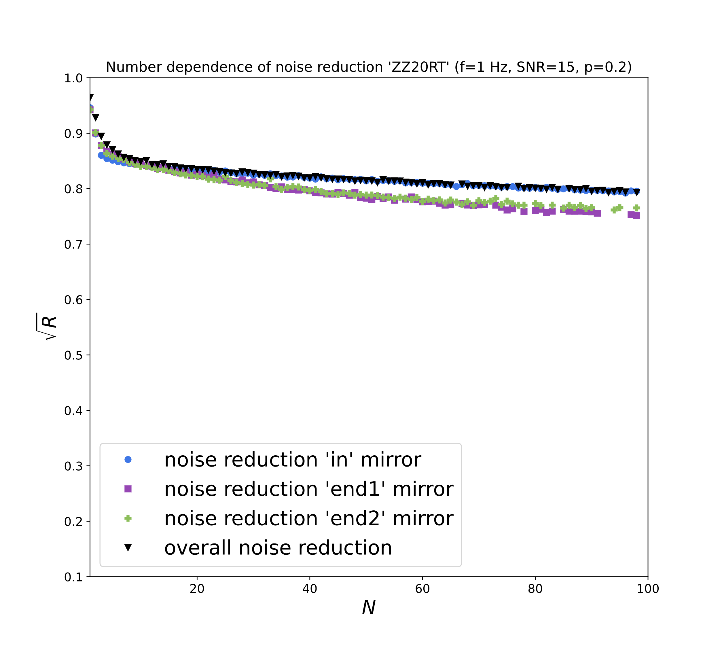
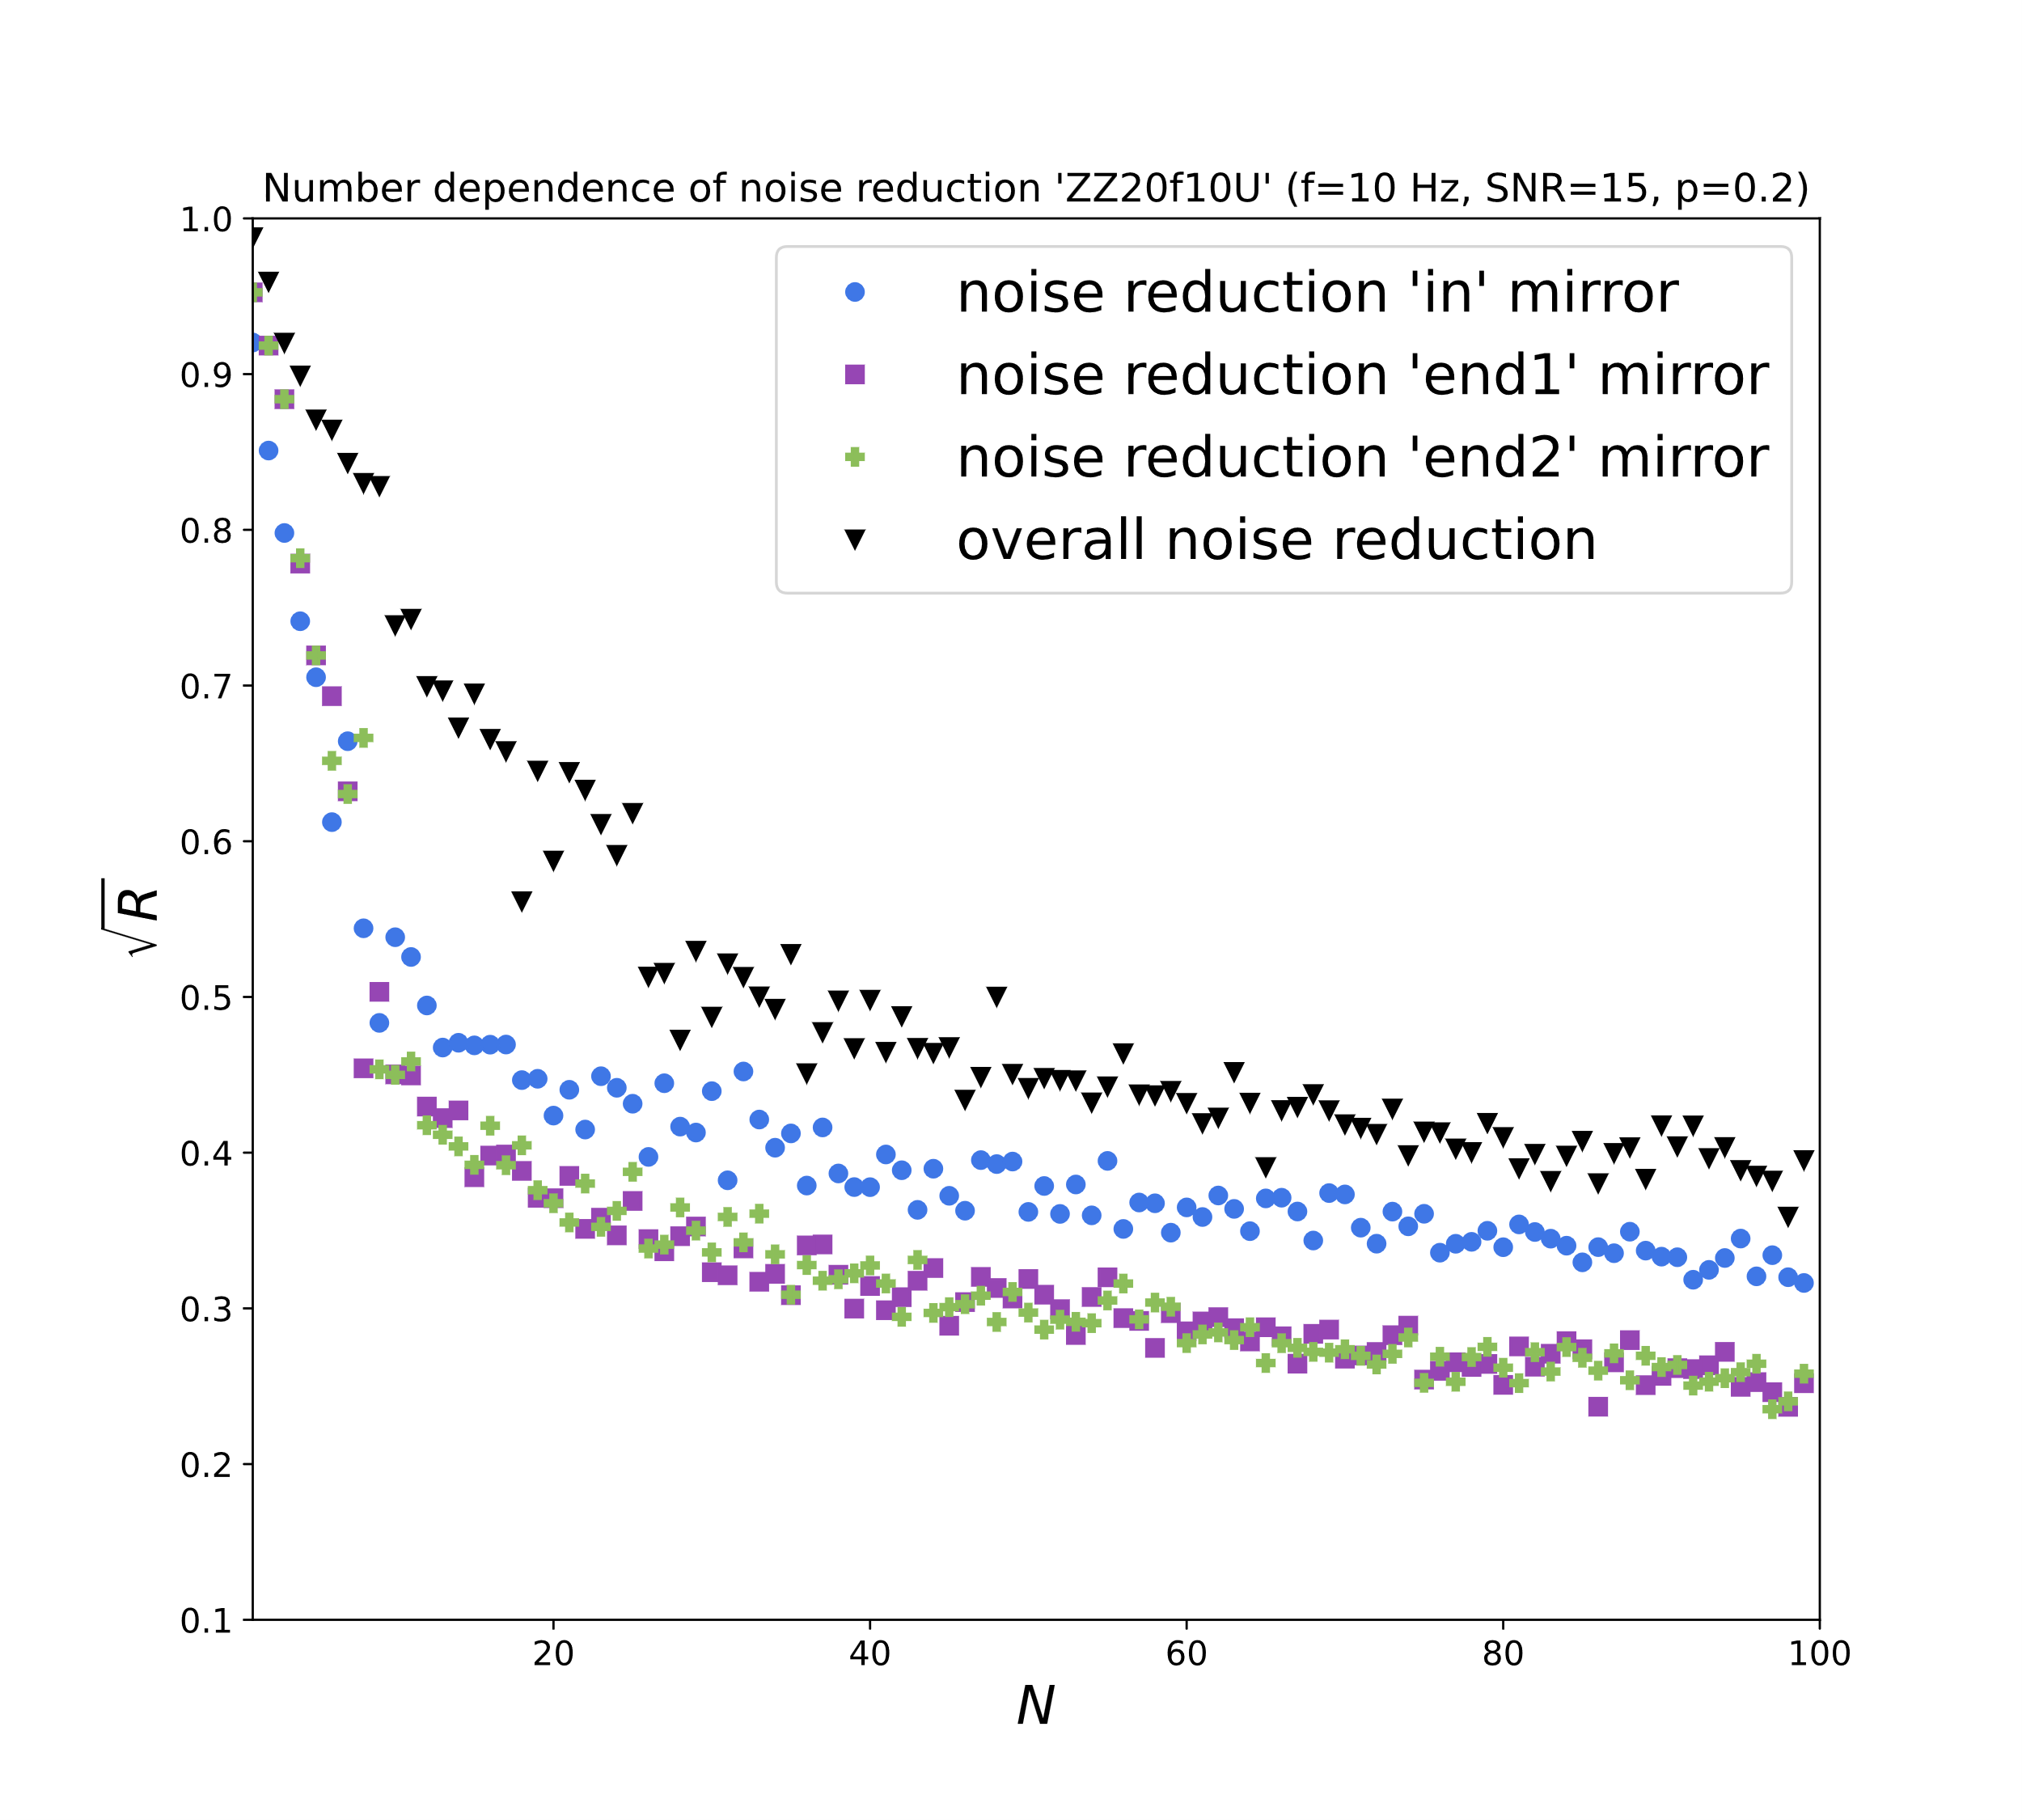
…for Different Tunnel Radii
end2 +
in ●
end1 ■
18%
60%
With a similar argument as before, slight drilling into cavern walls can lead to great improvement, especially for high f
Tunnel radius = 20m

Slide 19
Gain from in-Tunnel Optimization
end2 +
in ●
end1 ■
20 → 17 boreholes with additional in-tunnel seismometers
Similar effects with already placed seismometers
Combined in-tunnel and volume optimization with regard to actual cost (€) will follow
underground
+
tunnel surface

Slide 20
Simulations
Towards a more realistic optimization

Slide 21
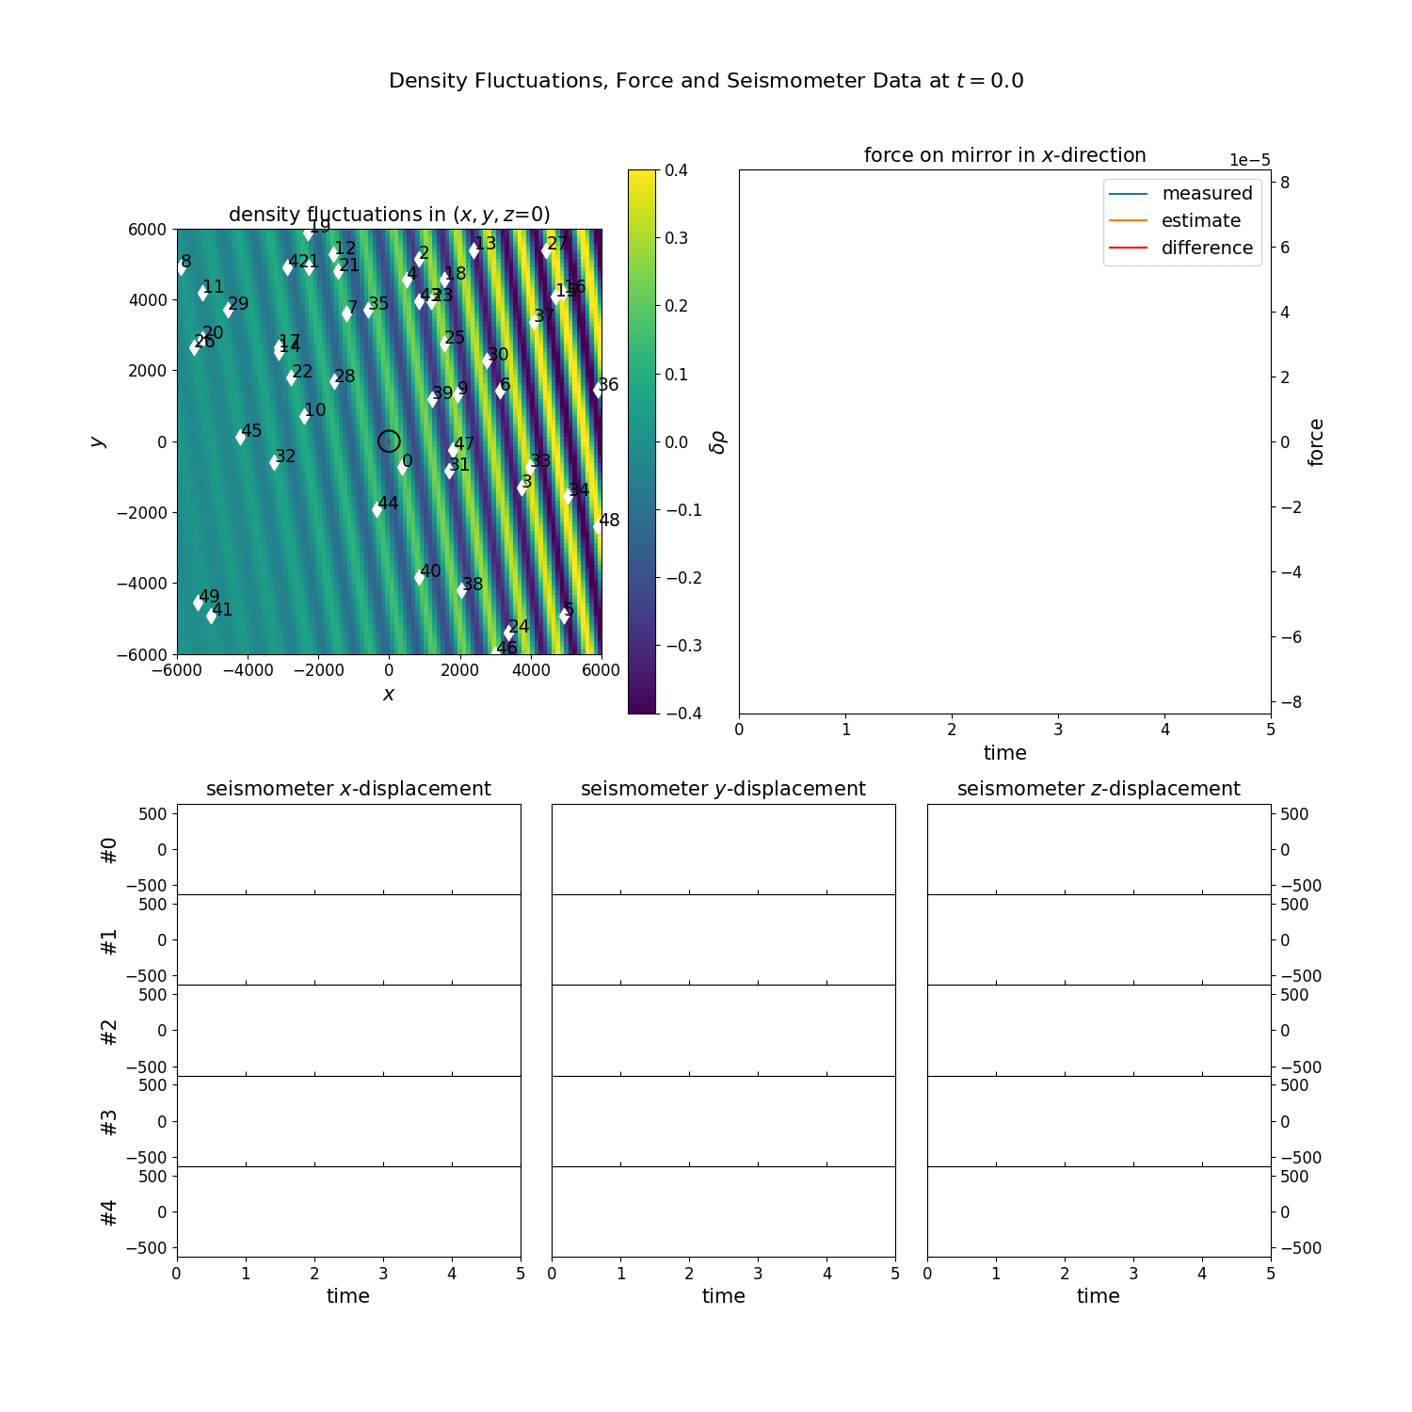
Seismic Simulation
Real-time prediction of Newtonian Noise for wave packages, moving away from the analytic calculation
Simulation of density fluctuations generated by p waves from far away, time-limited sources
Seismometer projection in z=0-plane
Cavern
Force on mirror (x-direction)
Example seismometer data
WF*seismometer data (WF from correlations of large number of previous simulations)

Slide 22
Summary
Many results by Francesca, Jan et al. reproduced for < 20 seismometers
Optimization for > 20 seismometers now possible but probably needs other optimization methods → ongoing work with gradient-based methods
Performed studies of adding seismometers in tunnels → can reduce number of necessary boreholes
Working towards a more realistic optimization based on simulations

Slide 23
Backup

Slide 24
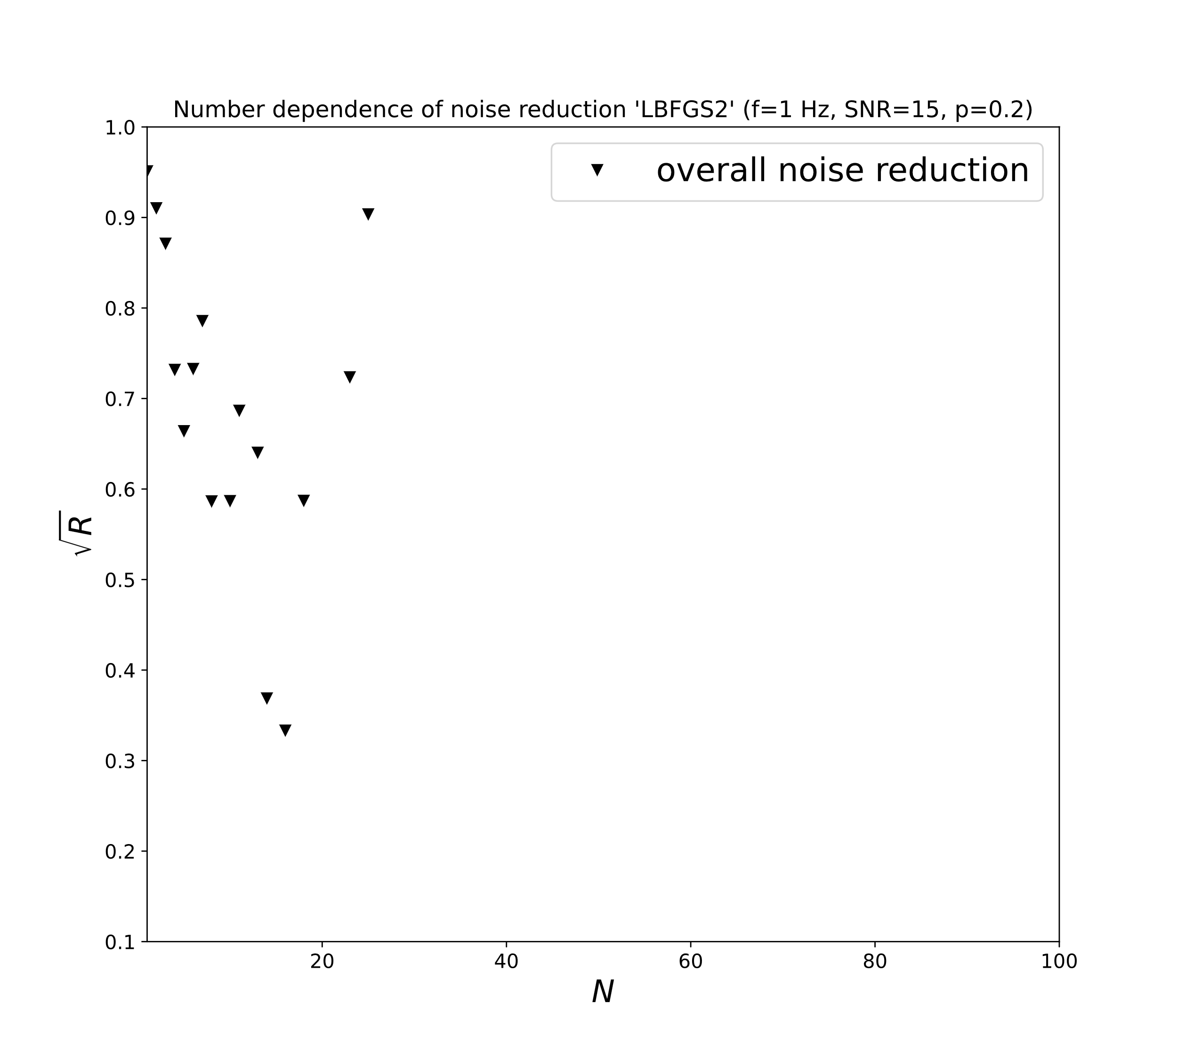
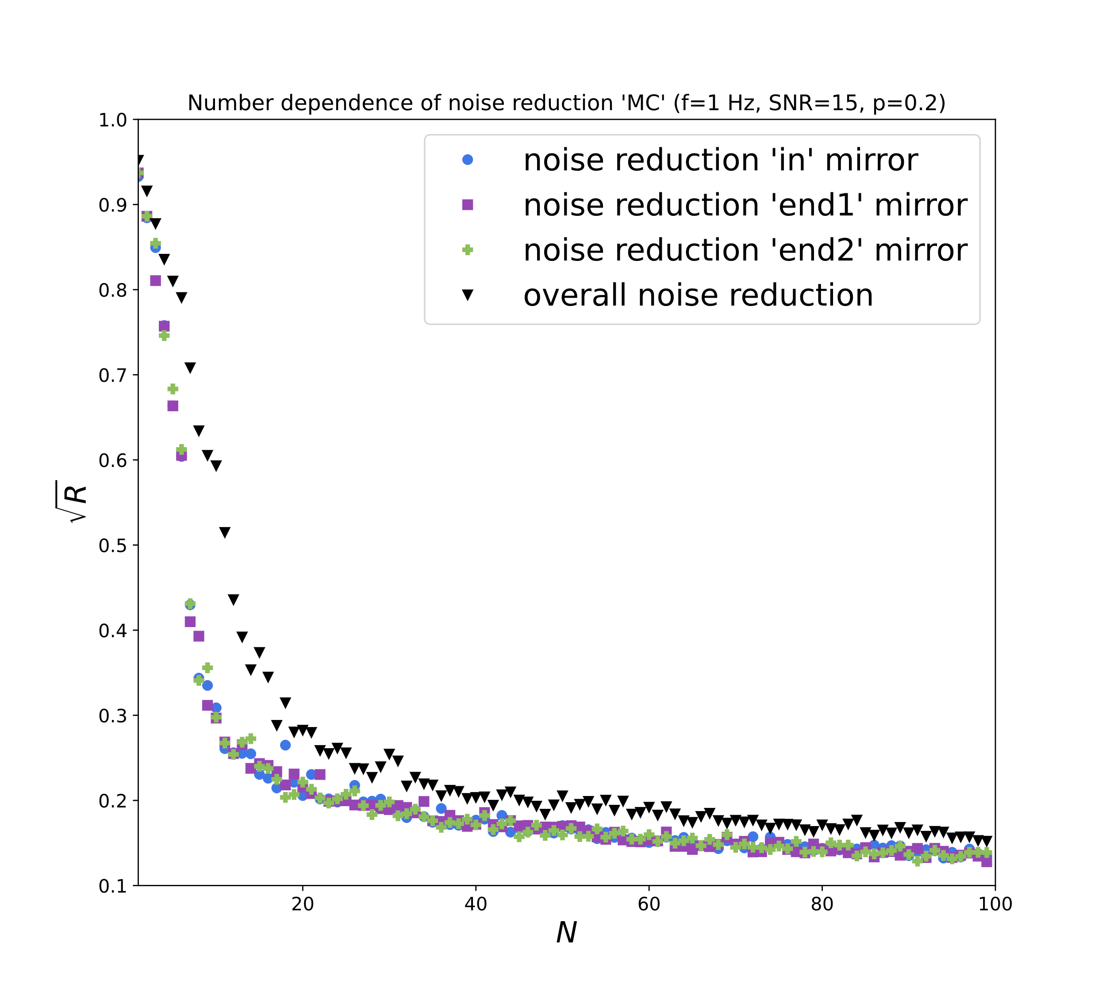

LBFGS-Results
Preliminary

Slide 25
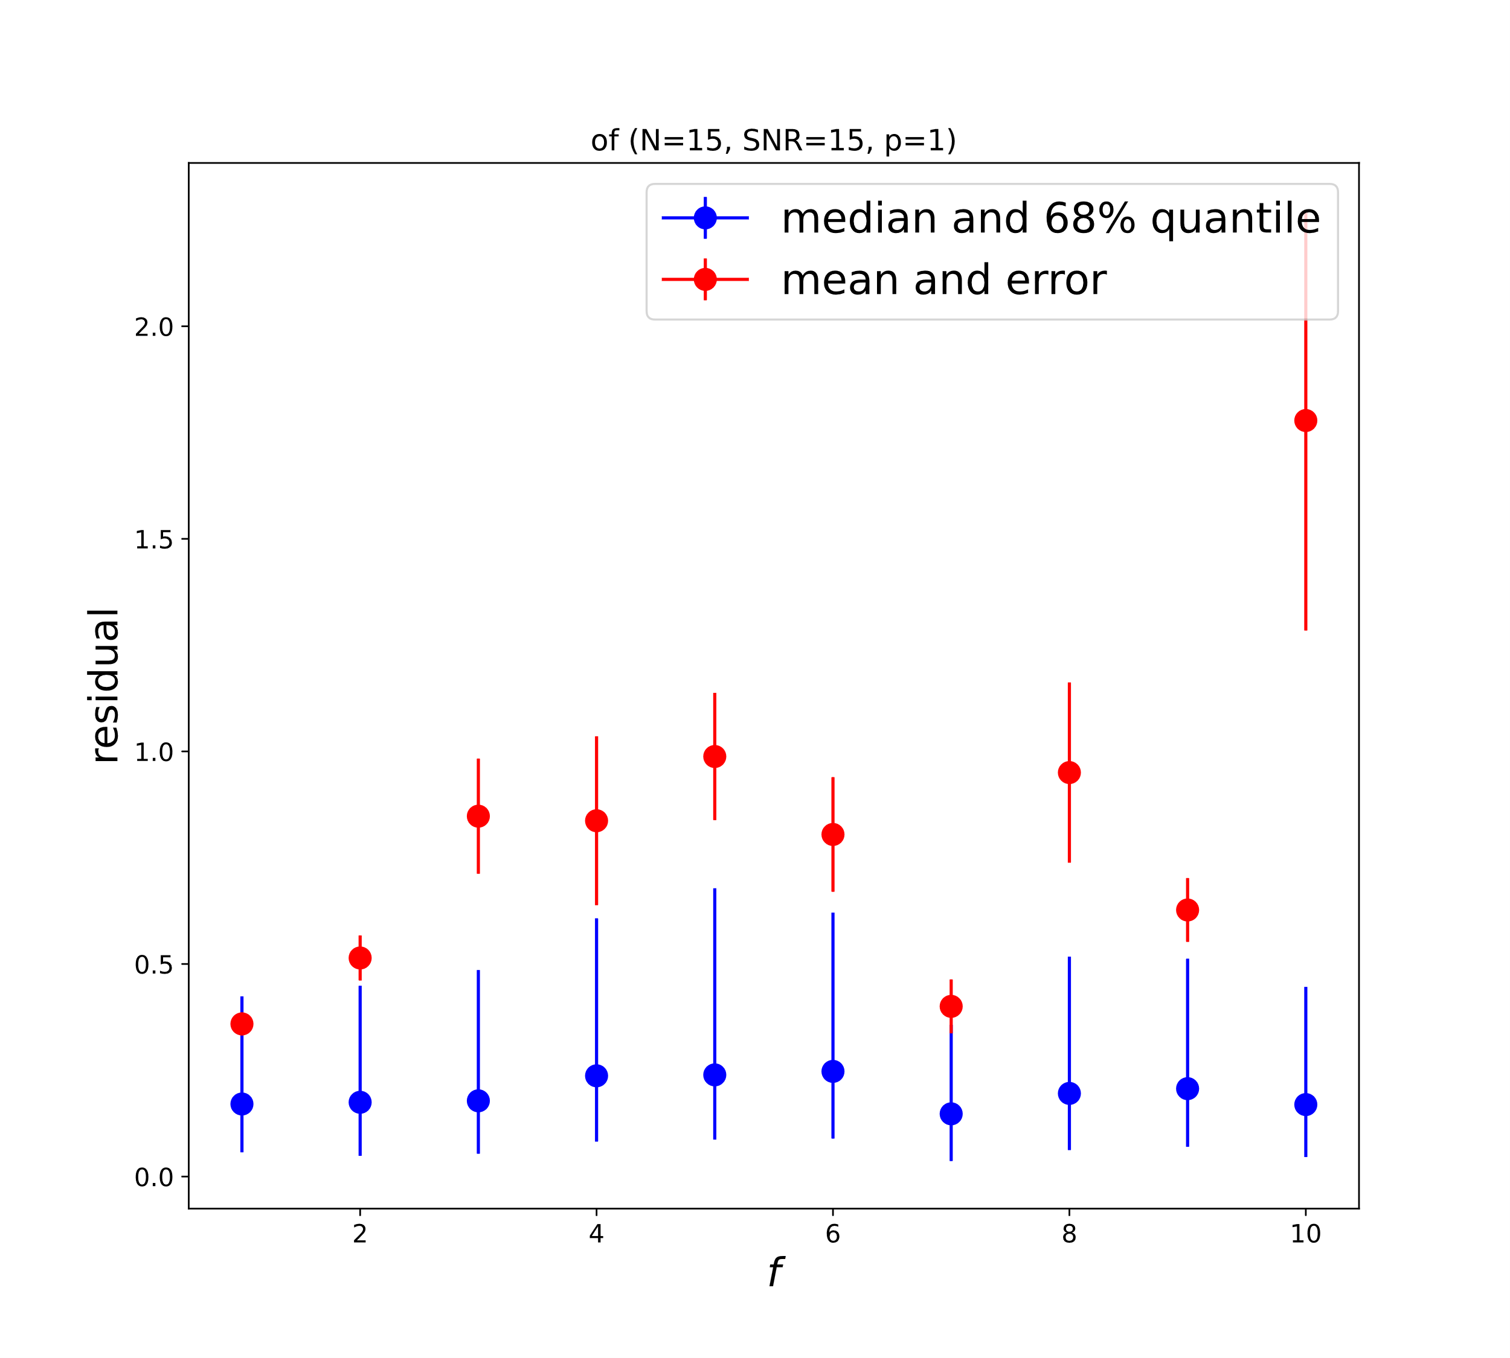
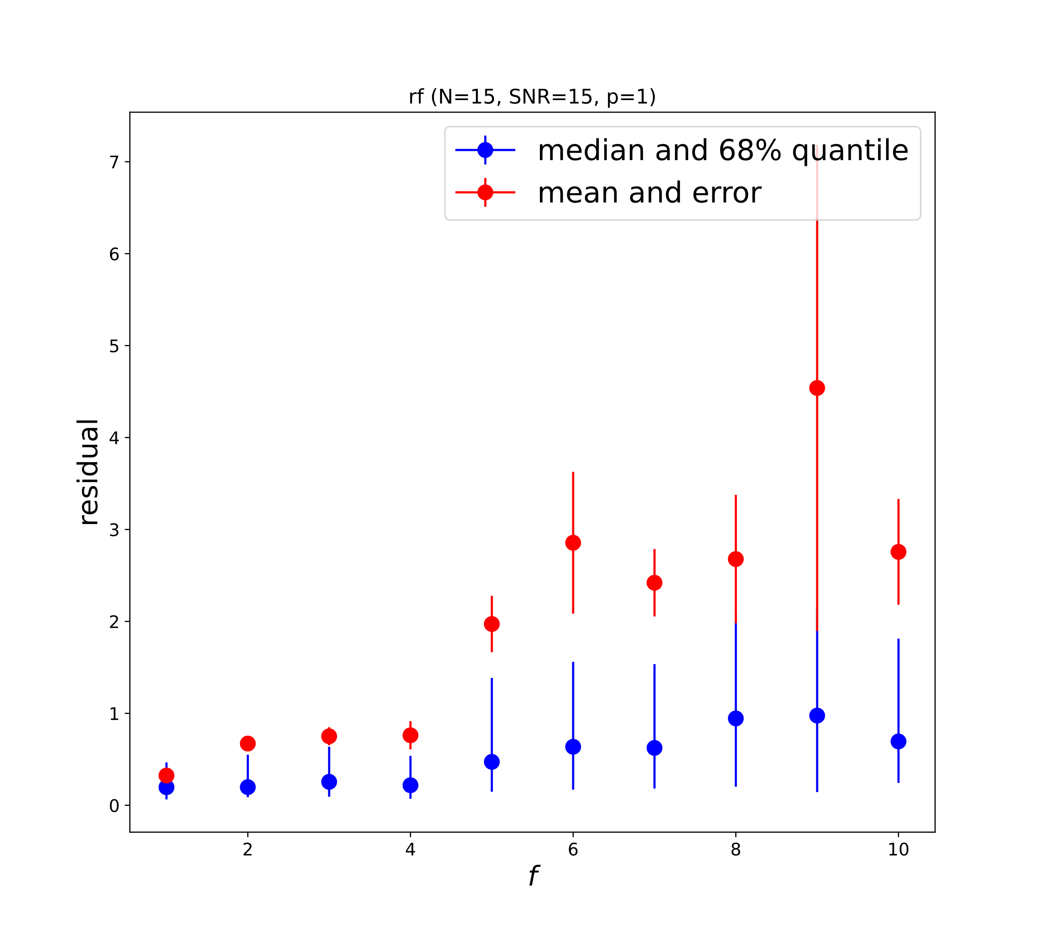
Confidence for Analytical Results
Plain waves, WF in frequency space
4500 training, 500 test
Preliminary
Optimized positions
Random positions

Slide 26
Question: Limit of optimization?
Why can I find a simple grid that is better than all my optimization attempts?

Slide 27
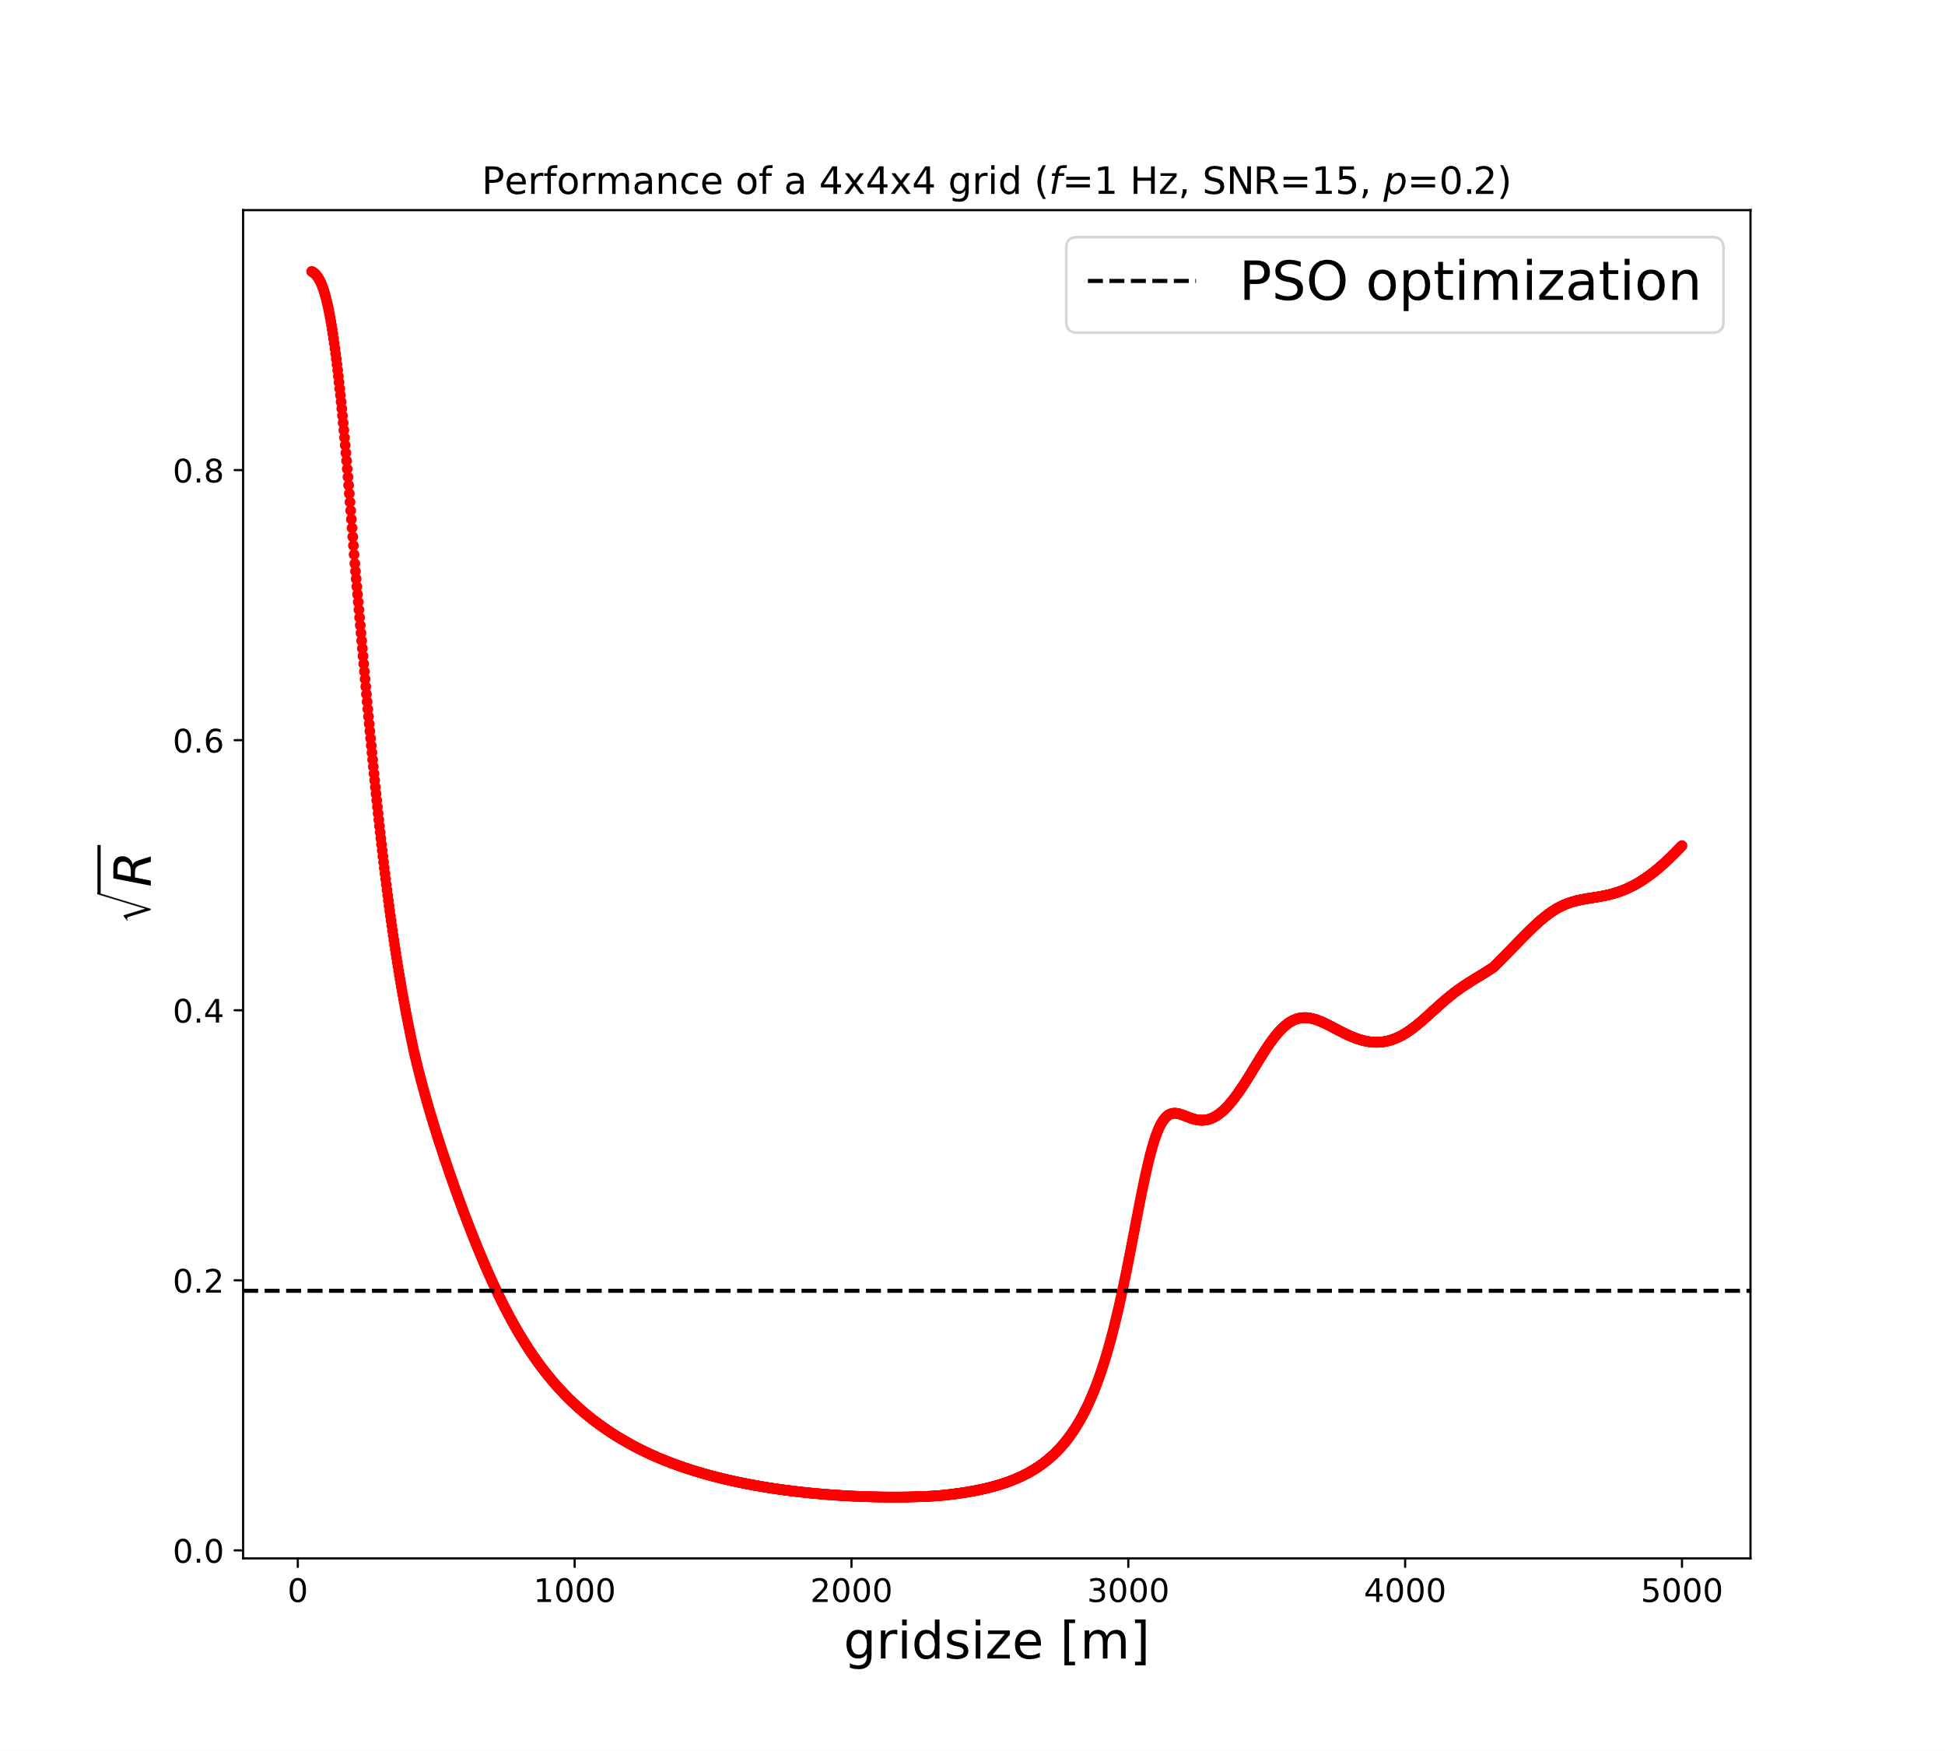
Performance of a simple grid
Residual from taking the positions as a 4x4x4 regular cubic grid with a total size of 2*gridsize centered at (0,0,0) – the corner of ET
=DE<=ADAM for N=64 and the given parameters
For distances between seismometers close to a quarter of the wavelength, performance is best – even better than all optimization attempts. That‘s depressing. ☹
Complicated optimization algorithms may not really find the global minimum. A regular grid isn‘t even the best one can imagine.
Is this good news, because in a 1d-minimization it is much, much simpler?
Is this bad news, because if a grid is not a good choice, will the optimizers be? Can we find good positions in all geometries?
Is this no big deal, because we do not need the global minimum, but are happy with a local one?

Slide 28
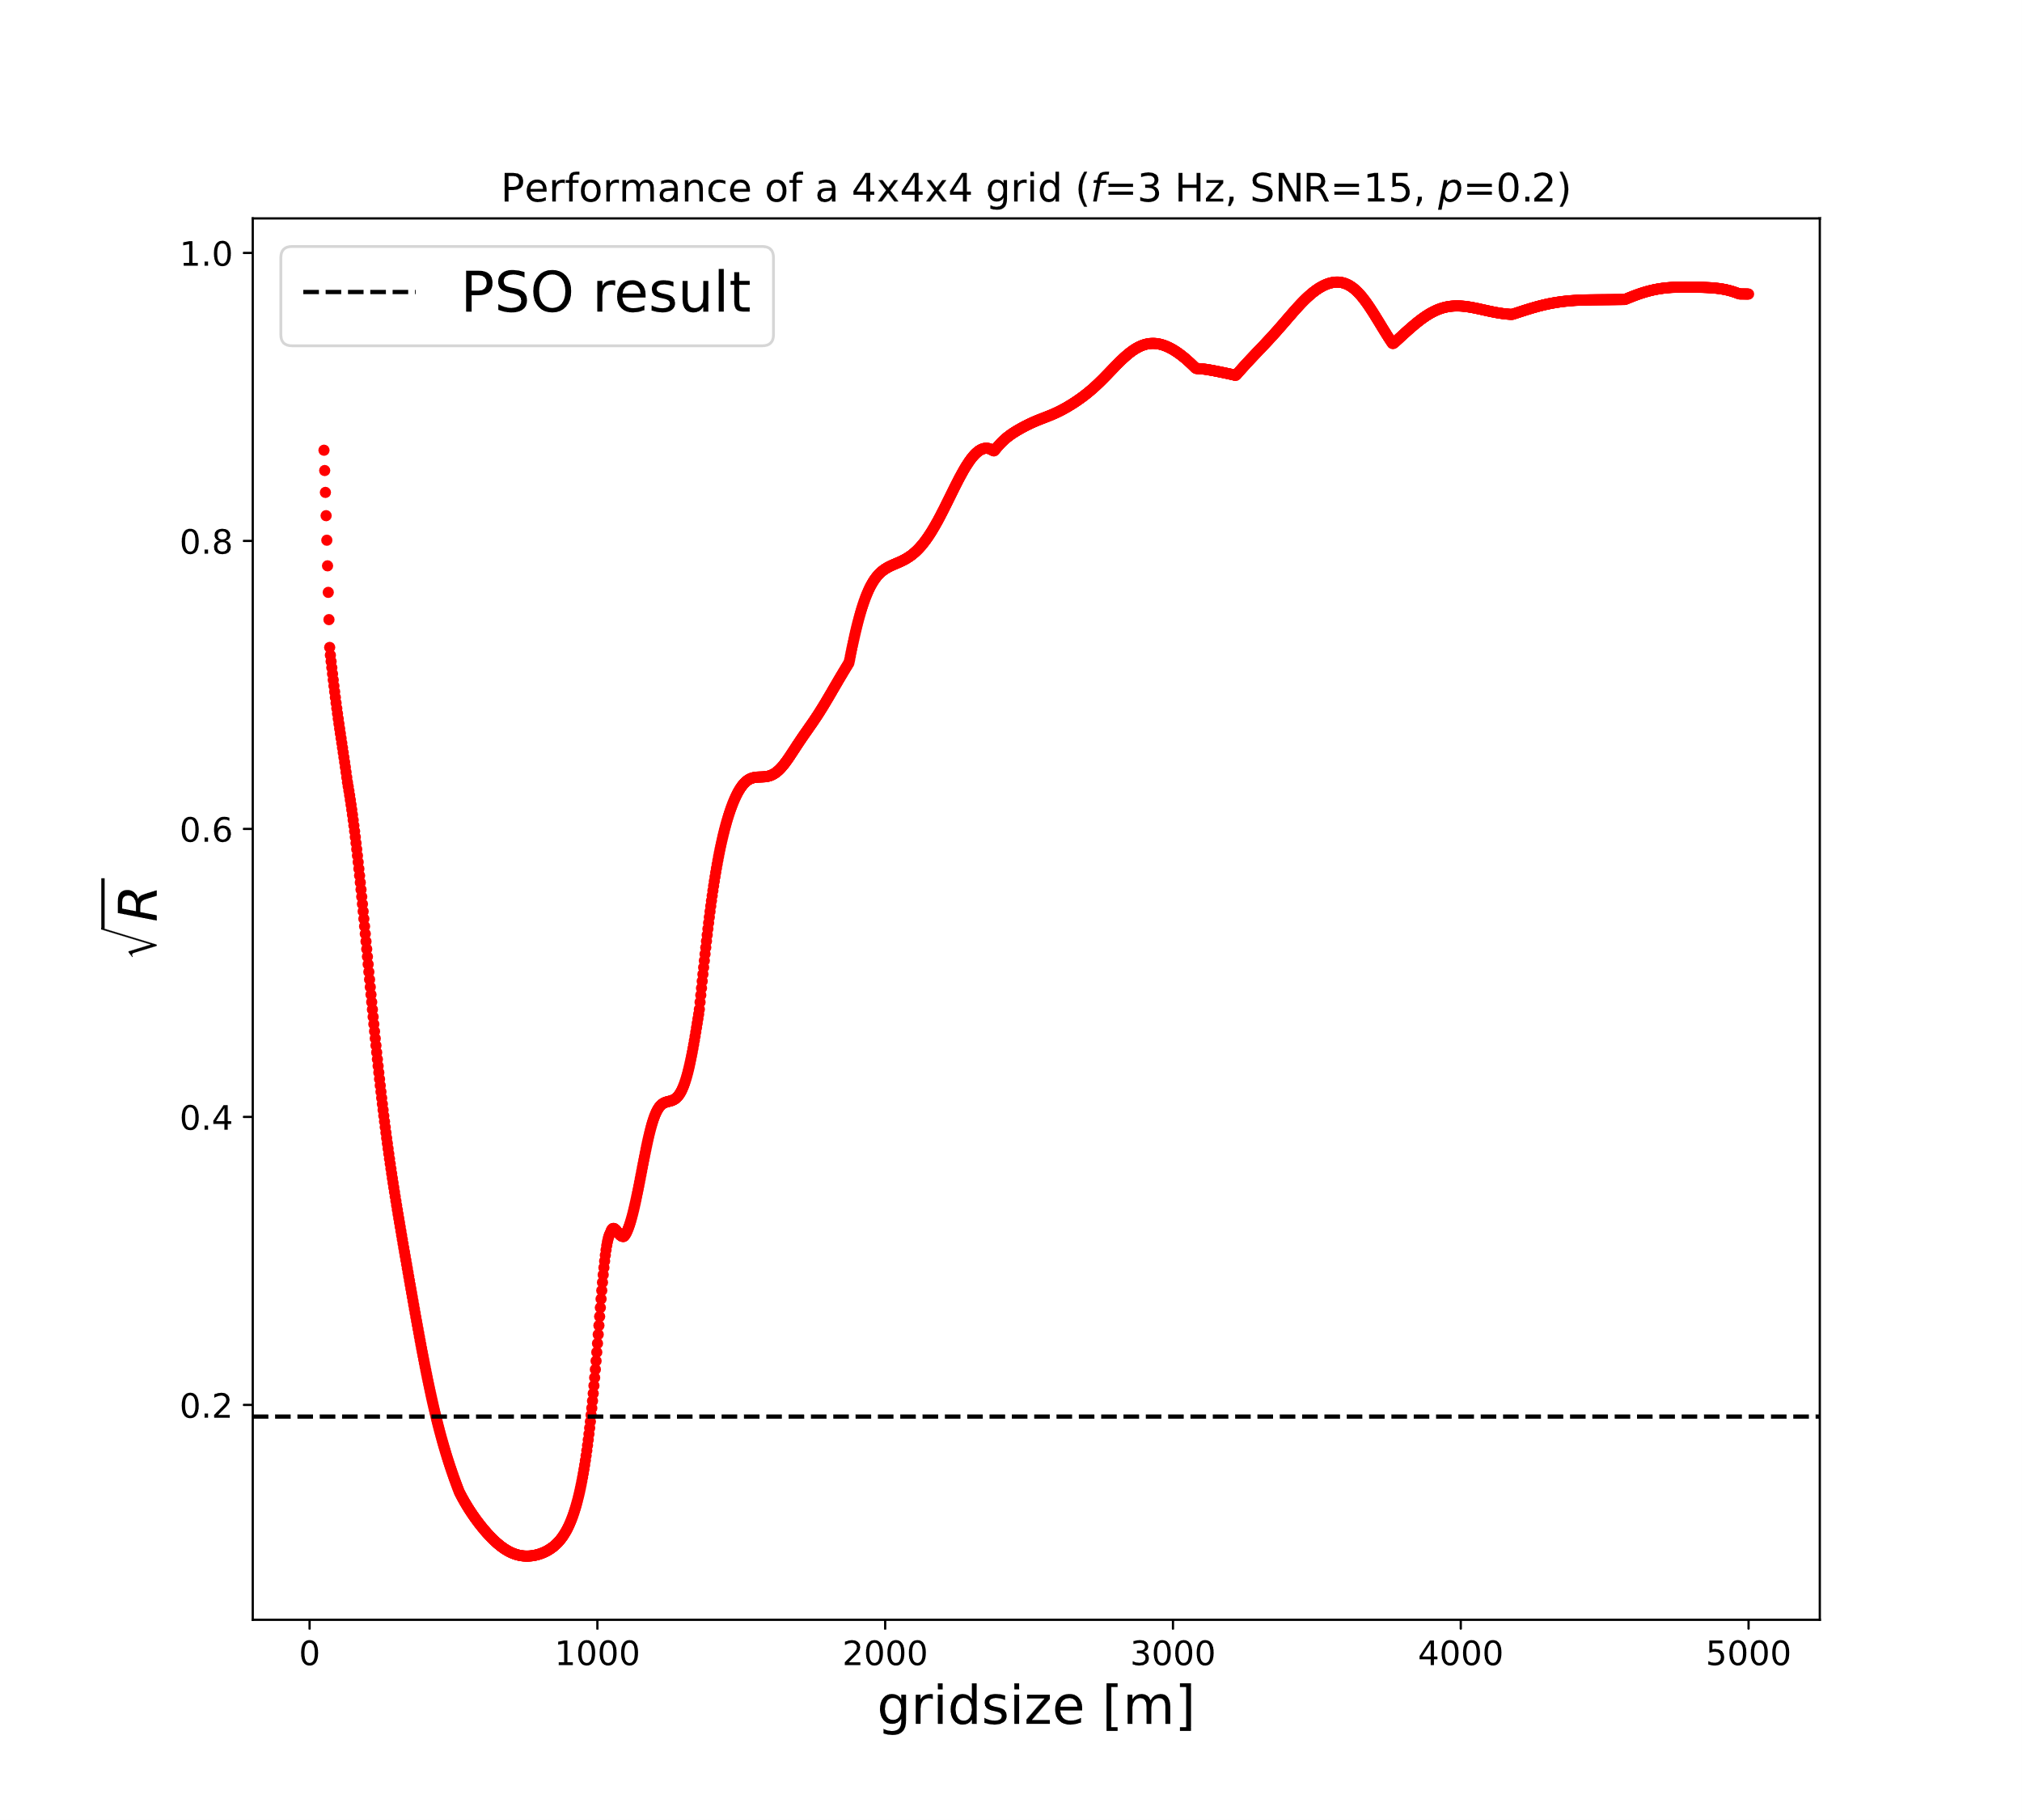
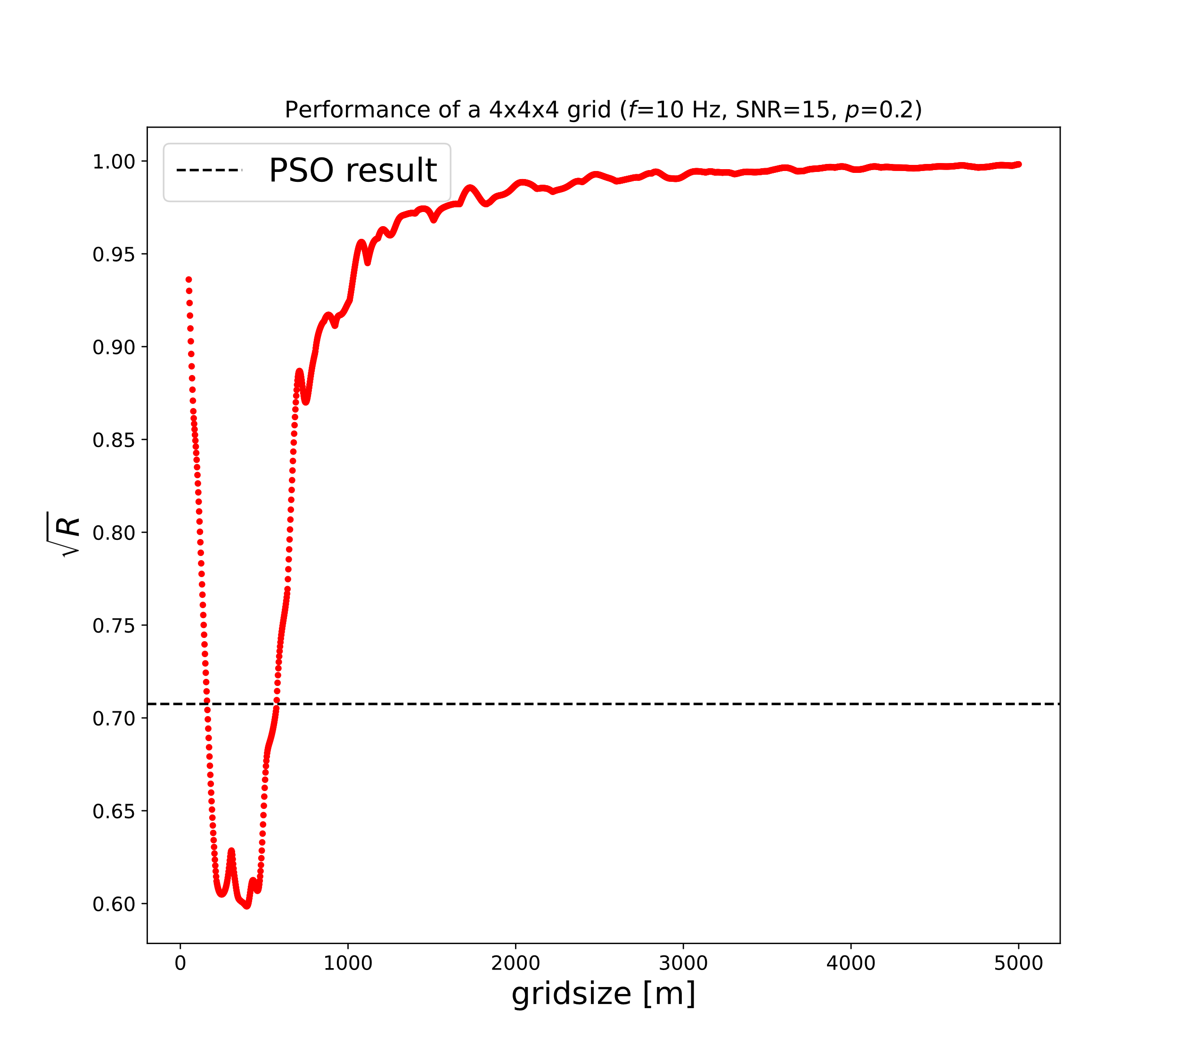
Additional grids

Slide 29
Question: What is the gain of the special treatment for the inner mirrors?
Why going through the trouble of summarization if there is no difference to seperated treatment?

Slide 30
Treatment of in-Mirrors
Summarized in mirrors
There is no significant improvement gained when treating the inner mirrors differently from the outer
Understanding and calculating is simpler when treating every mirror the same
Is there any advantage I am missing?
Please swap the slides →

Slide 31
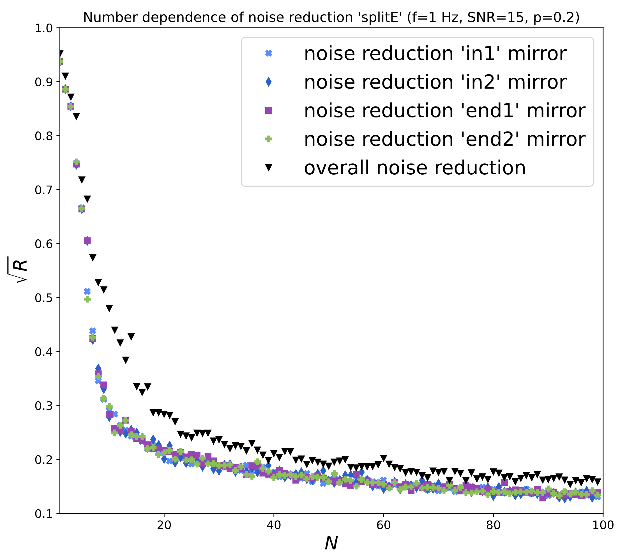
Treatment of in-Mirrors
Divided in mirrors
There is no significant improvement gained when treating the inner mirrors differently from the outer
Understanding and calculating is simpler when treating every mirror the same
Is there any advantage I am missing?
Please swap the slides ←

Slide 32
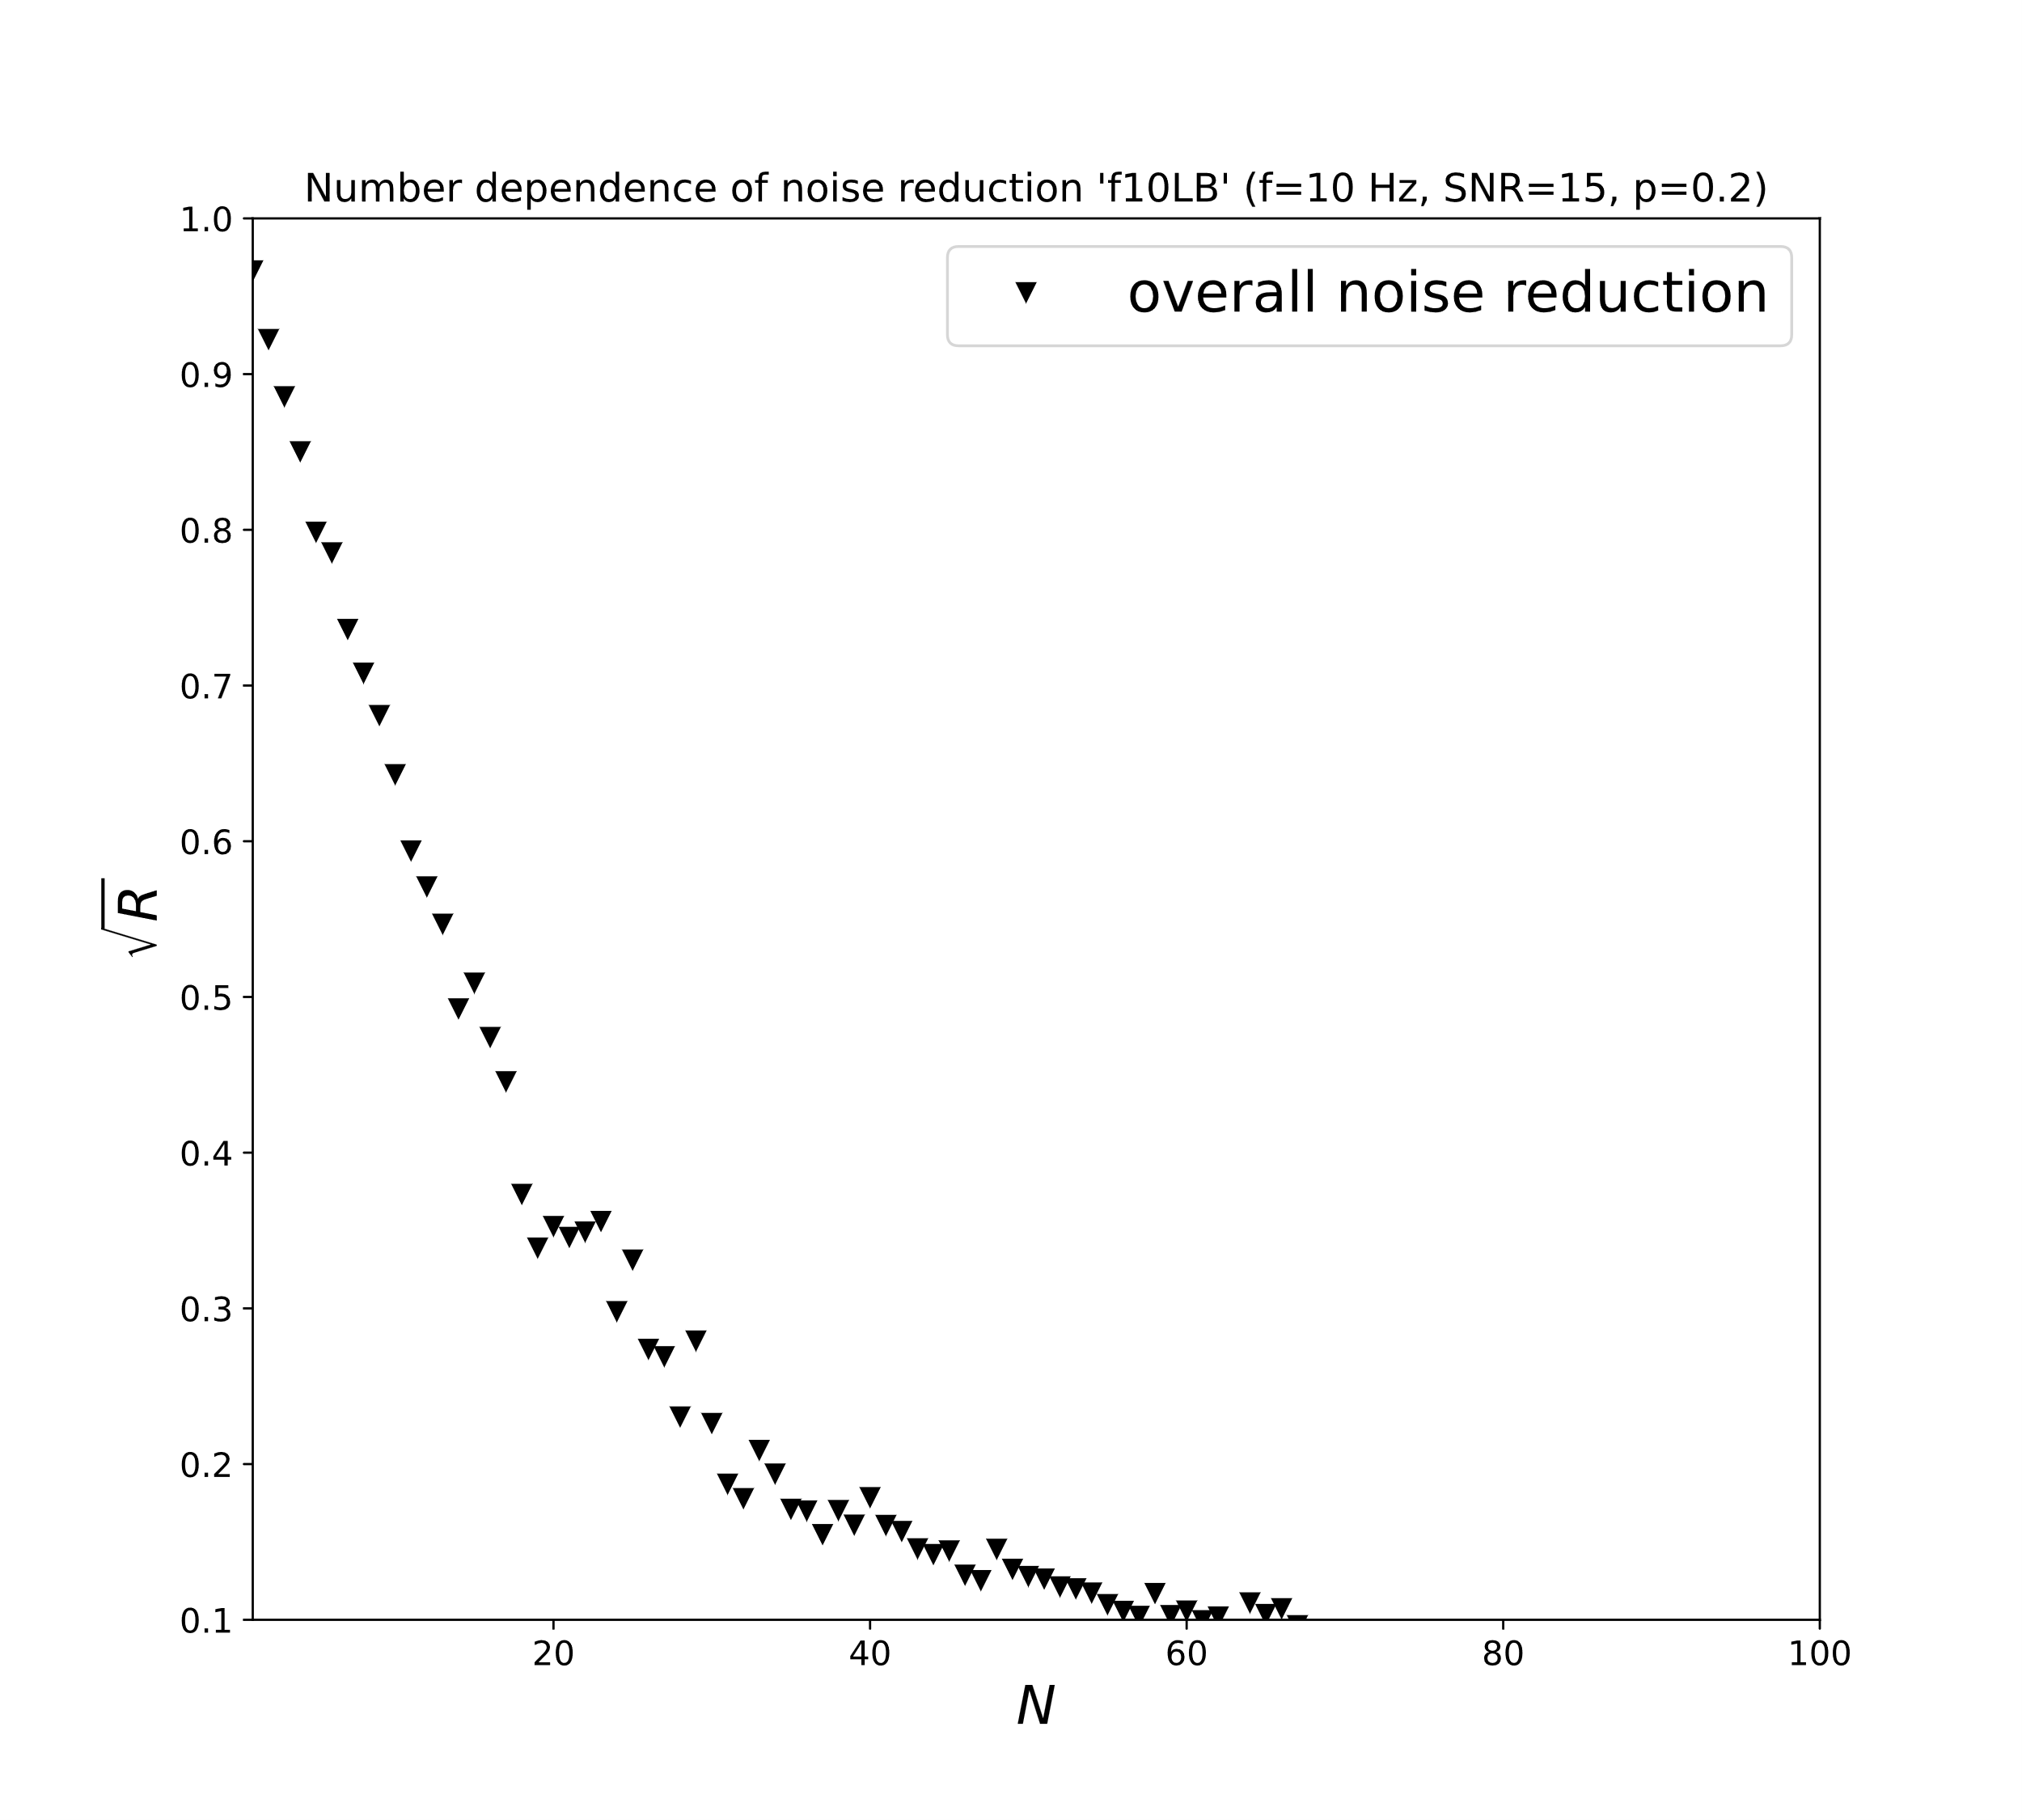
f=10 Hz split in
2 km
Please swap the slides →

Slide 33
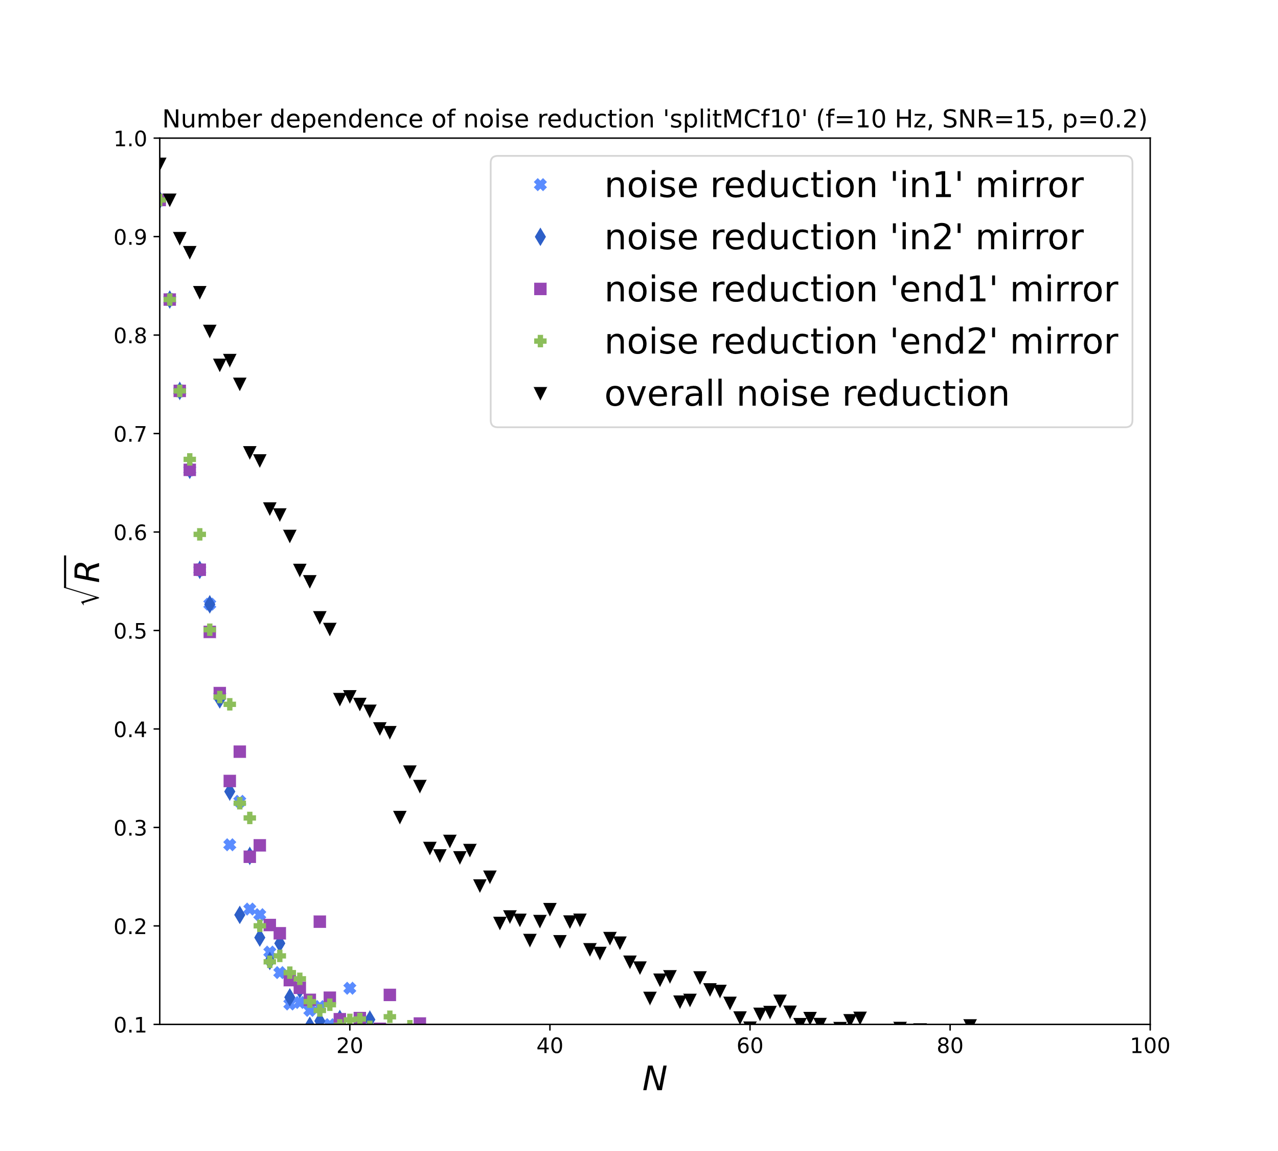
f=10 Hz split in
2 km
Please swap the slides ←

Slide 34
Comparison with Random positions
Does the optimization provide any gain?

Slide 35
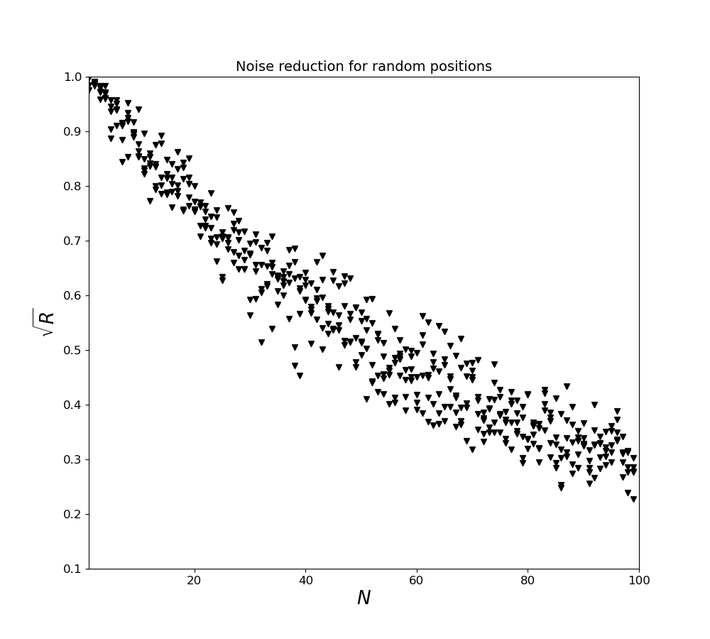
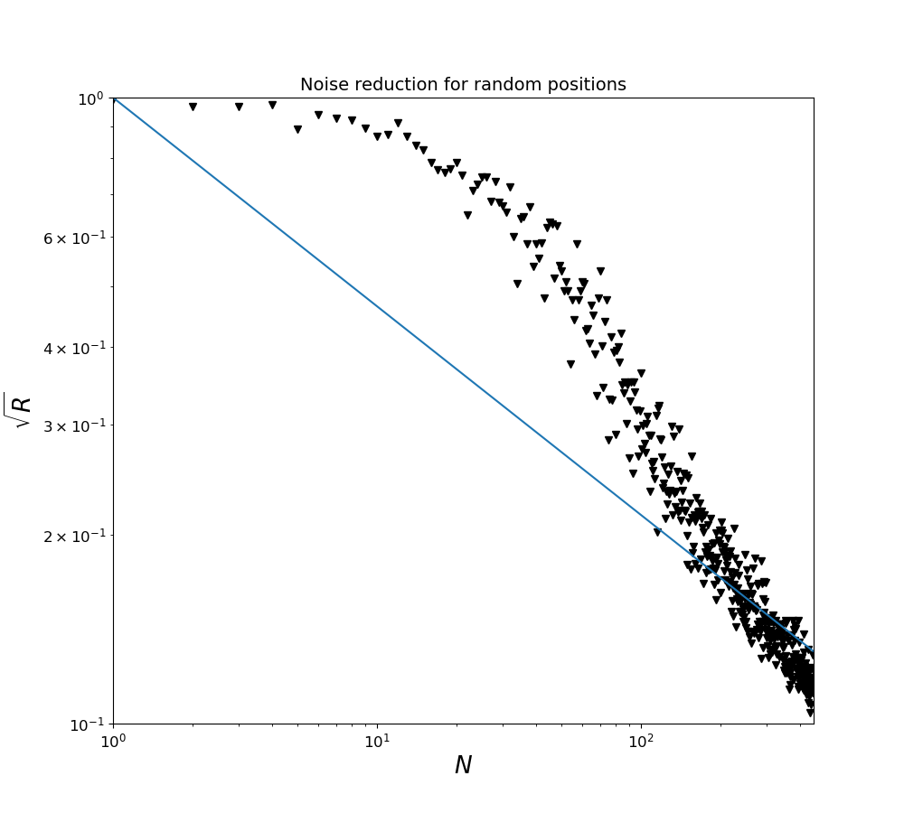
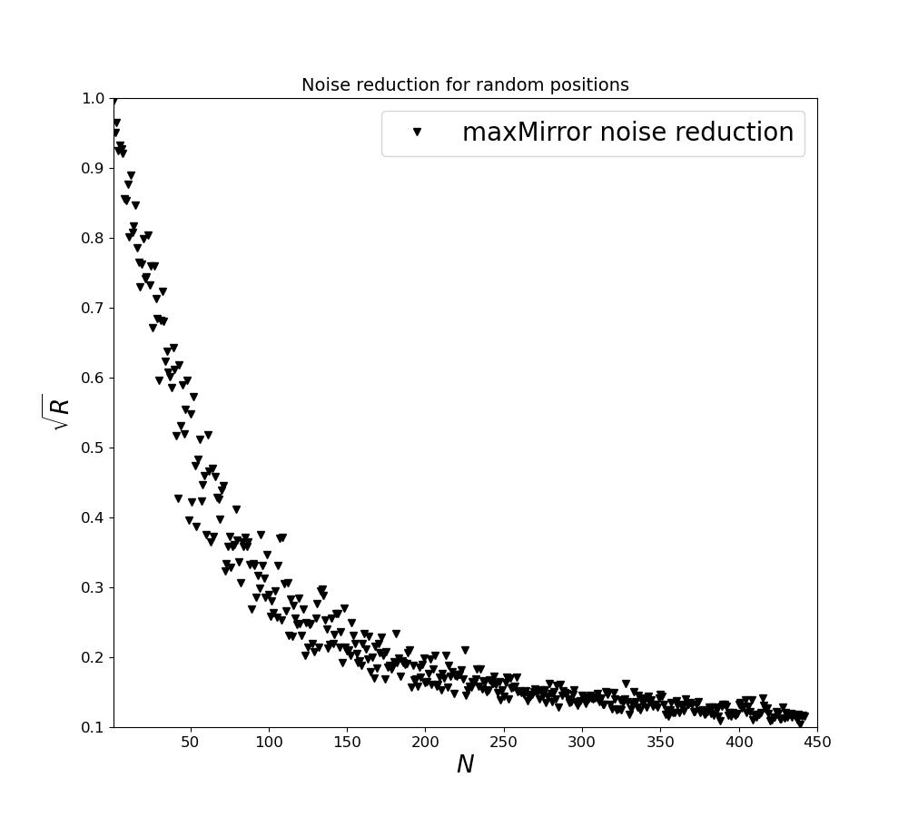
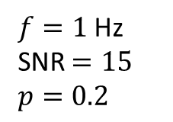
Random
$f=1$ Hz
SNR $=15$
$p=0.2$

Slide 36
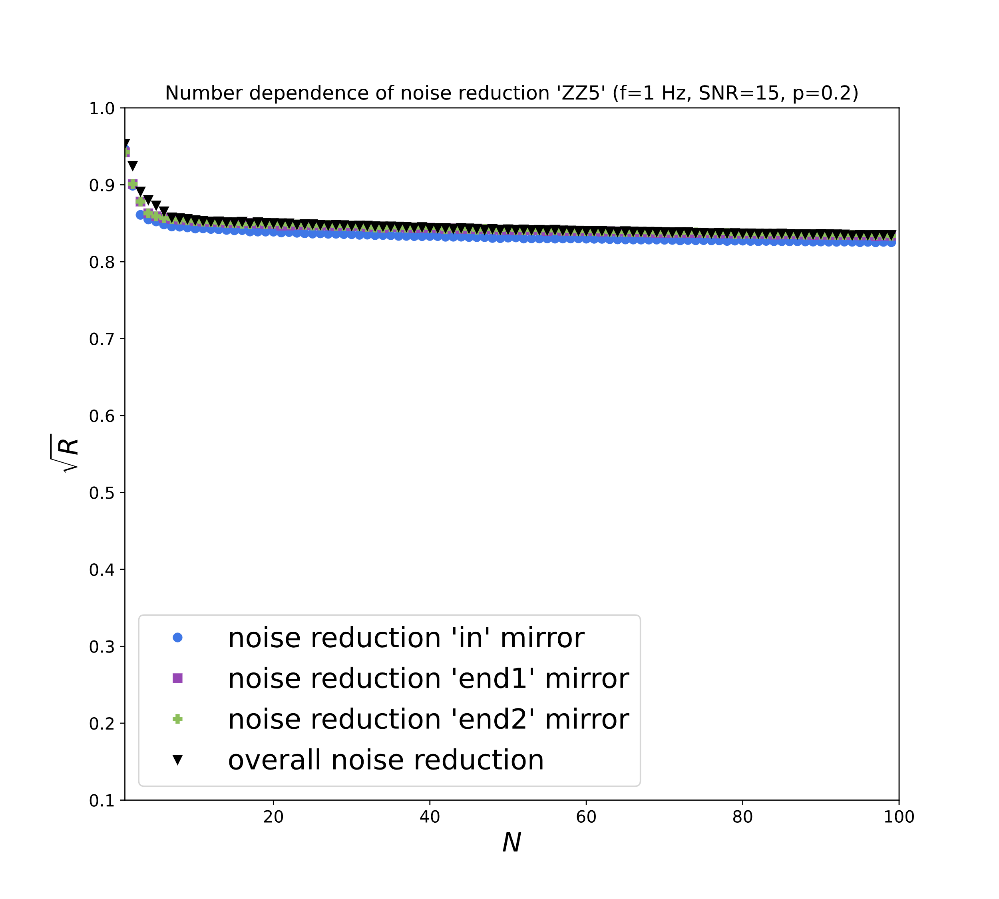
2Cylinder optimized
Please swap the slides →

Slide 37
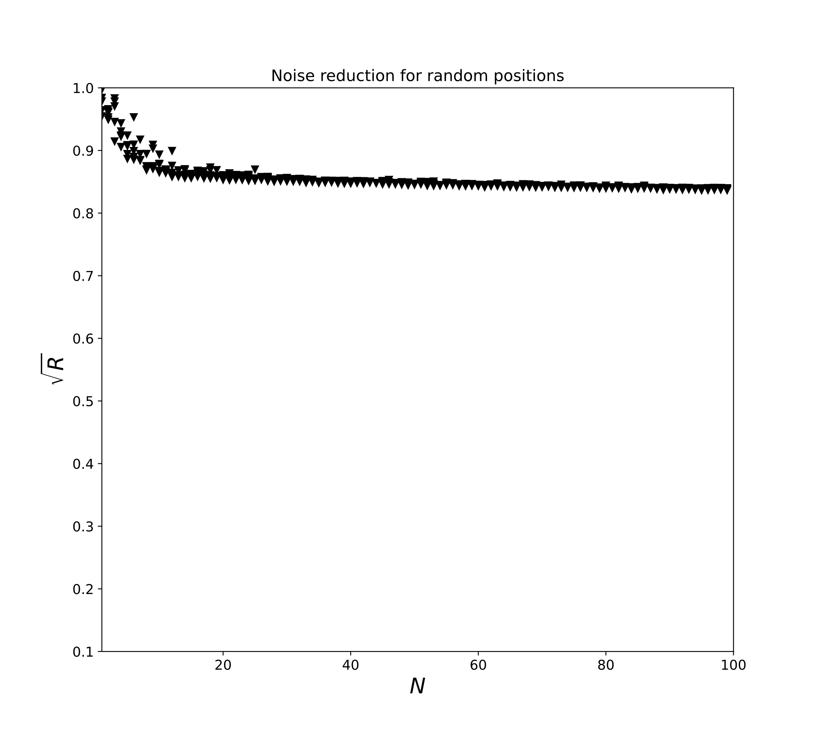
Random 2Cylinder
Please swap the slides ←

Slide 38
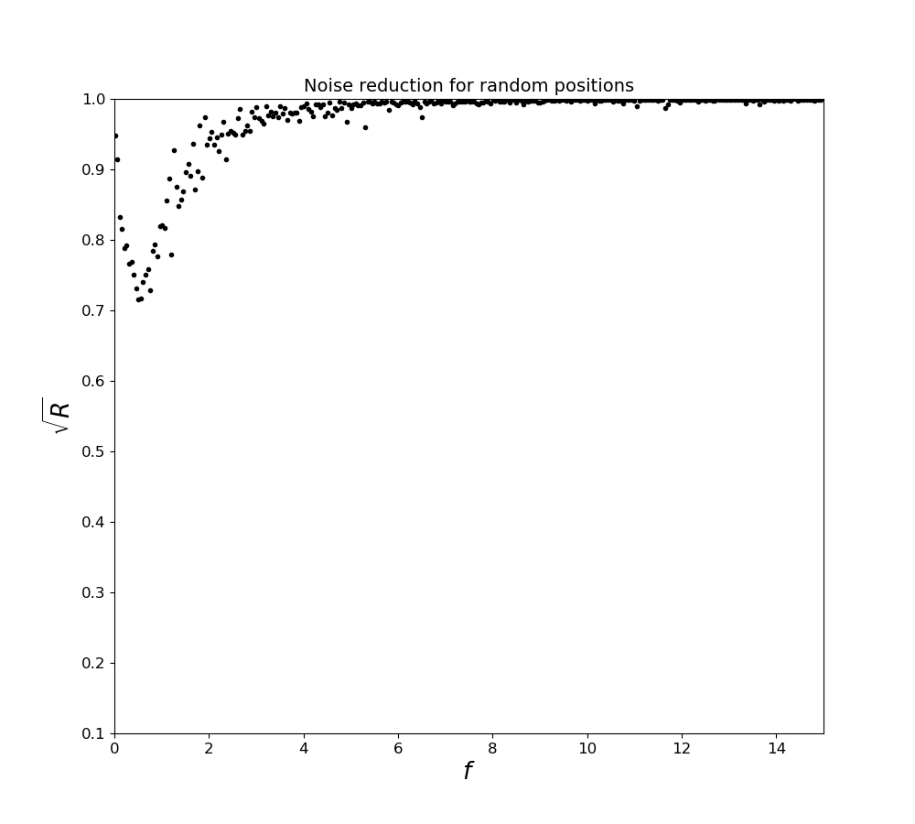
Random Volume (frequency)

Slide 39
Further Info

Slide 40
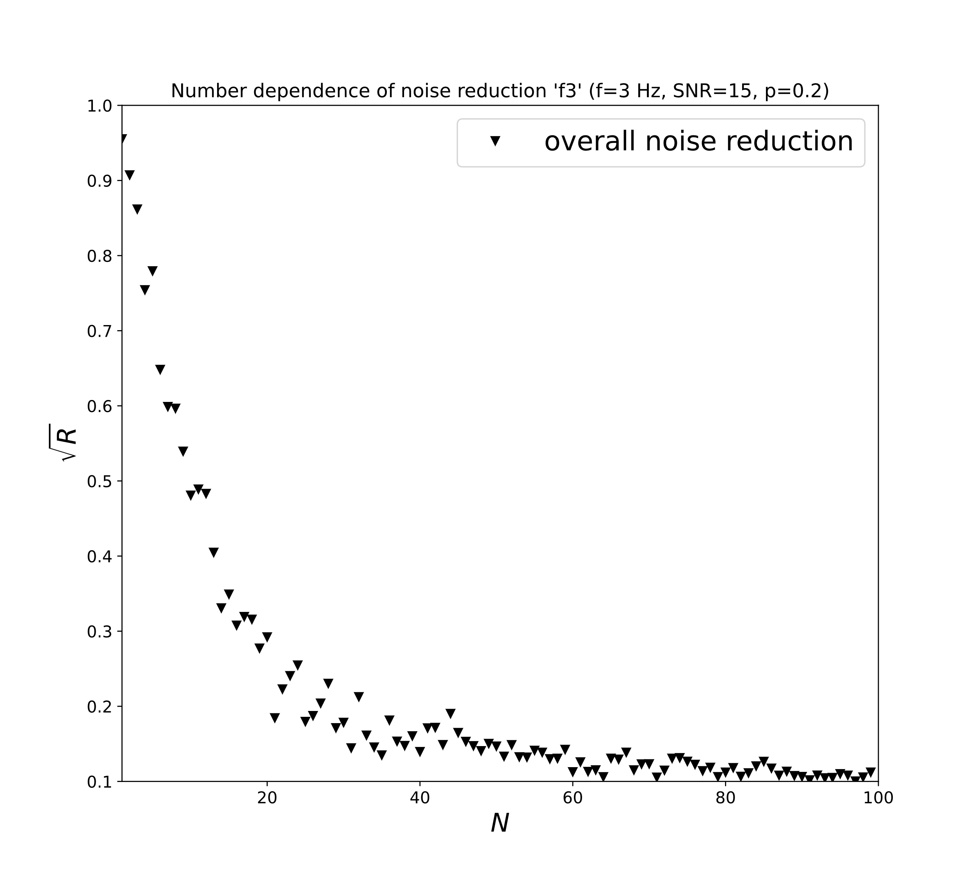
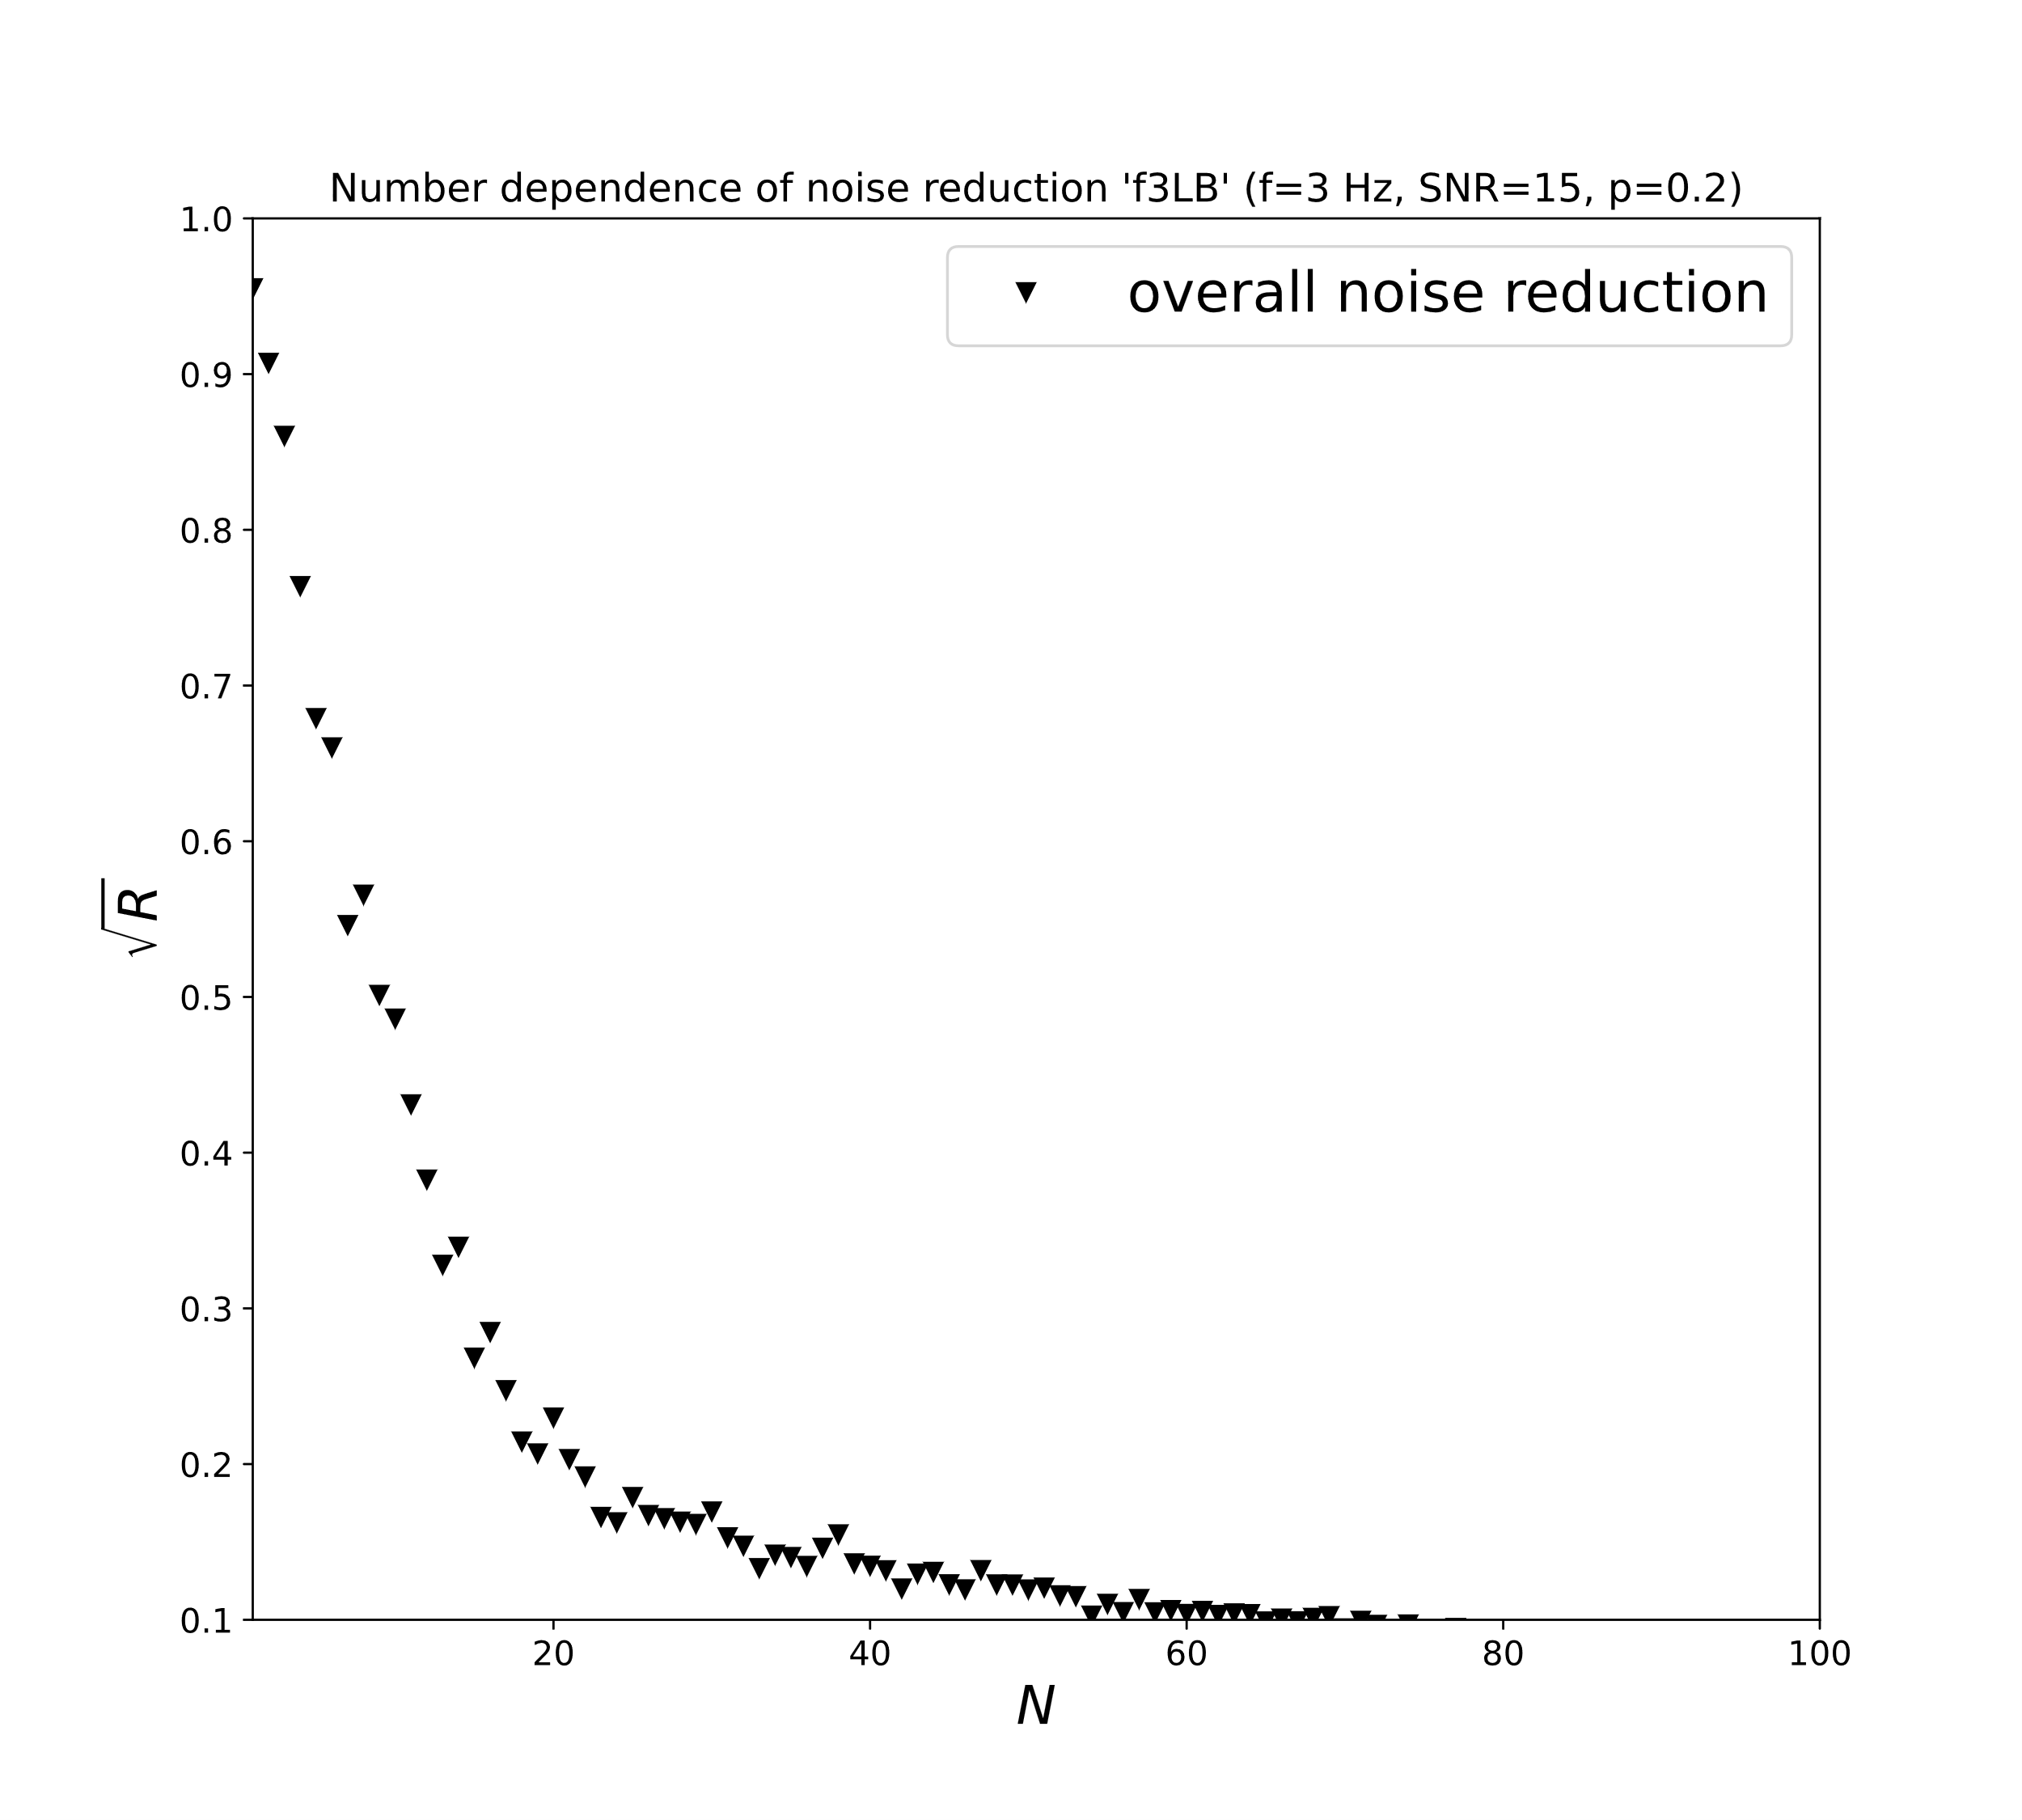
f=3 Hz
10 km
2 km

Slide 41
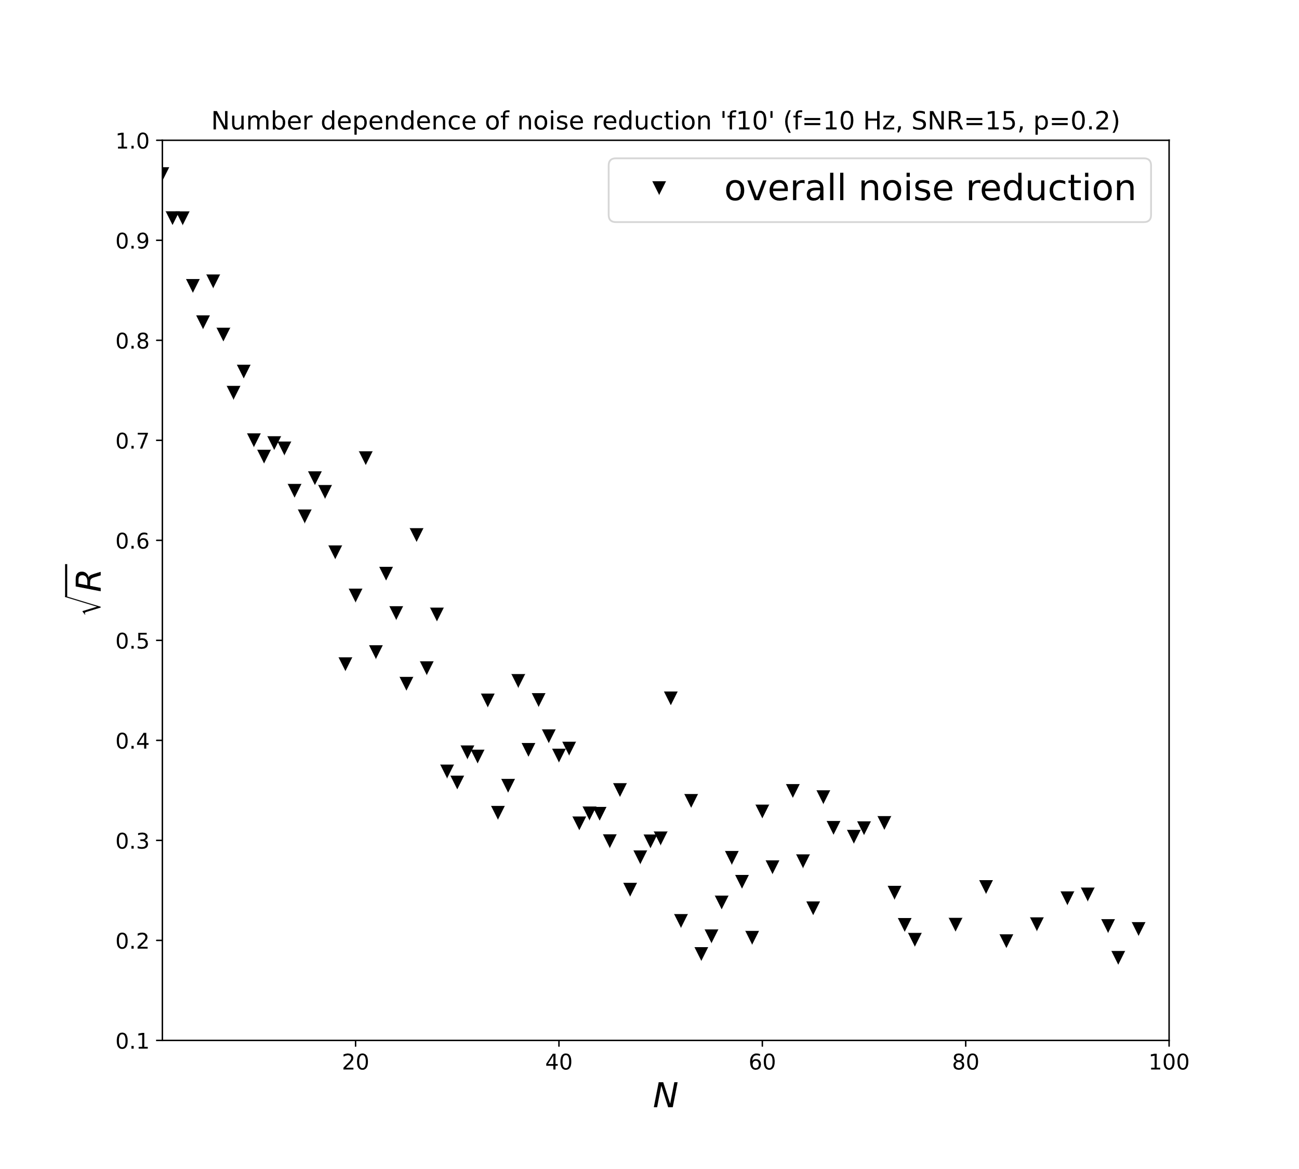
f=10 Hz
10 km
2 km

Slide 42

2 Cylinder Reverse Tunnel
Please swap the slides →

Slide 43
2 Cylinder Base
Please swap the slides ←→

Slide 44
2 Cylinder R_cavern=20m
Please swap the slides ←→

Slide 45

2 Cylinder R_cavern=5-20m
Volume optimization much harder than surface, especially, because PSO avoids the edges of the domain of definition
Please swap the slides ←

Slide 46
Old and New Slides

Slide 47


Particle Swarm Optimization
For each particle:
$${\vec{v}}_{n+1}=ω{\vec{v}}_{n}+c_{1}r_{1}\left({\vec{r}}_{pb}−{\vec{r}}_{n}\right)+c_{2}r_{2}({\vec{r}}_{gb}−{\vec{r}}_{n})$$
Quick!
Works in high dimensions
No need for differentiability
Finds good optima?
Idea: J. Kennedy & R. Eberhart, Particle swarm optimization (1995)

Slide 48

More frequency generalization

Slide 49
Gain from in-Cavern Seismometers
…then, in a first estimate, we can replace 1-3 boreholes with 1-15 seismometers placed inside the cavern to achieve the same residual as before.
In the best case, we can replace 3 boreholes with 3 seismometers in-cavern.
(This information is gained by taking the full-volume optimization for 17, 18 and 19 seismometers and adding additional in-cavern seismometers to the state, recalculating the residual of the new state and comparing it to the 20-seismometer optimization)
Combined in-cavern and volume optimization with regard to actual cost (€) will follow.
Suppose, we want to use 20 seismometers because that is when adding more boreholes will not lower the residual as strongly as before…

Slide 50



Ongoing Work
Seismometer projection in z=0-plane
Simulation of density fluctuations generated by p waves from far away, time-limited sources
Cavern
Force on mirror (x-direction)
Real-time prediction of Newtonian Noise for wave packages, moving away from the analytic calculation (see https://github.com/lc316353/ET-NN-Mitigation/blob/main/fullanimation3D4_29.gif )
Exemplary seismometer data
WF*seismometer data (WF from correlations of large number of previous simulations)

Slide 51



JAX
max(R)→mean(R) leads to differentiability of the problem
JAX can very efficiently calculate derivatives
Optimize with ADAM
Because of missing stochasticity ADAM only finds local minima ☹
$f=10$ Hz, SNR $=15$, $p=1$

